Slide 1
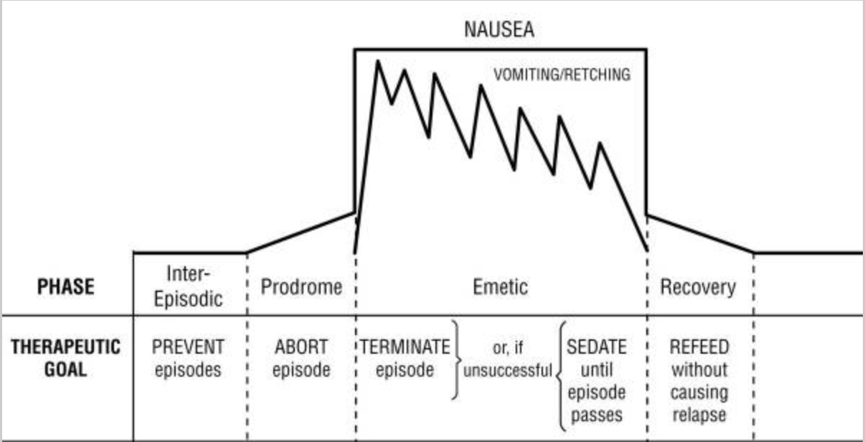
Diagnosis and Management of Cyclic Vomiting Syndrome (CVS)
Continuing Medical Education Poster
Sara Read
Objectives
Diagnostic Criteria¹
Management⁷
CVS is a chronic and debilitating condition that is widely misdiagnosed. Having a basic understanding of the diagnosis and management of this condition is crucial to patient care.
Be able to identify symptoms and clinical presentation of CVS
Be able to diagnose CVS using diagnostic criteria
Formulate a treatment regimen for patients with CVS
Rome IV Criteria (standard)
Stereotypical episodes of vomiting with acute onset with duration of < 1 week
3 or more discrete episodes in the past 1 year, and 2 episodes in the past 6 months occurring at least 1 week apart
Absence of vomiting between episodes
Symptoms not attributed to another known organic pathology
Criteria fulfilled for the last 3 months with symptom onset at least 6 months prior to diagnosis
Prophylactic Treatment
Tricyclic antidepressants → Amitriptyline first line at 75-100 mg/day Topiramate starting at 25 mg/day and titrating to 100 mg/day Aprepitant 125 mg or 80 mg twice per week Zonisamide starting dose 100 mg/day titrating to 400 mg/day Levetiracetam 250 mg BID titrating to 1000-2000 mg/day Co-Q10 10 mg/kg/day in two divided doses up to 200mg BID Riboflavin 200 mg BID
Abortive Treatment
Ondansetron → First line Sumatriptan during prodrome or within 30-45 minutes of vomiting onset 20 mg IN or 6 mg SQ with repeat dose 2 hours later Aprepitant during prodrome 125 mg day 1, 80 mg day 2, 80 mg day 3
Supportive Treatment
IV fluids for dehydration Ondansetron, diphenhydramine, metoclopramide for nausea/vomiting Lorazepam or diphenhydramine for sedation Sumatriptan for migraine like symptoms Ketorolac for pain Opioids nay be considered for pain relief in refractory patients Psychotherapy, guided meditation, coordination of care
Introduction
Recurrent episodes of nausea and vomiting that last from hours to days followed by asymptomatic periods, not due to any identifiable pathology¹
Estimated prevalence 1.9%-2.3% of the US population¹
Typically a diagnosis of childhood but affects patients of all ages
Etiology Hypotheses
Activation of the HPA axis caused by physical or psychological stress²
Dysfunction in the autonomic nervous system³
Neurologic component linked to migraines and epilepsy⁴
Pathogenic mitochondrial DNA polymorphism⁵
Cannabis hyperemesis syndrome possibly a subset of CVS⁶
North American Society for Pediatric Gastroenterology Hepatology and Nutrition (NASPGHAN) Criteria
At least 5 attacks in any interval or minimum 3 attacks during 6 month period
Episodic attacks of intense nausea and vomiting lasting 1 hour-10 days at least 1 week apart
Stereotypical pattern and symptoms
Vomiting during attacks at least 4 times/hour for at least 1 hour
Return to baseline between episodes
Not attributed to another disorder
Four Phases of CVS⁷
Prodromal Phase
Intense nausea and symptoms of panic
Diarrhea, hot/cold flashes, profuse sweating
Acute Emetic Phase
Severe vomiting and retching, between 1-6 times per hour
Abdominal pain, restlessness, intense thirst, migraine, photosensitivity, phonosensitvity
Recovery Phase
Few hours to a couple of days
Slowly able to tolerate oral intake and return to baseline
Inter Episodic Phase
Varies in length for each individual
May become shorter each cycle and result in chronic nausea and emetic episodes
CME Questions
Which of the following symptoms would most likely be present during the prodromal phase of CVS?
Vomiting
Restlessness
Nausea and feelings of panic
Intense thirst
Which of the following is not included in the Rome IV Criteria>
Acute onset of vomiting episodes lasting less than 1 week
Personal or family history of migraines
Asymptomatic period between episodes of vomiting
3 episodes of vomiting in the past year or 2 episodes in the last 6 months occurring more than 1 week apart
Answers: C, B, A, D, D
What is the first line medication for prophylactic treatment of CVS?
Amitriptyline
Ondansetron
Aprepitant
Topiramate
What is the first line medication for abortive treatment of CVS?
Sumatriptan
Aprepitant
Opioids
Ondansetron
What other methods are beneficial in the management of CVS?
Psychotherapy
Guided meditation
Support with coordination of care
All of the above
References:
Publishing 2022 Jan-. Available from: https://www.ncbi.nlm/nih.gov/books/NBK500018/
Taché Y. Cyclic vomiting syndrome: the corticotropin-releasing-factor hypothesis. Dig Dis Sci. 1-999; 44(8 Suppl):79S-86S. Davis A, Bryant JH. Cyclic Vomiting Syndrome. [Updated 2022 Jun 21]. In: StatPearls [Internet]. Treasure Island (FL): StatPearls.
3. Venkatesan, T., Prieto, T., Barboi, A., Li, B., Schroeder, A., Hogan, W., Ananthakrishnan, A. and Jaradeh, S. (2010), Autonomic nerve function in adults with cyclic vomiting syndrome: a prospective study. Neurogastroenterology & Motility, 22: 1303-e339. https://doi.org/10.1111/j.1365-2982.2010.01577.x
4. Levinthal DJ. The Cyclic Vomiting Syndrome Threshold: A Framework for Understanding Pathogenesis and Predicting Successful Treatments. Clin Transl Gastroenterol. 2016;7(10):e198. Published 2016 Oct 27. doi:10.1038/ctg.2016.55
5. Veenin K, Wattanasirichaigoon D, Suktitipat B, et al. Association of Mitochondrial DNA Polymorphisms With Pediatric-Onset Cyclic Vomiting Syndrome. Front Pediatr. 2022;10:876436. Published 2022 May 24. doi:10.3389/fped.2022.876436
6. Venkatesan T, Levinthal DJ, Li BUK, et al. Role of chronic cannabis use: Cyclic vomiting syndrome vs cannabinoid hyperemesis syndrome. Neurogastroenterol Motil. 2019;31 Suppl 2(Suppl 2):e13606. doi:10.1111/nmo.13606
7. Venkatesan T, Levinthal DJ, Tarbell SE, et al. Guidelines on management of cyclic vomiting syndrome in adults by the American Neurogastroenterology and Motility Society and the Cyclic Vomiting Syndrome Association. Neurogastroenterol Motil. 2019;31 Suppl 2(Suppl 2):e13604. doi:10.1111/nmo.13604

