Slide 1
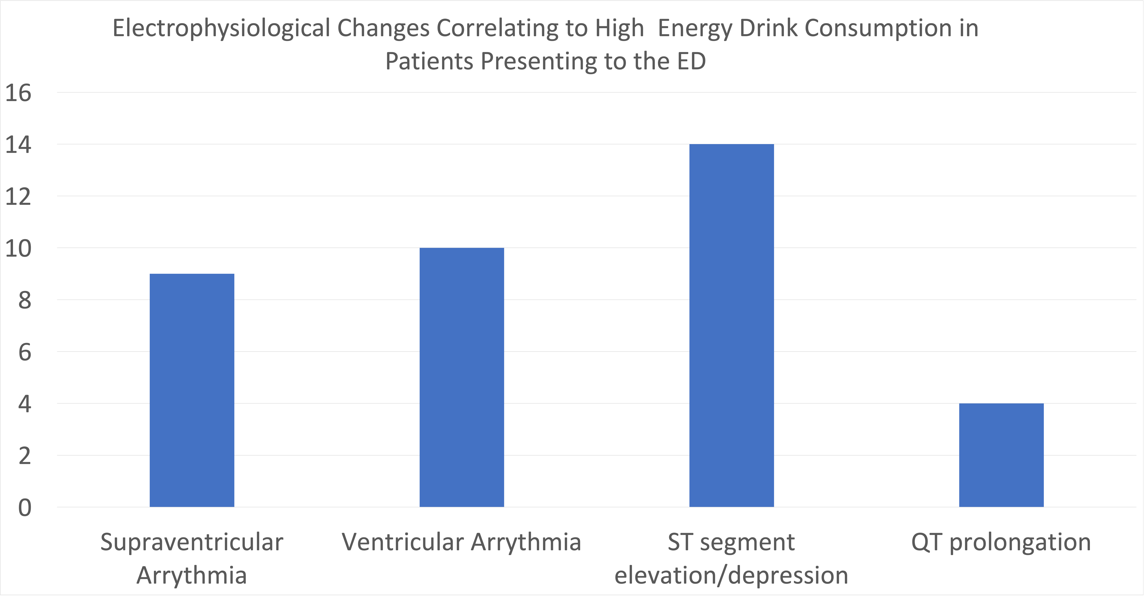
The Effects of Caffeine and Exercise on Cardiovascular Health
Caitlin Hubmaster PA-S
Timothy Besse MSPAS, MAT, PA-C
Department of Medical Science
Objectives
Results
Discussion
1. Evaluate the changes that occur to the cardiovascular system after the consumption of caffeine
2. Compare how the body reacts to caffeine alone versus when followed with exercise
3. Evaluate how the quantity of caffeine consumed in a certain time period can affect the cardiovascular system in a positive or negative manner
4. Educate providers about how to counsel patients on the benefits and risks of consuming large amounts of caffeine right before exercise
Vessel strength after caffeine intake was found to increase due to the influx of intracellular calcium, releasing nitric oxide, then resulting in vasodilation
Resting flow of the brachial artery increased after caffeine consumption but was found to be decreased when measured after exercise preceded with caffeine showing slowed perfusion
Heart rate and blood pressure recovery time was prolonged after exercise when caffeine was consumed prior
Regular exercise promotes cardiac remodeling including hypertrophy and dilation increasing outflow long term
QT prolongation was not seen in caffeine intake under 200 mg but with increased doses beyond this, it was prolonged by 80 ms with a p value < 0.001 showing a significant change
Adjustments in caffeine dosing need to be made for special populations including young children and pregnant individuals
When evaluating the effects of caffeine combined with exercise on the cardiovascular system, it was found that results were very dose dependent. The adverse effects experienced, mainly being cardiac arrythmias, arose when caffeine was consumed in doses above 400 mg and in addition to other substances. The benefits of regular exercise with caffeine consumption include cardiac remodeling and increased vessel strength due to the release of nitric oxide overall improving the cardiovascular system and preventing disease. The benefit of using caffeine or energy drinks to encourage regular exercise is found to be safe with consumption under the recommended daily limit of 400 mg. Further research should be performed in order to determine potential long-term effects.
Introduction
Pre-workout powders, energy drinks and highly caffeinated beverages are becoming popular amongst adolescents and young adults for use prior to a workout. Caffeine is a known stimulant that gives a sense of increased energy to the consumer. This research looks to evaluate how high amounts of caffeine consumed before exercise specifically can impact the cardiovascular system and its recovery period. By evaluating these changes and their potential cardiac effects, providers will be able to properly counsel patients on proper use before workouts along with the benefits and risks that come with it.
Conclusion
Exercise has many benefits to a patient’s overall health and decreases risk factors for cardiac disease proving that it is an important aspect of a healthy lifestyle. Many individuals use caffeine prior to their workout for energy and motivation to complete the exercise. With this increased in use, it has become clear that it is important to educate the patients specifically on the recommended quantity to consume before the risks of complications occur. Consuming amounts beyond the recommended limit of 400 mg has been shown to correlate with arrythmias and prolonged recovery after exercise has finished. Use below this amount, however, seems to have very little risk and the benefit to exercise should be more greatly valued in preventing cardiac disease.
Methods
A literature search was performed in January 2023 using the National Library of Medicine’s Pub Med
10 articles were chosen based on their correlation specifically with caffeine and exercise and how they affected the cardiovascular system
Keywords used included
Exercise
Caffeine
Cardiovascular effects
References:
1. Gutiérrez-Hellín J, Varillas-Delgado D. Energy Drinks and Sports Performance,
Cardiovascular Risk, and Genetic Associations; Future Prospects. Nutrients.
2021;13(3):715. Published 2021 Feb 24. doi:10.3390/nu13030715
2. Planning Committee for a Workshop on Potential Health Hazards Associated with
Consumption of Caffeine in Food and Dietary Supplements; Food and Nutrition Board;
Board on Health Sciences Policy; Institute of Medicine. Caffeine in Food and Dietary
Supplements: Examining Safety: Workshop Summary. Washington (DC): National
Academies Press (US); April 23, 2014.
3. Cao DX, Maiton K, Nasir JM, Estes NAM, Shah SA. Energy Drink-Associated
Electrophysiological and Ischemic Abnormalities: A Narrative Review. Front Cardiovasc
Med. 2021;8:679105. Published 2021 Jul 1. doi:10.3389/fcvm.2021.679105
4. Pereira FC. Keep an eye on the impact of caffeine on the recovery of the cardiovascular
system after exercise. Rev Port Cardiol (Engl Ed). 2021;40(6):407-408.
doi:10.1016/j.repce.2021.07.004
5. Benjamim CJR, Monteiro LRL, Pontes YMM, et al. Caffeine slows heart rate autonomic
recovery following strength exercise in healthy subjects. Rev Port Cardiol (Engl Ed).
2021;40(6):399-406. doi:10.1016/j.repce.2020.07.021
6. Gonzaga LA, Vanderlei LCM, Gomes RL, Valenti VE. Caffeine affects autonomic
control of heart rate and blood pressure recovery after aerobic exercise in young adults: a crossover study. Sci Rep. 2017;7(1):14091. Published 2017 Oct 26.
doi:10.1038/s41598-017-14540-4
7. Schroeder EC, Franke WD, Sharp RL, Lee DC. Comparative effectiveness of aerobic,
resistance, and combined training on cardiovascular disease risk factors: A randomized
controlled trial. PLoS One. 2019;14(1):e0210292. Published 2019 Jan 7.
doi:10.1371/journal.pone.0210292
8. Lavie CJ, Arena R, Swift DL, et al. Exercise and the cardiovascular system: clinical
science and cardiovascular outcomes. Circ Res. 2015;117(2):207-219.
doi:10.1161/CIRCRESAHA.117.305205
9. Ehlers A, Marakis G, Lampen A, Hirsch-Ernst KI. Risk assessment of energy drinks with
focus on cardiovascular parameters and energy drink consumption in Europe. Food Chem
Toxicol. 2019;130:109-121. doi:10.1016/j.fct.2019.05.028
10. Eilat-Adar S, Sinai T, Yosefy C, Henkin Y. Nutritional recommendations for
cardiovascular disease prevention. Nutrients. 2013;5(9):3646-3683. Published 2013 Sep 17. doi:10.3390/nu5093646

