Slide 1
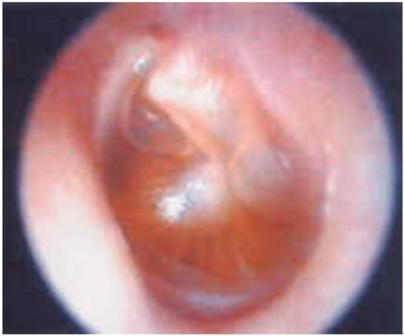
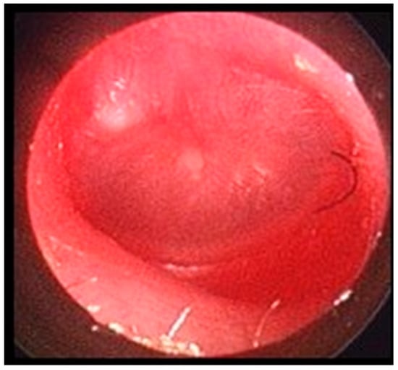
Acute Otitis Media: Management and Recurrence in
the Pediatric Population
Sydney Klaiman, PA-S
Faculty Advisor: Jacinta Hollinger, PA-C, MMS, BS
Department of Medical Science
Abstract
AOM Pathophysiology
Discussion
Acute otitis media (AOM) is one the the most common condition that affects the pediatric population. AOM place burden on affected children, caregivers, the healthcare system, and also contributes to antibiotic resistance. In many cases, AOM is not just a one-time occurrence and is the most common reason that kids receive oral antibiotics and undergo surgery. Relative to the number of articles available, there is a large gap in the research that does not thoroughly address recurrent AOM (rAOM) and the importance of its management and prevention. Therefore, the goal of this poster is to discuss different modalities used to treat and prevent rAOM such as expectant management, antibiotic management, tympanostomy tubes, and antibiotic prophylaxis.
Narrow and/or blocked ET’s lead to negative pressure within the middle ear → eustachian tube dysfunction (ETD).
Most common cause of narrowed ET: viral URI ⁶
Negative pressure causes mucosal inflammation and excess secretions, creating to an ideal environment for bacteria, viruses or fungal to colonize.
Antibiotic Management
First line medical management and management overall for AOM: Amoxicillin¹²
Piglansky et al (2003), looked at the efficiency of high dose amoxicillin in treating pediatric AOM…
Those that failed treatment were positive for a beta-lactamase producing bacteria¹³
If amoxicillin fails, the next best therapy is Augmentin¹³
Signs/Symptoms + PE + Diagnostics
Specific symptoms: ear pain, ear drainage, decreased hearing
Nonspecific symptoms: fever, irritability, nasal congestion, poor feeding, ear tugging⁷
Physical examination with otoscope: middle ear effusion (Figure 1), a bulging tympanic membrane (TM) (Figure 2), an erythematous TM (Figure 2), and if a pneumatic otoscopy is used, decreased mobility of the TM. ⁸
Available diagnostic modalities include tympanometry and acoustic reflectometry but they are rarely used.⁹¹⁰
Otoscopic evaluation is the most useful tool.
Tympanostomy Tubes (TT)
 | Failure Rate
Intervention Group | 21%
Control Group | 34%
Kujala et al: Failure rate of TT in children (10 months-2 years) vs. those without intervention.¹⁴
Failure rate: 2 AOM episodes within 2 months, 3 episodes within 6 months or persistent effusion for 2 months ¹⁴
Introduction
Acute otitis media (AOM): an infection within the middle ear causing signs and symptoms related to inflammation.¹
AOM is the most common reason that kids receive oral antibiotics and undergo surgery.²
Recurrent AOM (rAOM): infection must occur three times in a 6-month period or 4 times in 12-month period.¹
The goal of this CME project is to discuss different modalities used to treat AOM in the pediatric population in order to contribute to the effectiveness of management and to prevent recurrence.
P value =0.004
 | Recurrent Episodes in a 2 year period
Intervention Group | 1.48±0.08
Control Group | 1.56±0.08
Hoberman et al: TT placement vs. Antibiotic therapy (Augmentin) on pediatric recurrent AOM¹⁵
P value = 0.66
Figure 1. TM with MEE, without signs of inflammation⁵ Figure 2. TM with erythema and bulging⁵
Antibiotic Prophylaxis
Leach and Morris conducted a meta-analysis that reviewed 16 randomized control studies that looked at the effects of antibiotic prophylaxis on AOM episodes.¹⁶
Antibiotic prophylaxis is potentially beneficial in reducing AOM episodes for children while taking the medication.¹⁶
Additionally, Teele et al found the antibiotic prophylaxis only have effects while on the medication, but did not reduce episodes once the antibiotic has been discontinue.¹⁷
Pathogens
The most common pathogens associated with AOM:
Streptococcus pneumonia, Haemophilus influenza, and Moraxella cataharriis³
The pathogen that has been most commonly associated with rAOM is Haemophilus influenza.⁴
Discussion
Conclusion
Physiology
Amoxicillin is the first line treatment for AOM but there are other modalities that have been studied such as expectant management, TT placement, and antibiotic prophylaxis.
Expectant management of AOM is not the recommended course of action for children with AOM due to longer symptom duration, increased risk and rate of recurrence.
There is a lack of and variable evidence with TT placement on their use to prevent AOM and in the setting of rAOM.
Potential short-term benefits of antibiotic prophylaxis on AOM episodes
The eustachian tube (ET), located in the middle ear, leads from the middle ear to the nasopharynx.
ET function:
Equalize the pressure within the ear⁶
Assists with normal hearing⁶
Ventilates the ear and keep it clear of various secretions and debris⁶
Prevents reflux from the nasopharynx⁶
Pediatric anatomical features that increase their susceptibility to infection:
ET’s are more horizontal and shorter → risk of reflux and bacteria accumulation
ET’s are narrower → risk of blockage
Expectant Management: There are varied results in terms of antibiotics versus symptomatic management for AOM in the pediatric population
Compared watchful waiting (control group) vs amoxicillin use (intervention group)¹¹
 | Recovery | Recurrence Rate (1-3 months)
Intervention Group | 73% | 8%
Control Group | 44% | 13%
References:
Lieberthal AS, Carroll AE, Chonmaitree T, et al. The Diagnosis and Management of Acute Otitis Media. Pediatrics. 2013;131(3):e964-e999. doi:10.1542/peds.2012-3488
Marom T, Tan A, Wilkinson GS, Pierson KS, Freeman JL, Chonmaitree T. Trends in otitis media-related health care use in the United States, 2001-2011. JAMA Pediatr. 2014;168(1):68-75. doi:10.1001/jamapediatrics.2013.3924
Daly KA, Giebink GS. Clinical epidemiology of otitis media. Pediatr Infect Dis J. 2000;19(5 Suppl):S31-36. doi:10.1097/00006454-200005001-00006
Kilpi T, Herva E, Kaijalainen T, Syrjänen R, Takala AK. Bacteriology of acute otitis media in a cohort of Finnish children followed for the first two years of life. Pediatr Infect Dis J. 2001;20(7):654-662. doi:10.1097/00006454-200107000-00004
Esposito S, Bianchini S, Argentiero A, Gobbi R, Vicini C, Principi N. New Approaches and Technologies to Improve Accuracy of Acute Otitis Media Diagnosis. Diagn Basel Switz. 2021;11(12):2392. doi:10.3390/diagnostics11122392
HOUSE WF. The Function of the Eustachian Tube. AMA Arch Otolaryngol. 1960;71(3):405-407. doi:10.1001/archotol.1960.03770030047010
Schwartz RH, Rodriguez WJ, Brook I, Grundfast KM. The Febrile Response in Acute Otitis Media. JAMA. 1981;245(20):2057-2058. doi:10.1001/jama.1981.03310450049023
Shaikh N, Hoberman A, Rockette HE, Kurs-Lasky M. Development of an algorithm for the diagnosis of otitis media. Acad Pediatr. 2012;12(3):214-218. doi:10.1016/j.acap.2012.01.007
Danishyar A, Ashurst JV. Acute Otitis Media. In: StatPearls. StatPearls Publishing; 2022. Accessed December 6, 2022. http://www.ncbi.nlm.nih.gov/books/NBK470332/
Onusko E. Tympanometry. Am Fam Physician. 2004;70(9):1713-1720.
Shahbaznejad L, Talaei E, Hosseinzadeh F, Masoumi B, Rezai S, Rezai MS. Comparing Watchful Waiting Approach vs. Antibiotic Therapy in Children with Nonsevere Acute Otitis Media: A Randomized Clinical Trial. Int J Pediatr. 2021;2021:5515467. doi:10.1155/2021/5515467
Tahtinen, Paula, Pelton, Stephen. Acute otitis media in children: Treatment. In: UpToDate. UpToDate; 2023. Accessed January 9, 2023. www.uptodate.com
Piglansky L, Leibovitz E, Raiz S, et al. Bacteriologic and clinical efficacy of high dose amoxicillin for therapy of acute otitis media in children. Pediatr Infect Dis J. 2003;22(5):405-413. doi:10.1097/01.inf.0000065688.21336.fa
Kujala T, Alho OP, Luotonen J, et al. Tympanostomy with and without adenoidectomy for the prevention of recurrences of acute otitis media: a randomized controlled trial. Pediatr Infect Dis J. 2012;31(6):565-569. doi:10.1097/INF.0b013e318255ddde
Hoberman A, Preciado D, Paradise JL, et al. Tympanostomy Tubes or Medical Management for Recurrent Acute Otitis Media. N Engl J Med. 2021;384(19):1789-1799. doi:10.1056/NEJMoa2027278
Leach AJ, Morris PS. Antibiotics for the prevention of acute and chronic suppurative otitis media in children. Cochrane Database Syst Rev. 2006;(4):CD004401. doi:10.1002/14651858.CD004401.pub2
Teele DW, Klein JO, Word BM, et al. Antimicrobial prophylaxis for infants at risk for recurrent acute otitis media. Vaccine. 2000;19:S140-S143. doi:10.1016/S0264-410X(00)00293-0
P value = <0.05

