Slide 1
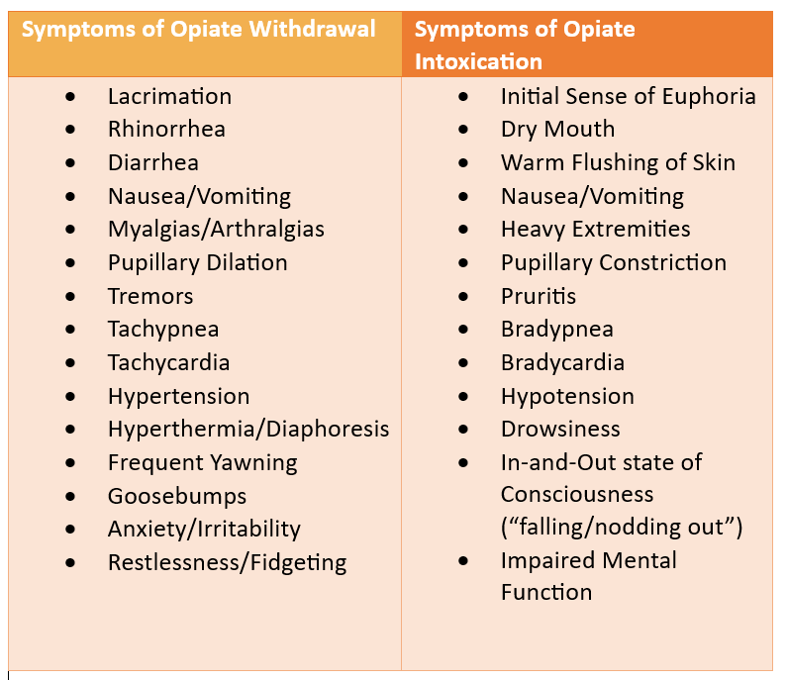
Management of opioid use disorder patients in primary care
Continuing Medical Education Poster
Carolyn Jeffries PA-S2
Treatment
Methadone
Buprenorphine/Naloxone
Objectives
Patient Assessment
Only available at federally regulated Opioid Treatment Programs (OTPs)
Synthetic opioid, full mu-opioid receptor agonist
Administration
Start at 30mg oral concentrate, titrate up 10mg/week until⁸ withdrawal symptoms are controlled
Therapeutic range 30-190mg daily⁹
Side effects: Prolonged QTc, overdose
Best option for MAT at a primary care office
Partial mu-opioid receptor agonist
Suboxone
Sublingual film strips, daily dosing
Therapeutic range 2mg/0.5mg-16mg/4mg¹⁰
Adverse effects: precipitated withdrawal
Sublocade
Subcutaneous injection, monthly dosing
Therapeutic range 100-300mg extended release¹¹
Be able to acknowledge and address barriers to receiving treatment for OUD
Discuss the mainstays of medication assisted treatment for OUD
Be able to establish a loose step-based approach to determining a treatment plan for an OUD patient
Diagnosis: DSM-5 and UDS
Specific history questions:
Age at first use, most recent use, drug of choice, method of use, amount used, have they sought prior treatment and if so, with what medication
PMH/Comorbid Conditions: Polysubstance abuse, psychological diagnoses, non-cancer pain, DM2
Physical Exam: Assess for symptoms of opiate withdrawal or intoxication, be aware of skin manifestations of IVDA complications
Introduction
The prevalence of opioid use disorder (OUD) in the United States has drastically increased since the COVID-19 pandemic. Overdose deaths involving opioids increased by more than 50% from the year 2019 to 2021¹. OUD is considered chronic condition and as is the case with many other chronic conditions, can be treated and requires lifetime care. This makes OUD patients excellent candidates to be managed by primary care providers (PCPs).
Side Effects
Weight gain→ insulin resistance, DM2, tooth decay¹²
Change in lifestyle, increased access to food, sugar cravings
Opioid-induced constipation (OIC)
Treat with high-fiber diet, increased fluid intake and physical activity
New adjunct agents specifically for OIC (Relistor, Amitzia, Movantik)¹³
Intravenous Drug Abuse (IVDA) Complications
Abscesses, cellulitis, track marks
Endocarditis, osteomyelitis, bacteremia
Behavioral Health and Comorbidities
Behavioral health interventions shown to not be effective alone, in conjunction with MAT,
Cognitive Behavioral Therapy (CBT) or
Contingency Management increases treatment adherence
Common psych comorbidities: depression/SI, anxiety, bipolar DO, PTSD
IVDA patients at higher risk for HIV, Hepatitis B and C, tuberculosis and STIs¹⁴
Barriers
DATA-X waiver
Removed in 2023, any provider registered with the DEA to prescribe scheduled II-IV can prescribe buprenorphine^{2,3}
Negative stigmas, difficult patient population
Try to take non-judgmental approach, adhere to strict rules and regulations
Systemic
Those experiencing homelessness, people of color, those involved in crime, those below the poverty line^{4, 5}
Clinical support
Access to counselors, nurse care managers, opioid training integrated into graduate medical programs, SAMHSA National Help Line
CME Questions
Engagement in Primary Care
The BMC-OBAT or Massachusetts Model heavily utilizes what role to provide quality routine care for OUD patients?
Physician Assistants
Nurse Practitioners
Nurse Care Managers
Physicians
What of the following is not a symptom of opioid withdrawal?
Constricted pupils
Tremors
Nausea/Vomiting
Rhinorrhea
OUD patients should be routinely screened for what?
Opiates, cocaine, marijuana and alcohol
Pregnancy, STIs, HIV and Hepatitis B
HIV, Hepatitis C, TB, and STIs
Blood glucose, buprenorphine plasma level, Hepatitis C and tetanus
What is the maximum recommended daily dose for Suboxone?
2mg/0.5mg
4mg/1mg
8mg/2mg
16mg/4mg
Boston Medical Center Office-Based Addiction Treatment (BMC-OBAT) Massachusetts Model (MA Model)⁶
Addresses lack of clinical support for providers
Nurse Care Managers (NCMs) play essential role in providing routine care for OUD patients and allows more patients per prescriber
PRimary Care Opioid Use Disorder (PROUD) Trial^{6, 7}
Makes improvements to MA Model
Guidance to hiring NCMs, providing training and continuing technical support for NCMs and providing training and mentorship for prescribers
Answers: 1.) C, 2.) A, 3.) C, 4.) D
References:
1. Tanz L, Dinwiddie A, Snodgrass S, O’Donnell J, Mattson C, Davis N. A qualitative assessment of circumstances surrounding drug overdose deaths during the early stages of the COVID-19 pandemic. SUDORS Data Brief No.2. Atlanta GA Cent Dis Control Prev US Dep Health Hum Serv. Published online 2022. 2. Removal of DATA Waiver (X-Waiver) Requirement. Published January 10, 2023. Accessed March 29, 2023. https://www.samhsa.gov/medications-substance-use-disorders/removal-data-waiver-requirement 3. dela Cruz AM, Walker R, Pipes R, Wakhlu S, Trivedi MH. Creation of an algorithm for clinical decision support for treatment of opioid use disorder with buprenorphine in primary care. Addict Sci Clin Pract. 2021;16:12. doi:10.1186/s13722-021-00222-0 4. DeFlavio JR, Rolin SA, Nordstrom BR, Kazal LA. Analysis of barriers to adoption of buprenorphine maintenance therapy by family physicians. Rural Remote Health. 2015;15:3019 5. Binswanger IA, Stern MF, Deyo RA, et al. Release from Prison — A High Risk of Death for Former Inmates. N Engl J Med. 2007;356(2):157-165. doi:10.1056/NEJMsa064115 6. Campbell CI, Saxon AJ, Boudreau DM, et al. PRimary Care Opioid Use Disorders treatment (PROUD) trial protocol: a pragmatic, cluster-randomized implementation trial in primary care for opioid use disorder treatment. Addict Sci Clin Pract. 2021;16:9. doi:10.1186/s13722-021-00218-w 7. LaBelle CT, Han SC, Bergeron A, Samet JH. Office-Based Opioid Treatment with Buprenorphine (OBOT-B): Statewide Implementation of the Massachusetts Collaborative Care Model in Community Health Centers. J Subst Abuse Treat. 2016;60:6-13. doi:10.1016/j.jsat.2015.06.010 8. Durrani M, Bansal K. Methadone. In: StatPearls. StatPearls Publishing; 2022. Accessed March 14, 2023. http://www.ncbi.nlm.nih.gov/books/NBK562216/ 9. Bart G. Maintenance Medication for Opiate Addiction: The Foundation of Recovery. J Addict Dis. 2012;31(3):207-225. doi:10.1080/10550887.2012.694598 10. Buprenorphine Quick Start Guide. Substance Abuse and Mental Health Services Administration. https://www.samhsa.gov/sites/default/files/quick-start-guide.pdf 11. How Does SUBLOCADE® (buprenorphine extended-release) injection, for subcutaneous use (CIII) Work? Accessed March 14, 2023. https://www.sublocade.com/how-sublocade-works 12. Mysels DJ, Sullivan MA. The relationship between opioid and sugar intake: Review of evidence and clinical applications. J Opioid Manag. 2010;6(6):445-452. 13. Sizar O, Genova R, Gupta M. Opioid Induced Constipation. In: StatPearls. StatPearls Publishing; 2023. Accessed April 2, 2023. http://www.ncbi.nlm.nih.gov/books/NBK493184/ 14. Magiorkinis G, Sypsa V, Magiorkinis E, et al. Integrating Phylodynamics and Epidemiology to Estimate Transmission Diversity in Viral Epidemics. PLoS Comput Biol. 2013;9(1):e1002876. doi:10.1371/journal.pcbi.1002876

