Slide 1
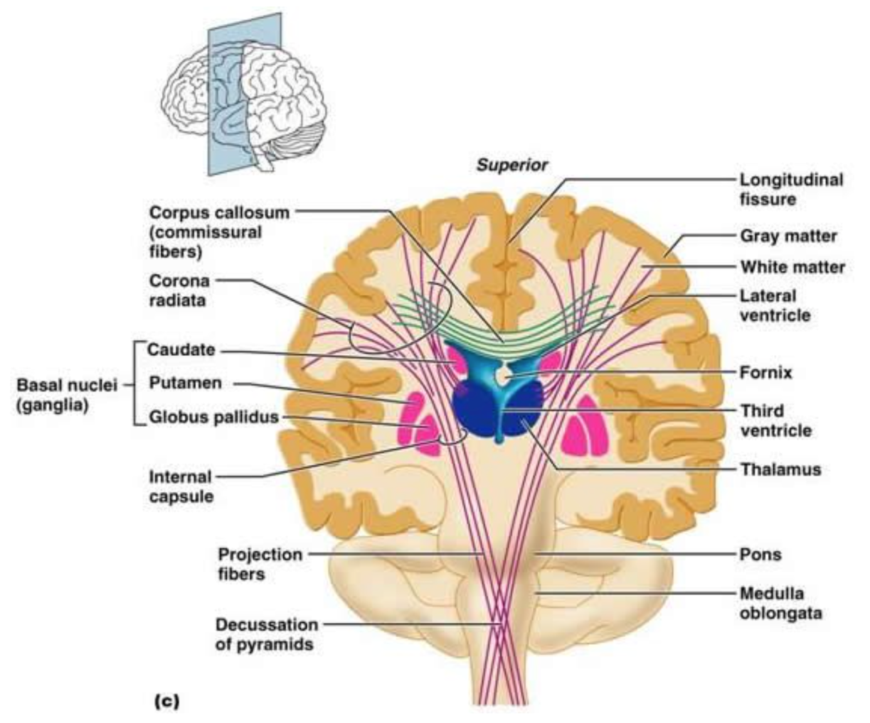
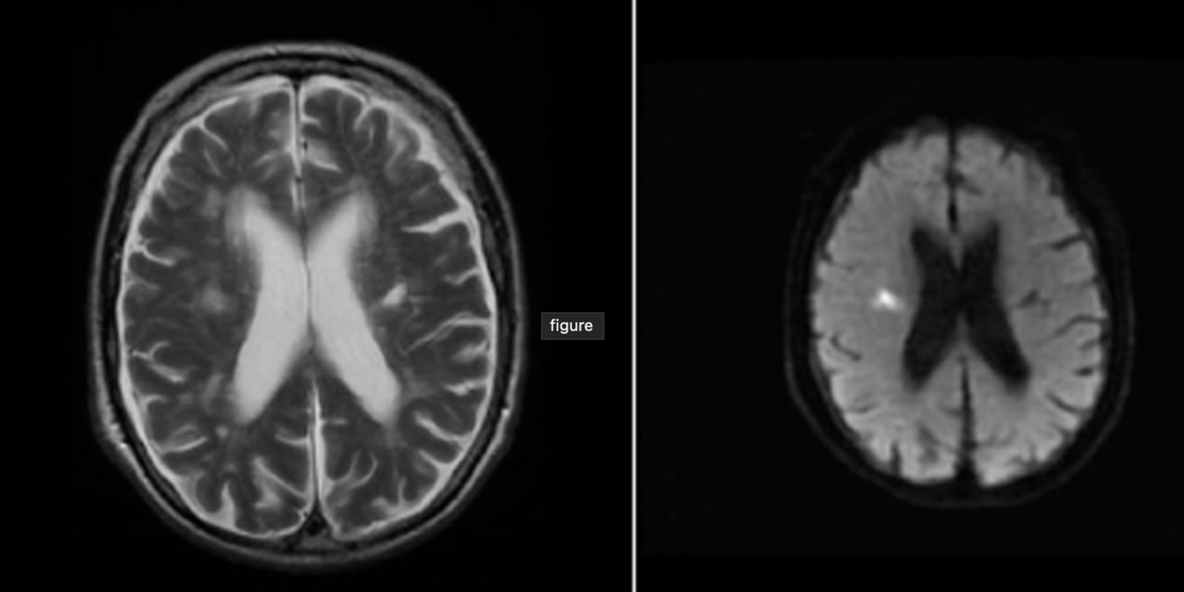
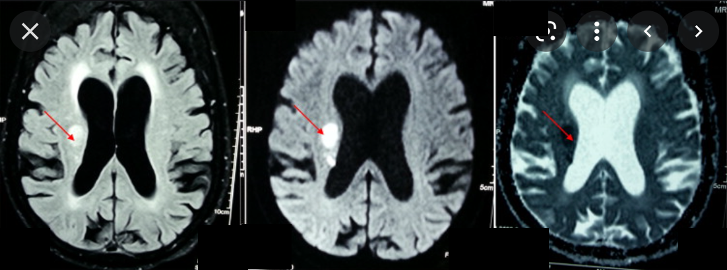
Case Study: Acute Onset Cerebral Ischemia Involving the Subcortical Region
Devin Nichols, MMS, PA-S
Faculty Advisor: Samantha Creamer, PA-C, MPAS
Department of Medical Science
Abstract
Treatment
Discussion
Corona radiata cerebral infarcts have the capability of leaving detrimental residual deficits if not recognized and treated promptly.
This article describes the presentation and management of a 43-year-old woman who was transferred from a local community hospital to a larger institution’s emergency department.
Initially presenting with nausea, vomiting, and dysarthria and examined global left sided extremity weakness and dysarthria, leading to a confirmed diagnosis via magnetic resonance imaging (MRI) of a corona radiata infarction.
Patient not administered tPA – out of 3-hour window⁴
Patient administered Integrillin
135μg/kg bolus⁵
0.5μg/kg/min infusion over 20 hours
Aspirin 325mg and Clopidogrel 300mg
Continue DAPT for 21 days⁷
Follow up with the following therapies
OT
PT
Speech Pathology
PCP – hypertension and diabetes maintenance
New Diagnosis of Diabetes
Hgb A1c – 12.5%
Currently managed by inpatient internal medicine team
Ensure proper outpatient treatment of new Diagnosis of Diabetes
Corona Radiata - white matter within the cerebral cortex
Internal capsule inferiorly and portion of corticospinal tract
Axon bundle allow for voluntary motor movements
Multiple nervous system tracts
Present with various symptoms
Hemiplegia, hypoesthesia of upper or lower extremities, dysarthria, clumsy hand syndrome
Intermittent mild symptoms quickly progress
Preferred Treatments
IV tPA bolus followed by infusion
ASA guidelines < 3 hours
Secondary Treatments
Intra-arterial intervention
Microangiopathic basilar
artery and risk of rupture
Integrillin therapy –
success with SIESTA trial⁶
Introduction
Sudden onset of nausea, vomiting, mild dysarthria, and global left sided extremity weakness.
Local community hospital withing an hour of symptom onset
No tPA administration
intermittent physical exam findings of left sided weakness, yet consistent mild dysarthria.
No repeat CT head or MRI completed to confirm stroke rule out
Return of now constant motor symptoms
Patient transferred from community hospital to larger hospital system ER as a stroke alert, 16 hours after initial onset of symptom.
Patient presenting to receiving facility with global left sided extremity weakness and mild dysarthria.
CT and MRI performed and confirmed a right sided hyperintense lesion within corona radiata
Integrillin therapy presented to patient
Figure 1. MRI of Right Sided Corona Radiata Stroke
Figure 3. Coronal View Illustration of Anatomical Corona Radiata and Efferent Projection Fibers.
Conclusion
Physical Exam
A thorough and attentive initial neurologic evaluation is crucial to optimal patient outcomes.
Timely recognition of IV tPA initiation congruent with eligibility.
Using all available resources (subjective events, baseline, re-evaluations)
A negative head CT for acute hemorrhage nor a reported negative brain MRI for ischemia does not rule out an acute ischemic stroke.
Re-imaging is crucial for accurate diagnosing and patient outcome when physical exam findings are not as consistent with expectation, for early recognition.
Patient presented with mild dysarthria and global left sided extremity weakness
Initial NIHSS : 5
2 points for left arm motor drift – some effort against gravity
2 points for left leg motor drift – some effort against gravity
1 point for dysarthria – mild/moderate, slurring but understandable
Secondary exam - 24 hours post treatment
NIHSS : 9
4 points for left arm motor drift – no movement
4 points for left leg motor drift – no movement
1 point for dysarthria – mild, slurring but understandable
Left image: T2. Right image: DWI area of restricted diffusion of the right corona radiata. Hypointense lesion in Left corona radiata indicating old infarct. Reproduced from Wiley Online Library⁸
Figure 2. MRI and DWI with ADC Correlation of Right Sided Hyperintensity
References:
1. Biller José, DeMyer W. Chapter 2 - Applied Anatomy of the Brain Arteries. In: Stroke in Children and Young Adults. 2nd ed. Philadelphia, PA: Saunders/Elsevier; 2009:15-68. https://www.sciencedirect.com/book/9780750674188/stroke-in-children-and-young-adults
2. Description - Food and Drug Administration. Integrilin (eptifibatide) Injection for Intravenous Administration. https://www.accessdata.fda.gov/drugsatfda_docs/label/2011/020718s034lbl.pdf. Published March 2011.
3. Sandercock P, Lindley R, Wardlaw J, et al. The Third international stroke trial (IST-3) of thrombolysis for acute ischaemic stroke. NCBI. 2008;9(1). doi:10.1186/1745-6215-9-37.
4. Powers WJ, Rabinstein A, Ackerson T, et al. 2018 AHA/Asa Stroke Early Management Guidelines. American College of Cardiology. https://www.acc.org/latest-in-cardiology/ten-points-to-remember/2018/01/29/12/45/2018-guidelines-for-the-early-management-of-stroke. Published May 9, 2018.
5. Cheng NT, Kim AS. Intravenous thrombolysis for acute ischemic stroke within 3 hours versus between 3 and 4.5 hours of symptom onset. The Neurohospitalist. 2015;5(3):101-109. doi:10.1177/1941874415583116
6. Mehta S, Ahmad J, Hussain M, et al. JFK Medical Center; 2014. http://www.svin.org/files/Safety_Mehta.pdf.
7. Clopidogrel in High-risk Patients with Acute Non-disabling Cerebrovascular Events (CHANCE). ClinicalTrials.gov identifier: NCT00979589. Updated July 15, 2020. Accessed December 5th. 2021. https://clinicaltrials.gov/ct2/show/NCT00979589
8. Bradley N, Hannon N, Lebus C, O'Brien E, Khadjooi K. Acute Corona Radiata Infarct on MRI. World Stroke Organization; 2014. https://onlinelibrary.wiley.com/doi/full/10.1111/ijs.12387.
9. Mahale R, Mehta A, Javali M, Srinivasa R. MRI of Corona Radiata. Elsevier B.V.; 2015. https://www.sciencedirect.com/science/article/abs/pii/S2210533615000027.
10. Dipanda A, Goulette F, Jaillet F, Payan Y, Promayon E. B.4 Fiber Tracts in White Matter. Allen Institute; 2012. https://www.semanticscholar.org/paper/Segmentation-d'images-IRM-du-cerveau-pour-la-d'un-%C3%A0-Galdames/b2614d73862c508f56c9ee9123ea4ae4fcb1ae80#extracted.
Left: T2 Flare of Right sided hyperintensity corona radiata infarct. Center: DWI with right sided area of restricted diffusion. Right Image: ADC correlation of DWI acute right sided corona radiata lesion.
Reproduced from ScienceDirect: Basal Ganglia⁹

