Slide 1
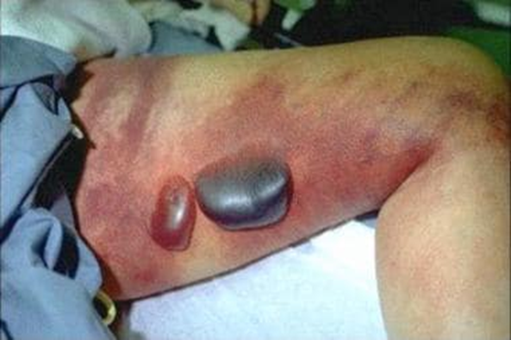
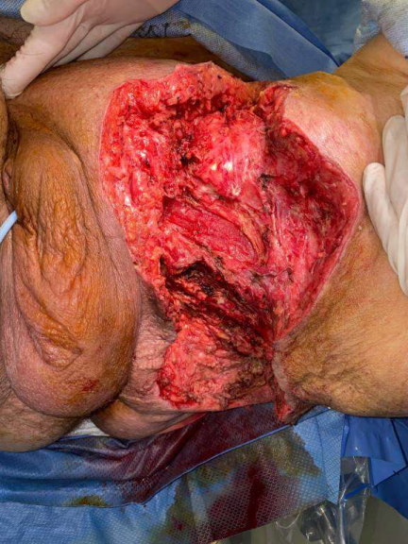
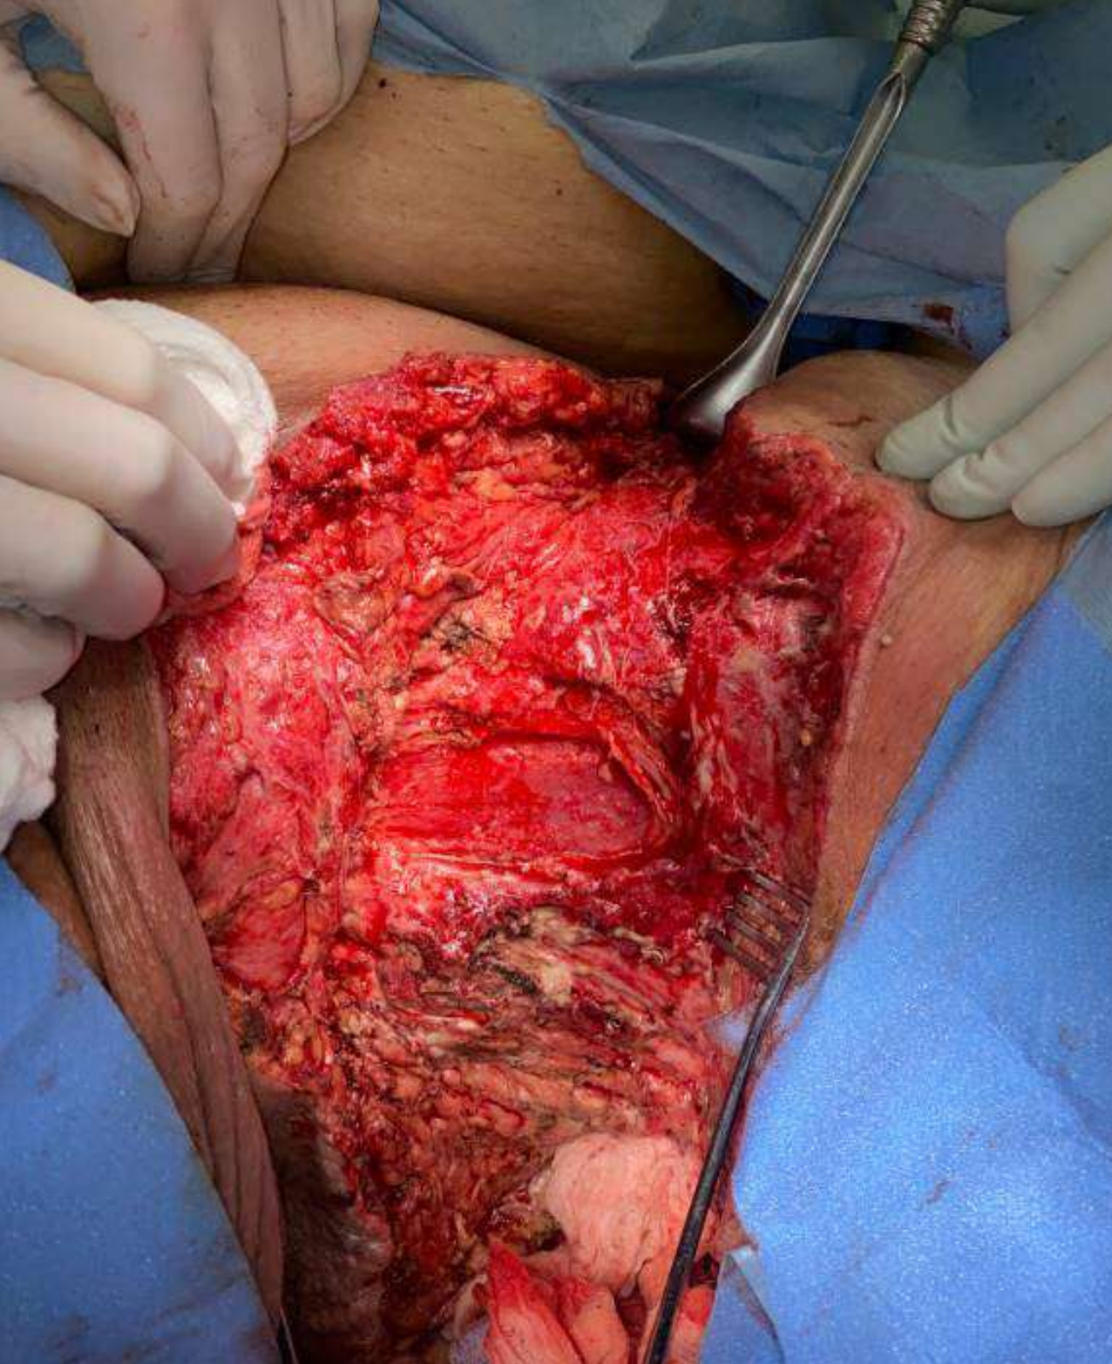
Case Report: Fournier’s Gangrene
Abigail Groos, MMS
Faculty Advisor: Sharonda Felton, MME, PA-C
Department of Medical Science
Introduction
Case Presentation
Discussion
Fournier’s gangrene is a rare manifestation of the already sparse skin infection known as necrotizing fasciitis, specifically of the scrotal and perineal region. This case illustrates a patient in the emergency department with a severe necrotizing skin infection who quickly progressed to sepsis and multiorgan damage. It is important to understand the common presentation, complications, and ideal management of patients with necrotizing fasciitis.
Case: A 72-year-old Caucasian male was brought to the emergency department via emergency medical services following a fall associated with an episode of dizziness and generalized weakness
History
Physical Exam
Necrotizing soft tissue infections can arise via direct portals of entry or less commonly, indirect portals of entry
It is most commonly polymicrobial
Clinical presentation: soft tissue edema, erythema, pain out of proportion, tenderness, fever, hypotension and skin necrosis
Late clinical manifestations are tight skin, color changes, hemorrhagic bullae, cutaneous gangrene, sepsis, and multiorgan failure
Clinical presentation is often not severe until complications arise and must be recognized quickly by clinicians in order to decrease mortality
Complications of necrotizing fasciitis include organ failure, limb amputation, toxic and septic shock, and death
Diagnosis is primarily clinical, with imaging and laboratory studies used to assess severity and presence of end-organ damage and/or sepsis
Surgical management is the most important intervention for patients with Fournier’s Gangrene
Broad spectrum antibiotics are used concomitantly to surgical management
New managements include vacuum assisted therapy and hyperbaric oxygen therapy
PMH: chronic kidney disease stage III, diabetes mellitus type 2, hypertension, hyperlipidemia, sleep apnea, and morbid obesity
+ ROS: activity change, appetite change, fatigue, scrotal swelling, painful abscess, abscess drainage draining foul smelling purulent material
Vital Signs: temperature, 98° F (36.7° C); pulse, 103 beats per minute; blood pressure, 97/55 mmHg; respirations, 20 breaths per minute; and Spo2, 98% on room air
Open necrotic gluteal wound (2.5cm x 2.5cm)
Musculoskeletal edematous changes and overlying erythema to the left upper thigh into the left perineum and groin
Diagnostics
Remarkable lab values: alkaline phosphatase (150 U/L), AST (119 U/L), ALT (125 U/L), lactate (2.8 mmol/L), total CK (316 U/L), PBNP (833 Pg/ml), WBC (18.0 K/μL), absolute neutrophil count (16.1 K/uL), neutrophil % (89.2%), BUN (113 mg/dL), serum creatinine (6.3 mg/dL) and glucose (188 mg/dL), albumin (2.4 L), lymphocyte % (3.0%), sodium (128 mmol/L), chloride (95 mmol/L), CO2 (20.0 mmol/L), and estimated GFR (9 mL/min/1.73m*2)
Chest radiograph: no acute abnormalities and had no evidence of infiltrates or pleural effusions
EKG: sinus tachycardia with no evidence of acute ischemic changes
Conclusion
Management
Prompt identification of necrotizing skin infections is important to initiate early surgical intervention and decrease mortality. Prognosis is poor in those with comorbidities, commonly, diabetes mellitus, renal failure, liver failure, and immunosuppression. Means of treatment are primarily surgical with new footholds in wound vacuum therapy, as used in this case, as well as the more controversial hyperbaric oxygen therapy.
Intravenous fluid resuscitation
Broad spectrum antibiotics (cefepime, vancomycin, and piperacillin-tazobactam), and vasopressor (levophed)
Four surgical debridement's over a 9-day period
Vacuum assisted closure therapy

