Slide 1
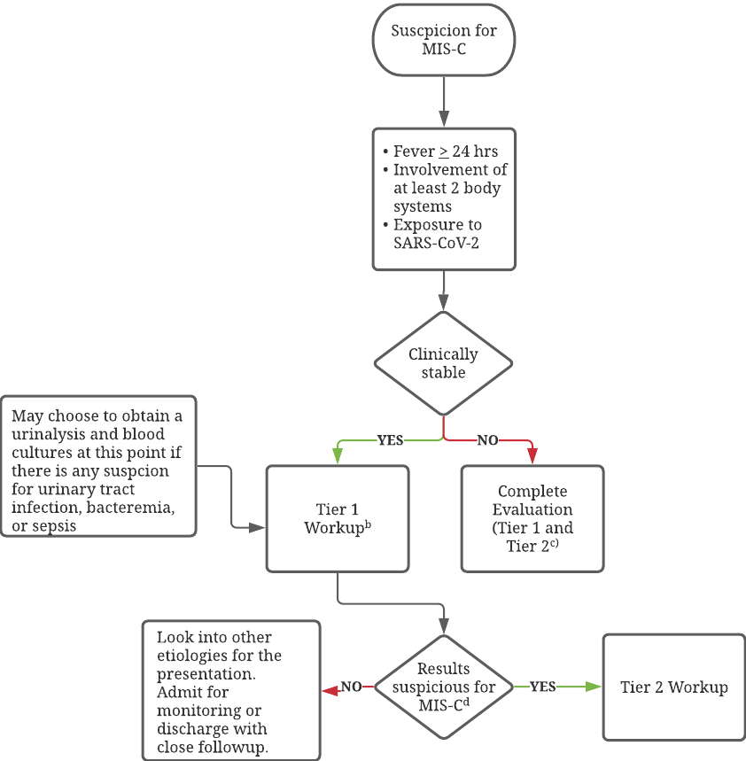
CME: Identification and Management of Multisystem Inflammatory Syndrome in Children
Sarah Lasser, PA-S
Faculty Advisor: Kevin Basile, MD, PT
Department of Medical Science
Abstract
Diagnostic Approach
Management and Follow-Up
Multisystem inflammatory syndrome in children and adolescents (MIS-C) was first described in Europe in April 2020 as a post viral inflammatory syndrome. Since then it has gained attention worldwide and become better understood. This CME summarizes current best practices regarding its work-up, diagnosis, treatment strategies and follow-up.
Figure. Diagnostic Approach to MIS-C
Treatment
IVIG – 2 g/kg based on ideal weight over 10-24 hours^{3,8}
Aspirin - 30-50 mg/kg/d until afebrile, then 3-5 mg/kg/d x 48 hrs.^{5,6}
Corticosteroids - 1-2 mg/kg/day IV methylprednisolone up to 10-30 mg/kg/day in refractory disease.⁶ Transition to PO and taper upon discharge.
Anakinra - for refractory disease after high dose glucocorticoids.⁶ 1-8 mg/kg/day SQ.^{3,5} Monitor LFTs.
Infliximab - single dose of 10 mg/kg.⁸
Tocilizumab - 12 mg/kg IV if < 30 kg and 8 mg/kg IV if > 30 kg.⁵ Obtain CMP, CBC, lipid panel before initiation and during treatment. Not as well studied in pediatric patients.
Thromboprophylaxis – Enoxaparin at 0.5 mg/kg SQ BID for 2+ weeks after discharge if EF< 35%, longer if thrombosis or significant coronary artery aneurysms.^{3,6}
Supportive Care and Empiric Treatment – Fluid management, respiratory and cardiovascular support. Empiric broad spectrum antibiotics for septic shock-like picture.
Follow-Up
Cardiology reassessment for those who presented with myocardial dysfunction
Cardiac MRI at 2-6 months after diagnosis if significant LV dysfunction.
Echocardiograms – at 1-2 weeks and 4-6 weeks after diagnosis
Consider Holter monitor at discharge for arrhythmias or conduction disturbances
The American College of Rheumatology (ACR) developed guidelines for the diagnosis and management of MIS-C.⁶ Recommendations from the ACR and other organizations were taken into consideration to develop this approach to diagnosis.
Introduction
In April 2020, the first cases of children presenting with Kawasaki Disease-like symptoms were reported in Europe.¹⁻⁴ These cases were geographically and temporally associated with COVID-19 outbreaks, leading to the hypothesis this was a post viral inflammatory response to COVID-19.^{1,3-6} The World Health Organization (WHO) named this condition Multisystem Inflammatory Syndrome in Children and Adolescents (MIS-C).¹
Table 1. CDC and WHO Case Definitions for Diagnosis of MIS-C
CDC Definitionª | WHO Definition^{b}
< 21 yrs Fever for > 24 h Lab evidence of inflammation (e.g., elevated CRP, ESR, fibrinogen, procalcitonin, d-dimer, ferritin, LDH, IL-6, neutrophilia, lymphocytopenia, low serum albumin) Evidence of severe illness requiring hospitalization Multisystem involvement of >2 organs (cardiac, renal, hematologic, gastrointestinal, dermatologic, or neurologic) No alternative dx Positive recent or current SARS-CoV-2 infection or exposure to suspected or confirmed COVID-19 case | <19 yrs Fever for > 3 days Elevated CRP, ESR, or procalcitonin Multisystem involvement: 2+ of the following: Rash, conjunctivitis, mucocutaneous inflammation Hypotension or shock Cardiac involvement Coagulopathy Acute GI symptoms Any of the following: Positive PCR test Positive antigen test Positive serology Contact with a person with COVID-19 infection No other obvious microbial cause of inflammation
ªAdapted from Henderson LA, Canna SW, Friedman KG, et al.⁶
^{b}See Table 3 for Tier 1 evaluation and notes
^{c}See Table 4 for Tier 2 evaluation and notes
^{d}If CRP or ESR is elevated AND at least one of following (thrombocytopenia, lymphocytopenia, neutrophilia, hyponatremia, hypoalbuminemia) then Tier 2
Key Points
Table 3. Tier 1 Evaluation Labs and Suggestive Findingsª
All children presenting with symptoms suspicious for MIS-C and probable exposure to SARS-CoV-2 should be referred to the emergency department for further workup.
Suspicion for MIS-C should not preclude workup for other causes of a patient presentation.
A tiered approach to the workup of MIS-C should be employed in the emergency setting, unless a child is acutely ill, in which case immediate supportive measures and empiric treatment should be started while a full workup is obtained.
Knowledge regarding the best treatment strategies is constantly evolving and providers should keep apprised of the latest recommendations.
The long-term sequelae of MIS-C remain largely unknown. Close follow-up of children with MIS-C will be needed to gain this knowledge.
Tier 1 Evaluation | Notes, Findings Suggestive of MIS-C
CBC | Thrombocytopenia (platelets < 150,000/μl) Lymphopenia (ALC < 1,000/μl) Neutrophilia, Leukocytosis
CMP | Hyponatremia (Na < 135 mmoles/liter) Hypoalbuminemia Increased ALT/AST
ESR +/- CRP | ESR > 40 mm/hr, CRP > 5 mg/dl
SARS-CoV-2 PCR and/or serology | Positive
+/- Blood Cultures | Consider primary vs concomitant bacteremia
+/- Urinalysis
ªData adapted from Centers for Disease Control⁷
^{b}Data adapted from World Health Organization⁸
Table 2. Signs, Symptoms, and Complications of MIS-C by System
System | Signs, Symptoms, and Complicationsª
General | Fever, myalgias, lymphadenopathy
Dermatologic* | Mucocutaneous, maculopapular or petechial rash, desquamation, erythroderma
Neurologic | Headache, meningismus, encephalopathy, altered mental status, focal neurological deficits, papilledema
HEENT | Conjunctivitis without exudate, lip swelling/redness, oropharyngeal erythema, strawberry tongue, sore throat
Cardiovascular* | myocarditis, left ventricular dysfunction, low ejection fraction, coronary artery abnormalities (dilation, aneurysms), vasculitis, arrhythmia, valvular dysfunction, pericardial effusion, cardiovascular shock
Pulmonary | Cough, respiratory distress, hypoxia, pulmonary infiltrates, pulmonary edema, atelectasis, pulmonary embolism, acute respiratory distress syndrome
Hematologic | Thrombocytopenia, neutrophilia, lymphopenia, increased PT/PTT, low fibrinogen
Gastrointestinal* | Abdominal pain, diarrhea, nausea, vomiting, mesenteric lymphadenitis, peritonitis, ileitis, colitis, ascites, ileus, GI bleed
Renal | Acute kidney injury, renal failure, hyponatremia
References
1. Radia T, Williams N, Agrawal P, et al. Multi-system inflammatory syndrome in children & adolescents (MIS-C): A systematic review of clinical features and presentation. Paediatr Respir Rev. 2021;38:51-57. doi:10.1016/j.prrv.2020.08.001
2. Consiglio CR, Cotugno N, Sardh F, et al. The immunology of multisystem inflammatory syndrome in children with COVID-19. Cell. 2020;183(4):968-981. doi:10.1016/j.cell.2020.09.016
3. McMurray J, May J, Cunningham M, Jones O. Multisystem inflammatory syndrome in children (MIS-C), a post-viral myocarditis and systemic vasculitis - A critical review of its pathogenesis and treatment. Front Pediatr. 2020;8. doi:10.3389/fped.2020.626182
4. Abrams JY, Oster ME, Godfred-Cato S, et al. Factors linked to severe outcomes in multisystem inflammatory syndrome in children (MIS-C) in the USA: a retrospective surveillance study. Lancet Child Adolesc Health 2021;5:323-31. doi: 10.1016/S2352-4642(21)00050-X
5. Nakra N, Blumberg D, Herrera-Guerra A, Lakshminrusimha S. Multi-system inflammatory syndrome in children (MIS-C) following SARS-CoV-2 infection: review of clinical presentation, hypothetical pathogenesis, and proposed management. Children. 2020;7(7):69. doi:10.3390/children7070069
6. Matic K. SARS-CoV-2 and multisystem inflammatory syndrome in children (MIS-C). Curr Probl Pediatr Adolesc Health Care. 2021:101000. doi:10.1016/j.cppeds.2021.101000
7. World Health Organization. Multisystem inflammatory syndrome in children and adolescents with COVID-19. May 2020. Available at: https://www.who.int/publications/i/item/multisystem-inflammatory-syndrome-in-children-and-adolescents-with-covid-19
8. Centers for Disease Control and Prevention. Information for healthcare providers about multisystem inflammatory syndrome in children (mis-c). May 2021. Available at: https://www.cdc.gov/mis/mis-c/hcp/index.html. Accessed 2022.
9. Henderson L, Canna S, Friedman K et al. American college of rheumatology clinical guidance for multisystem inflammatory syndrome in children associated with SARS–CoV‐2 and hyperinflammation in pediatric COVID‐19: version 2. Arthritis & Rheumatology. 2021;73(4). doi:10.1002/art.41616
10. Njideka U, Hazel Jones P, Melonie O. Abdominal pain, a red herring for multisystem inflammatory syndrome in children (MIS-C): a case report. J Fam Med Dis Prev. 2020;6(3). doi:10.23937/2469-5793/1510127
11. Roberts JE, Campbell JI, Gauvreau K, et al. Differentiating multisystem inflammatory syndrome in children: a single-centre retrospective cohort study. Arch Dis Child. 2021;0:1-6. doi: 10.1136/archdischild-2021-322290
12. Mavrogeni SI, Kolovou G, Tsirimpis V, Kafetzis D, Tsolas G, Fotis L. The importance of heart and brain imaging in children and adolescents with multisystem inflammatory syndrome in children (mis-c). Rheumatology International. 2021;41(6):1037-1044. doi:10.1007/s00296-021-04845-z
13. Cole LD, Osborne CM, Silveira LJ, et al. IVIG compared with IVIG plus infliximab in multisystem inflammatory syndrome in children. Pediatrics. 2021;148(6). doi:10.1542/peds.2021-052702
14. Mahmoud S, El-Kalliny M, Kotby A, El-Ganzoury M, Fouda E, Ibrahim H. Treatment of mis-c in children and adolescents. Current Pediatrics Reports. 2022. doi:10.1007/s40124-021-00259-4
Table 4. Tier 2 Evaluation Labs and Suggestive Findings
Tier 2 Evaluation | Notes, Findings Suggestive of MIS-C
BNP | Elevated
Troponin | Elevated
Procalcitonin | Increased, even in absence of bacterial infection
Ferritin | Increased
D-dimer | Elevated
PT, PTT | Increased
Fibrinogen | Decreased
LDH | Increased
Cytokine Panel | Elevated levels of IL-6, TNF, IL-10
Lipid Panel
EKG | Assess for conduction abnormalities, arrhythmias, ischemia
Echocardiogram | Evaluate for: Decreased myocardial function, low EF, ventricular dysfunction, valvular dysfunction, pericardial effusion, coronary artery measurements indexed to BSA → z-score
ªData adapted from multiple studies.¹⁻⁸
*Most common⁹

