Slide 1
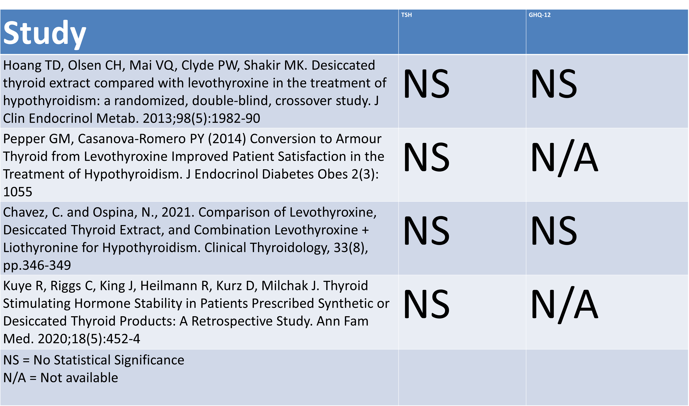
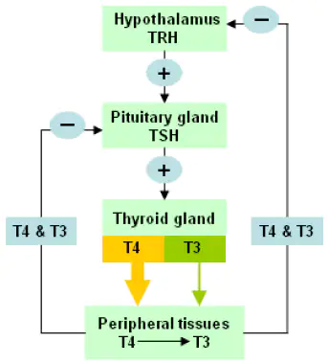
Treatment of Hypothyroidism: Desiccated Thyroid Extract
Aimee Fong, PA-S
Faculty Advisor: Lisa Murphy, PA-C
Department of Medical Science
Abstract
DTE vs Levothyroxine for TSH and GHQ-12
Discussion Points for Patient without Symptomatic Relief with Levothyroxine
The treatment of hypothyroidism with Levothyroxine (T4) has been well studied and FDA approved. However, many patients continue to have signs and symptoms of hypothyroidism while on Levothyroxine treatment despite reaching appropriate thyroid levels. An additional thyroid treatment known as desiccated thyroid extract (DTE) is made from dried pig thyroid glands and is advertised as a “natural” alternative to Levothyroxine. Despite lack of FDA approval and studies surrounding DTE, clinicians have prescribed DTE to patients, many of whom reported relief of their symptoms. The following poster highlights the approach to the treatment of hypothyroidism with Levothyroxine and DTE and outlines potential side effects due to the gaps in knowledge from the medical community.
Ensure Levothyroxine Compliance
Check thyroid panel levels
Rule out additional causes of symptoms: depression, anemia, cortisol insufficiency, dementia, hypercholesteremia, sleep apnea, polycystic ovarian syndrome
Studies have shown no benefit in TSH levels, cognitive function, or general health outcomes
There are no long term studies regarding the side effects
DTE is not recommended by the FDA or American Thyroid Association
T3 overdose can lead to fatal cardiac and metabolic symptoms
Introduction: Hypothyroidism
Overview:
Thyroid hormone influences almost every organ system
T4 is directly released from thyroid gland
T3 is more biologically active from T4 -> T3 conversion
S/S:
Weakness, lethargy, cold intolerance, facial edema, constipation, weight gain, dry skin
Tx:
Levothyroxine: Synthetic T4
Desiccated Thyroid Treatment (Armour Thyroid, NP Thyroid): T4/T3 combination
Patient Preference DTE vs Levothyroxine
15% of women expressed dissatisfaction with Levothyroxine¹
Lack of symptomatic improvement (75%)²
No change in overall well being (36%)²
Unchanged TSH values (12%)²
After Switching from Levothyroxine
84% showed symptomatic relief¹
81% stated clear preference for combination therapy¹
Preference is NOT due to weight loss³
Conclusion
Despite recommendations, an online survey showed that 3-6% of providers prescribed DTE for symptomatic patients with low L-T3 levels
This highlights the need for more studies regarding its long-term effects, potential side effects, and standardization of its products
However, patients have also expressed dissatisfaction and mistrust in their providers who do not acknowledge their concerns
The decision to begin DTE should be an individualized discussion between a clinician and their patient
DTE
Initial Dosage: 30 mg in the AM
Maximum Dosage: 60 mg
Increase every 4-6 weeks as needed
Baseline TSH, FT4, FT3 levels
Do NOT use in combination with Levothyroxine
Adverse Effects:
Weight loss
Insomnia
Palpitations
Atrial fibrillation
Avoid in patients with CV history and 65+ years
Avoid in pregnant patients: T4 is vital for fetal development
Objections from Medical Community
American Thyroid Association states there is insufficient clinical evidence to support routine use⁴
Unpredictable T3 fluctuations^{5,6}
L-T4/L-T3 dose ratio 4.2:1⁵
FDA recall of NP Thyroid and Armour Thyroid for containing less than 90% of labeled thyroid hormone⁷
Lack of data on long term effects
References:
Peterson SJ, Cappola AR, Castro MR, et al. An Online Survey of Hypothyroid Patients Demonstrates Prominent Dissatisfaction. Thyroid. 2018;28(6):707-21.
Burch HB, Burman KD, Cooper DS, Hennessey JV. A 2013 Survey of Clinical Practice Patterns in the Management of Primary Hypothyroidism. The Journal of Clinical Endocrinology & Metabolism. 2014;99(6):2077-85
Pepper GM, Casanova-Romero PY (2014) Conversion to Armour Thyroid from Levothyroxine Improved Patient Satisfaction in the Treatment of Hypothyroidism. J Endocrinol Diabetes Obes 2(3): 1055
Bible KC, Kebebew E, Brierley J, et al. 2021 American Thyroid Association Guidelines for Management of Patients with Anaplastic Thyroid Cancer. Thyroid. 2021;31(3):337-86
Surks MI, Schadlow AR, Oppenheimer JH. A new radioimmunoassay for plasma L-triiodothyronine: measurements in thyroid disease and in patients maintained on hormonal replacement. J Clin Invest. 1972;51(12):3104-13
Cohen Jh, Ingbar Sh, Braverman Le. Thyrotoxicosis due to Ingestion of Excess Thyroid Hormone. Endocrine Reviews. 1989;10(2):113-24
Center for Drug Evaluation and Research. Acella Pharmaceuticals, LLC, issues voluntary nationwide recall of certain lots of NP thyroid® (thyroid tablets, USP) due to Sub Potency. U.S. Food and Drug Administration.

