Slide 1
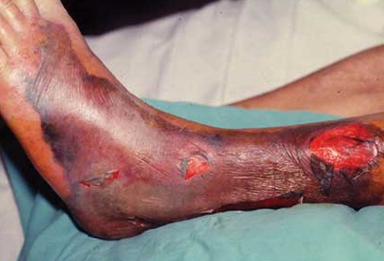
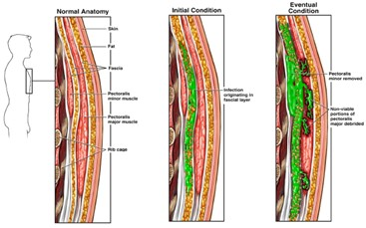
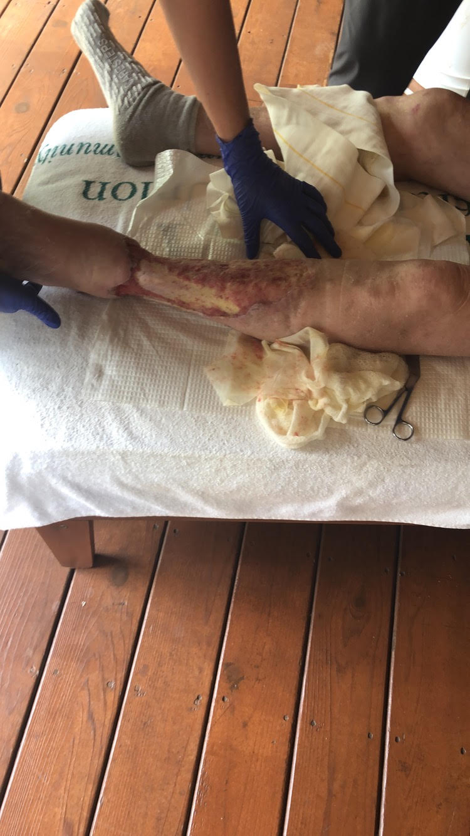
Vibrio Vulnificus: Necrotizing Fasciitis CME
Michael Davis, MMS, PA-S
Sharonda Felton, MME, PA-C
Department of Medical Sciences
Abstract
History and Physical
Figure 2: bullae and necrotic tissue from V. vulnificus
Management
Vibrio vulnificus is a gram-negative bacillus that is found in warmer bodies of saltwater and brackish water. It can cause gastrointestinal syndromes as well as necrotizing fasciitis in rare cases. The latter has a worse prognosis and must be treated aggressively with antibiotics. Other adjunctive treatments may be used as well, such as hyperbaric oxygen, debridement, and early amputation. Antibiotic resistance and rising temperatures may contribute to increased cases along with refractory strains.
Aggressive debridement along with antibiotic
CDC recommends IV doxycycline 100mg BID for 7-14 days + Ceftazidime 1g IV TID for 7-14 days
Must consider the possibility of abx resistance
Hyperbaric Oxygen may be used in adjunct but weight risks of pressure exposure
Early amputation creates the best outcomes
Use SIRS criteria to correlate
Trauma around the suspected site
Exposure to shellfish, saltwater, brackish water in the last 24-48 hours
Severe disease associated with liver, kidney, immunosuppressive disease, diabetes.
Signs of infection
Tachycardia
Fever
Cellulitis, compartment syndrome, necrotic tissue
Epidemiology/Pathology
Figure 1: Progression of necrotizing fasciitis
Prognosis
Rapidly progressing
16% fatality rate and 26% amputation rate
Increased mortality with comorbidities
Accounts for the majority of seafood-related deaths
Diagnosis
Gram negative bacilli
Found in shellfish, fish, and sediment of saltwater and brackish water
Found in warmer climates
NF is caused by the entrance of bacteria into an open wound
Bacteria can enter blood leading to sepsis and death
Increasing cases
Rising water temperatures
Increasing salinity
CBC/CMP to assess kidney and liver function
PCR – DNA load may be correlated with the severity of infection
Wound, blood, stool cultures
SIRS criteria – infection + 2 of the following
Respiratory rate >20 BPM
Heart rate > 90
Temperature >38.0 or <36.0
WBC >12,000 or <4,000 cells per microliter
Figure 3: Wound care following resolution of NF after aggressive debridement

