Slide 1
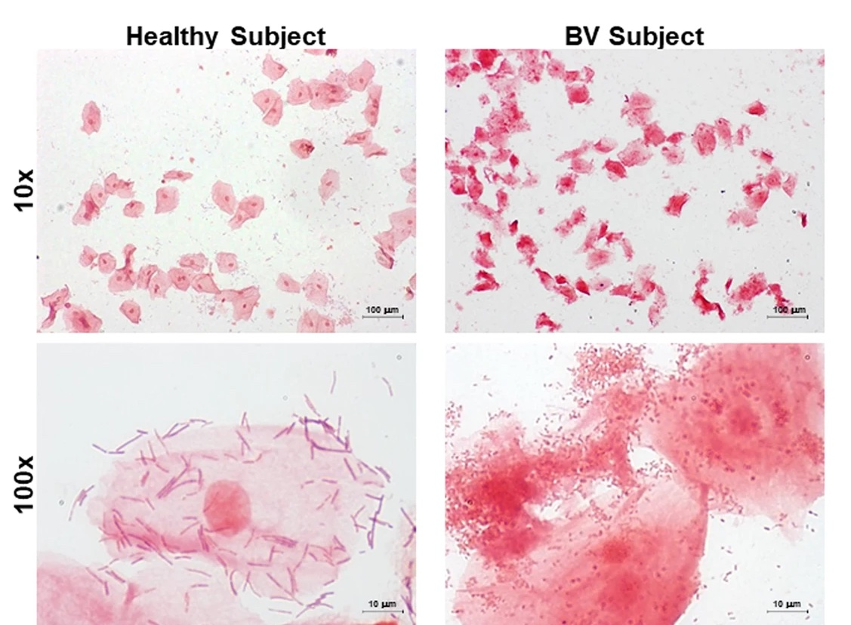
Will screening women for bacterial vaginosis in pregnancy reduce the adverse outcomes of bacterial vaginosis infection in pregnancy, such as preterm delivery or low-birth-weight infants?
Lauren Greiner MMS (c)
Faculty Advisor: Lisa Akselrad, MMS PA-C
Department of Medical Science
Abstract
Results
Discussion
Bacterial Vaginosis (BV) is a common genital tract infection in women, and in pregnant women, has been linked to adverse birth outcomes such as premature delivery and low-birth-weight infants. The treatment of BV is either Metronidazole or Clindamycin, both of which are safe during pregnancy. Currently, there are no guidelines for screening asymptomatic women for BV while pregnant. The goal is to analyze current literature to determine if screening asymptomatic pregnant women will reduce the outcome of preterm and low-birth-weight infants.
Kiss, Petricevic and Husslein evaluated if a screening strategy for bacterial vaginosis during pregnancy will lower rates of preterm delivery among the general population. Overall, this study found 50% reduction in low-birth-weight infants in the intervention group vs the control group⁵.
Hauth et al. double-blind study investigated if treatment with Metronidazole and erythromycin during the second trimester would lower the incidence of preterm delivery before 37 weeks. There was little difference in preterm delivery rates among those without BV, 22% in the treatment group compared to 25% in the control group⁶.
Hillier et al. aimed to derive a relationship between bacterial vaginosis and preterm delivery and low-birth-weight in infants in mothers with no other risk factors for preterm delivery. Overall, this study found that women with BV were 40% more likely to have a preterm birth than women without BV⁷.
Leitich and Kiss analyzed 32 studies containing 30,518 participants to evaluate bacterial vaginosis as a risk factor for late miscarriage or preterm delivery. This study found that screening in early pregnancy (before 15 weeks gestation) is not associated with increased risk of preterm delivery⁸.
Subtil et al. double-blind control trial examined if treatment of bacterial vaginosis can reduce late miscarriage or very preterm birth. Late miscarriage or very preterm birth occurred in 1.2% of those receiving Clindamycin and 1.0% of the placebo group,⁹.
Carey et al., evaluated the effect of treatment of BV on preterm delivery. Relative risk of preterm delivery in the Metronidazole group compared to the placebo group is 1.0 with a 95% confidence interval of 0.8-1.2¹⁰.
Afolabi, Moses and Oduye bo aimed to determine an association between BV infection and preterm delivery. All women in this study were treated, and still BV infection was associated with 2.7 times increased risk of preterm delivery compared to the general population¹¹.
Studies analyzed in this paper found that BV infection is associated with an increased risk for both preterm delivery before 37 weeks gestation and low-birth-weight less than 2,500g. The odds ratio of BV infection and preterm delivery ranging from 1.5 in Hillier’s study to 2.6 in Leitich and Kiss’s meta-analysis.
Studies with support for treatment of BV lowering preterm delivery/LBW
Kiss, Petricevic and Husslein found a statistically significant decrease in both preterm delivery and low-birth-weight in women who were treated for BV compared to placebo
Hauth et al. found a statistically significant decrease in preterm delivery rates among women with BV who were treated vs untreated, from 49% in infected and untreated to 31% in infected and treated
Hillier et al. found that BV positive women who were treated by their primary care provider had similar rates of preterm delivery and low-birth-weight as women who were not BV positive
Studies without support for treatment of BV lowering preterm delivery/LBW
Leitich and Kiss, data showed that there was no association between early term screening for BV before 15 weeks gestation and decreased incidence of preterm birth
Subtil et al., there was no association found between treatment of BV on the outcome of late term miscarriage and very preterm birth
Carey et al. found the relative risk of preterm delivery between treatment group and control group to be 1.0
Roselletti, E., Sabbatini, S., Perito, S. et al. Apoptosis of vaginal epithelial cells in clinical samples from women with diagnosed bacterial vaginosis.
Sci Rep 10, 1978 (2020). https://doi.org/10.1038/s41598-020-58862-2
Introduction
Bacterial Vaginosis (BV) is a common vaginal condition characterized by the imbalance of vaginal flora. In fact, the CDC states that BV is the most common vaginal condition in women aged 15-44. Typically, BV is caused by an overgrowth of the anaerobe Gardenerlla vaginalis. Symptoms of BV include thin, gray to white vaginal discharge; pain, itching or burning of the vagina and vulva; and a strong fish-like odor. Diagnosis of BV is mostly clinical and can include in office tests such as KOH whiff tests as well as wet mount microscopy.
Pregnant woman with confirmed BV is more likely to have a premature infant or a low-birth-weight infant. Low-birth-weight and premature infants are at higher risk for several life- threatening complications during birth and neonatal period. For example, preterm infants are at higher risk of hypoxia at birth, infant respiratory distress syndrome, infection, sudden infant death syndrome (SIDS) and necrotizing enterocolitis.
Conclusion
Currently, the USPSTF recommends against screening for Bacterial Vaginosis in pregnant women not at risk for preterm delivery, citing that there is adequate evidence that shows no benefit of treatment of BV in pregnant women with low-risk of preterm birth¹².
Leitich and Kiss that examined over 30,000 participants, there was no relationship shown between treatment of BV and decreased risk of preterm delivery and low-birth-weight. In the two blind prospective studies done by Subtil et al. and Carey et al., there was no statistically significant decrease in preterm delivery or low-birth-weight shown after treatment of BV.
In conclusion, after a thorough literature review, the current recommendation of the USPSTF to advise against routine screening and treatment of asymptomatic bacterial vaginosis in low-risk pregnant women is valid, and screening is not shown to reduce adverse birth outcomes.
Methods
A literature search was completed using search terms such as “bacterial vaginosis AND screening AND pregnancy”, “bacterial vaginosis AND preterm”, “bacterial vaginosis AND pregnancy”, and “bacterial vaginosis AND preterm delivery AND treatment”. Search engines used included PubMed, CDC, AccessMedicine, and Google Scholar.
1.Kiss H, Petricevic L, Husslein P. Prospective randomised controlled trial of an infection screening programme to reduce the rate of preterm delivery. BMJ. 2004;329(7462):371. doi:10.1136/bmj.38169.519653.EB
Hauth JC, Dubard MB. Reduced Incidence of Preterm Delivery with Metronidazole and Erythromycin in Women with Bacterial Vaginosis. THE NEW ENGLAND JOURNAL OF MEDICINE. 1995;333(26):5.
Hillier SL, Krohn MA, Edelman R, Regan JA. Association between Bacterial Vaginosis and Preterm Delivery of a Low-Birth-Weight Infant. The New England Journal of Medicine. 1995;333(26):6.
Leitich H, Kiss H. Asymptomatic bacterial vaginosis and intermediate flora as risk factors for adverse pregnancy outcome. Best Practice & Research Clinical Obstetrics & Gynaecology. 2007;21(3):375-390. doi:10.1016/j.bpobgyn.2006.12.005
Subtil D, Brabant G, Tilloy E, et al. Early Clindamycin for bacterial vaginosis in pregnancy (PREMEVA): a multicentre, double-blind, randomised controlled trial. The Lancet. 2018;392(10160):2171-2179. doi:10.1016/S0140-6736(18)31617-9
Carey JC, Thom EA, Fischer ML. Metronidazole to Prevent Preterm Delivery in Pregnant Women with Asymptomatic Bacterial Vaginosis. The New England Journal of Medicine. Published online 2000:7.
Afolabi BB, Moses OE, Oduyebo OO. Bacterial Vaginosis and Pregnancy Outcome in Lagos, Nigeria. Open Forum Infectious Diseases. 2016;3(1):ofw030. doi:10.1093/ofid/ofw030
US Preventive Services Task Force. Screening for Bacterial Vaginosis in Pregnant Persons to Prevent Preterm Delivery: US Preventive Services Task Force Recommendation Statement. Obstetrical & Gynecological Survey. 2020;75(9):537-538. doi:10.1097/01.ogx.0000697056.13268.ec

