Slide 1
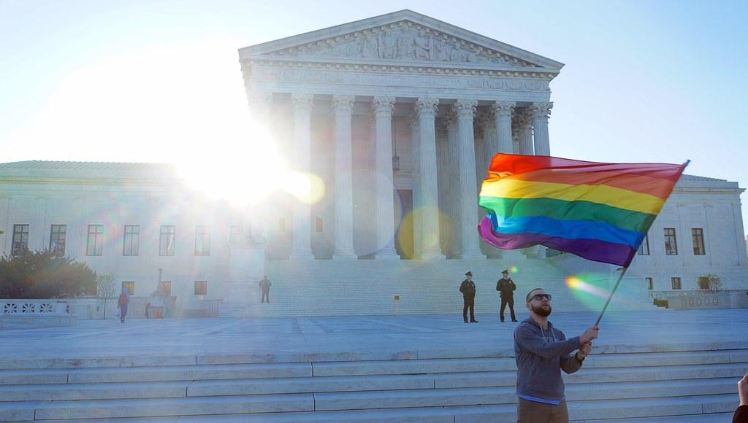
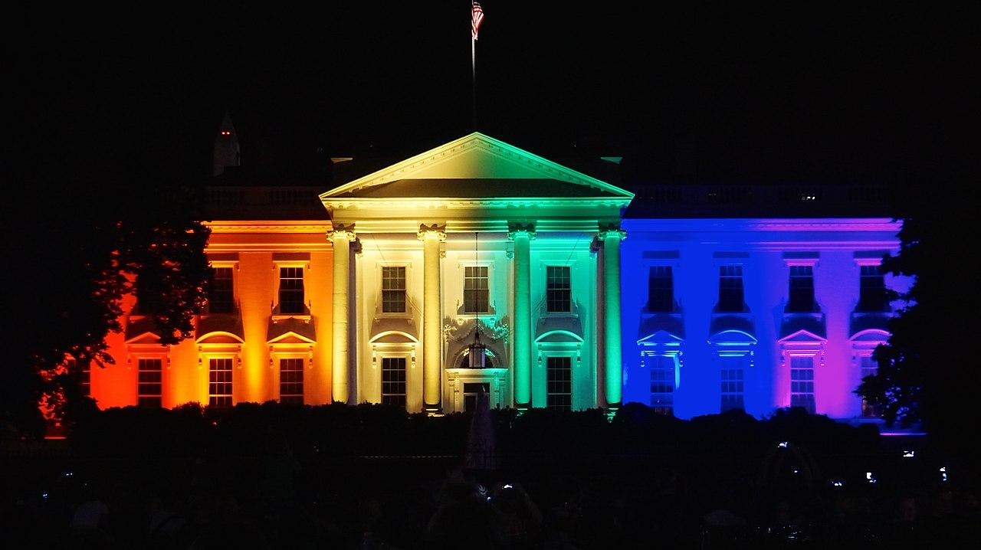
Stonewall to the Present: An Analysis of the LGBT Rights Movement and U.S. Public Policy
Jake Mericle

Slide 2
Introduction
The modern LGBT rights movement began in 1969 with the Stonewall Riots
Question: To what extent has the LGBT rights movement affected U.S. policy and public opinion on LGBT issues?
Power is the ability of the movement to create desired effects in public policy and the ability to influence public opinion
Importance will be defined as recognition of individual or group actors in bringing about change in public policy and public opinion and evidence of direct links between the movement and policy changes
The LGBT rights movement has been powerful in bringing about changes in U.S. policy and public opinion and has been an important factor in those changes.

Slide 3
Literature Review
Scholars largely agree that social movements do influence policy and public opinion, however there is disagreement over the specific effects of social movements and how they influence policy
Theories of how social movements influence policy (amplification model, types of dissent, effects of counter movements)
Notes:
Amplification model- According to Agnone, public opinion on pressing issues are amplified by social pressures, such as protests. Therefore, social movements impact changes in law and public policy by increasing awareness of the issues by legislators and those in positions of authority.
Types of dissent- Dutiful, Disruptive, and Dangerous. Dutiful dissent works within the existing systems and power structures. Disruptive dissent contests existing social norms and policy practices to redirect policy outcomes. Dangerous dissent creates new, alternative systems which destabilize existing power structures. All of these forms of dissent have risks and benefits which is why they must be used interchangeably in order to create a more effective movement
Effects of counter movements- in the presence of a counter-movement, a social movement organization will change the way it organizes and operates which changes the way in which it affects policy

Slide 4
Analytic Framework
Based on the literature, power and importance are integral to a social movement’s success in changing law and public policy.
Power will be defined as the ability to create desired effects in public policy and the ability to influence public opinion
Importance will be defined as recognition of individual or group actors in bringing about change in public policy and public opinion and evidence of direct links between the movement and policy changes

Slide 5
Method- Process Tracing
Variables | Measurement
Power | Policy changes- Supreme Court Cases, Acts of Congress, Executive Orders pertaining to LGBT rights that have a significant effect on those rights Public Opinion- Public polling since 1969 about American attitudes on LGBT rights
Importance | Recognition- Media coverage of the movement and policy changes and policy reasons (Supreme Court policy reasons or statements of purpose in Acts of Congress or Executive Orders) that identify the work of the movement and its actors Policy Impact- LGBT lobbying organizations

Slide 6
Findings
Power
Supreme Court decisions trend toward the positive for the movement
Gay and trans military bans repealed
Public opinion on LGBT issues trends positively for the movement
Importance
News media recognizes the role of the movement in changing policy and public opinion
Supreme Court and Congress, by discussing history of movement, recognize the positive climate it has created which can justify decisions to expand equality
LGBT organizations have large followings and are financially powerful

Slide 7
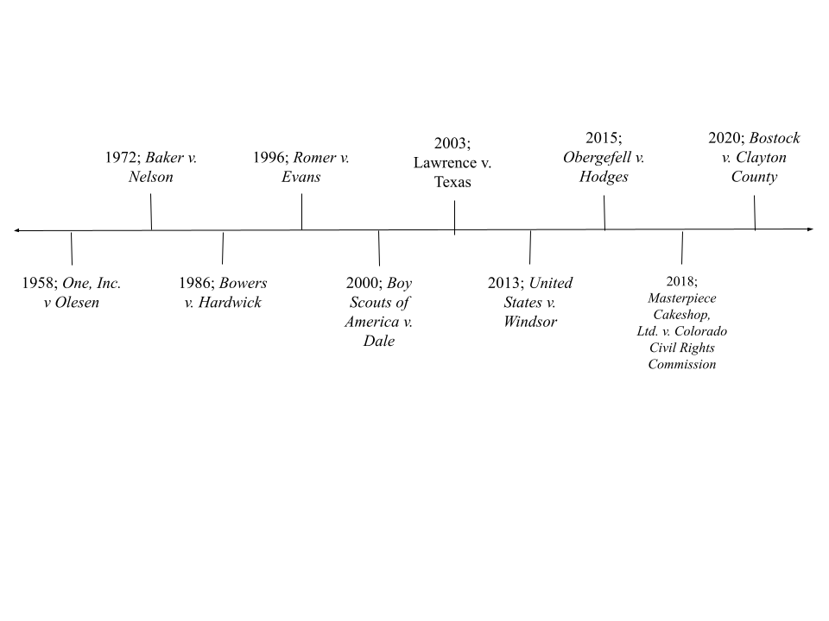
Findings: Chart 1

Slide 8
Questions?

