Slide 1
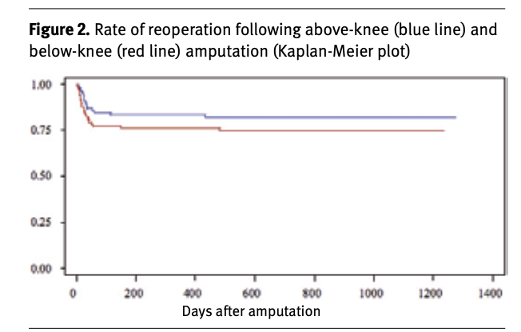
Effects of an Exercise Regimen on Amputation Rates in Adults with Uncontrolled Diabetes
Mike Coleman, MMS (c)
Faculty Advisor: Dr. Kevin Basile, MD
Department of Medical Science
Abstract
Methods
Discussion
Diabetes is a disease that affects a multitude of people across the world, and with a large variety of complications that results from uncontrolled glucose levels, including amputations. This study was done to assess the likelihood of reducing re-amputations rates with a prescribed exercise regimen. Studies that indirectly addressed the topic found, but no direct study on ambulation rates in regards to amputations were able to be located. What was found was several studies finding that re-amputations rates were most often due to infection of the initial amputation, or the surgeons had amputated at the wrong location, and not progression of the Peripheral Vascular Disease, as the premise of the question surmised.
A literature search was completed through Google Scholar and PubMed in 2019. Seven articles were selected based on their relevance to the research question, study design, outcome measurements, and results to be analyzed, with additional articles used as background information. A criteria of free text articles was added in order to be able to fully assess the articles and be able to accurately compare the studies, and assess any and all shortcomings with them.
Additional literature searches were conducted in early 2020, with no additional literature ultimately being selected.
Exclusion criteria were based on relevance to PICO question
Articles directly discussing whether an exercise regimen would help to decrease amputation rates were unable to be found. The articles found that ambulation in amputees was decreased, and majority of patients were unhappy with their levels of physical activity. It was also found that patients with diabetes and patients without diabetes had differing levels of amputations and mortality. However, the rates of amputation and mortality decreased significantly one-year post amputation, with many of the researchers suggesting a majority of re-amputations are due to surgical complications and incorrect surgical location, as opposed to progression of the disease.
This ultimately suggests that the premise behind this PICO question is wrong, that preventing re-amputations would instead require additional research into amputation site selection, as well as how to take better care of surgical sites in the healing deficient, as re-amputation rates were relatively similar even in different countries and regions.
Introduction
Some of the complications from uncontrolled diabetes can cause secondary and tertiary comorbidities, including amputations. Some patients with diabetes will have only one amputation in their lifetime, but others may have to undergo additional amputations on the same limb. This is done to contain the spread of the peripheral vascular disease that can result from uncontrolled diabetes. One of the most important questions for care of these patients, is how do we prevent further complications in these patients and prevent the need for additional amputations?
Conclusion
Direct evidence that an exercise regimen would decrease mortality and re-amputations rates in patients with diabetes was ultimately unable to be found, but there was indirect evidence that a potential benefit may exist for a small number of patients. However, multiple studies have suggested that the decrease in re-amputations rates at 1 year indicate that it is not disease progression but rather wound infection and incorrect surgical sites that leads to re-amputations.
With this in mind, it is unlikely that an exercise regimen would significantly decrease re-amputations rate, as the underlying premise of this PICO question was that the re-amputations occurred due to progression of the disease that caused the initial amputation. As suggested above, this is likely not the main cause, and therefore an exercise regimen is unlikely to have much of an effect.
.
Reference: 8
Results
Studies from different regions of the world were found and analyzed, and while the exact percentage of patients with diabetes vs patients without diabetes mortality rates and re-amputation rates differed, every study found that patients with diabetes suffered from high rates of mortality and re-amputations.
One of the most interesting things was that re-amputation rates began to decrease over time, with most of the re-amputations happening before the 1 year post amputation timeframe. This seems to be independent of the country and any cultural differences.

Slide 2
Effects of an Exercise Regimen on Amputation Rates in Adults with Uncontrolled Diabetes
Mike Coleman, MMS (c)
Faculty Advisor: Dr. Kevin Basile, MD
Department of Medical Science
References
What is Diabetes? National Institute of Diabetes and Digestive and Kidney Diseases. https://www.niddk.nih.gov/health-information/diabetes/overview/what-is-diabetes. Published December 1, 2016. Accessed April 7, 2020.
Wurdeman SR, Stevens PM, Campbell JH. MobilitJournaly Analysis of AmpuTees II. American of Physical Medicine & Rehabilitation. 2018;97(11):782-788. doi:10.1097/phm.0000000000000967.
Limb Loss Statistics. Amputee Coalition. https://www.amputee-coalition.org/limb-loss-resource-center/resources-filtered/resources-by-topic/limb-loss-statistics/limb-loss-statistics/. Accessed April 5, 2020.
New CDC report: More than 100 million Americans have diabetes or prediabetes. Centers for Disease Control and Prevention. https://www.cdc.gov/media/releases/2017/p0718-diabetes-report.html. Published July 18, 2017. Accessed April 5, 2020.
Geiss LS, Li Y, Hora I, Albright A, Rolka D, Gregg EW. Resurgence of Diabetes-Related Nontraumatic Lower-Extremity Amputation in the Young and Middle-Aged Adult U.S. Population. Diabetes Care. 2018;42(1):50-54. doi:10.2337/dc18-1380.
Asano RY. Acute effects of physical exercise in type 2 diabetes: A review. World Journal of Diabetes. 2014;5(5):659. doi:10.4239/wjd.v5.i5.659.
Paxton RJ, Murray AM, Stevens-Lapsley JE, Sherk KA, Christiansen CL. Physical activity, ambulation, and comorbidities in people with diabetes and lower-limb amputation. Journal of Rehabilitation Research and Development. 2016;53(6):1069-1078. doi:10.1682/jrrd.2015.08.0161.
Rosen N, Gigi R, Haim A, Salai M, Chechik O. Mortality and Reoperations following Lower Limb Amputations. IMAJ 2014; 16: 83-7.
Norvell DC, Turner AP, Williams RM, Hakimi KN, Czerniecki JM. Defining successful mobility after lower extremity amputation for complications of peripheral vascular disease and diabetes. Journal of Vascular Surgery. 2011;54(2):412-419. doi:10.1016/j.jvs.2011.01.046.
Dillingham TR, Pezzin LE, Shore AD. Reamputation, mortality, and health care costs among persons with dysvascular lower-limb amputations. Arch Phys Med Rehabil 2005; 86 (3): 480-6.
Johannesson A, Larsson GU, Ramstrand N, Turkiewicz A, Wirehn AB, Atroshi I. Incidence of lower-limb amputations in the diabetic and nondiabetic general population: A 10-year population-based cohort study of initial unilateral and contralateral amputations and reamputations. Diabetes Care 2009; 32 (2): 275-80.
Matos M, Mendes R, Silva AB, Sousa N. Physical activity and exercise on diabetic foot related outcomes: A systematic review. Diabetes Research and Clinical Practice. 2018;139:81-90. doi:10.1016/j.diabres.2018.02.020.
Izumi, Y., Satterfield, K., Lee, S., Harkless, L. B., & Lavery, L. A. (2009). Mortality of first-time amputees in diabetics: A 10-year observation. Diabetes Research and Clinical Practice, 83(1), 126-131. https://doi.org/10.1016/j.diabres.2008.09.005.
Izumi Y, Satterfield K, Lee S, Harkless LB, Lavery LA. Mortality of first-time amputees in diabetics: A 10-year observation. Diabetes Research and Clinical Practice. 2009;83(1):126-131. doi:10.1016/j.diabres.2008.09.005.
Papadakis MA, McPhee SJ. Current Medical Diagnosis and Treatment. McGraw-Hill Education / Medical; 2020.
Olson R, Pierce katrina, Troiano R, et al. Physical Activity Guidelines for Americans 2nd Edition.; 2018. https://health.gov/paguidelines/second-edition/pdf/Physical_Activity_Guidelines_2nd_edition.pdf. Accessed October 2019.

