Slide 1
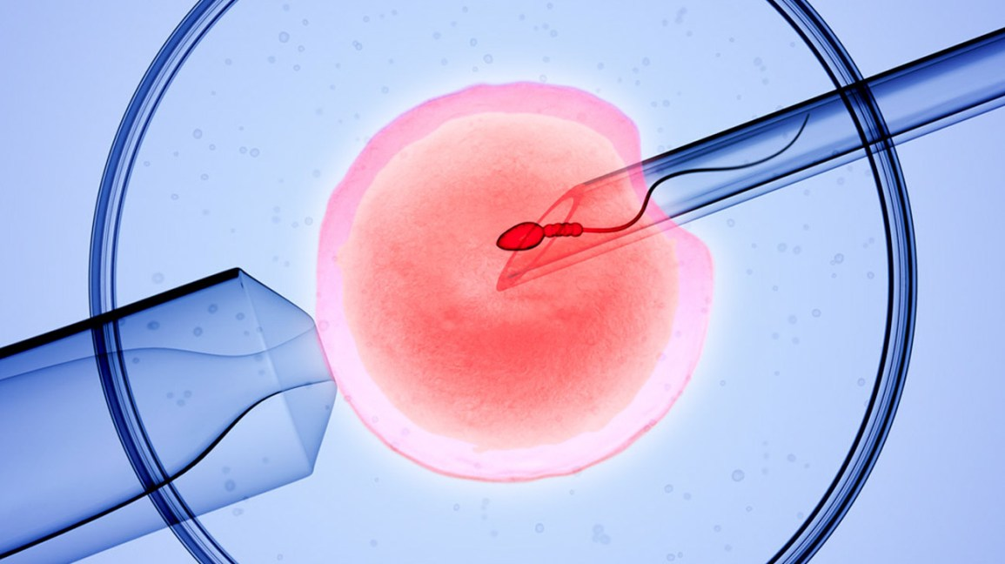
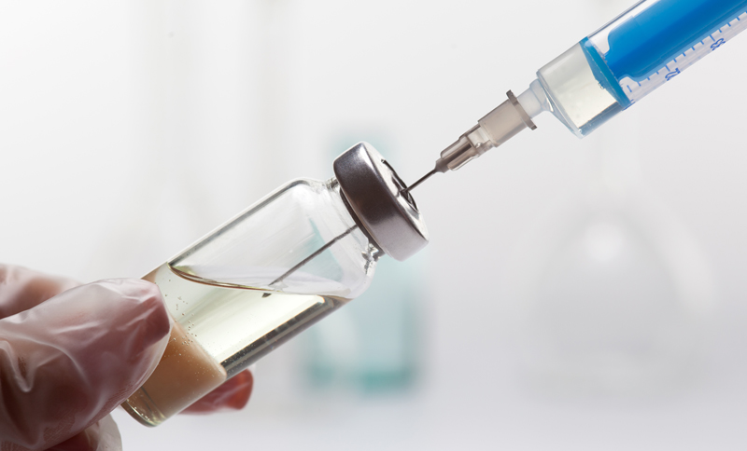
The Efficacy of In Vitro Fertilization in Treating Infertility due to Anovulatory PCOS in Comparison to Ovulation Induction via Letrozole
Amanda Salay, MMS (c)
Faculty Advisor: Jodi Freeman, MMS, PA-C
Department of Medical Science
Abstract
Results
Discussion
Polycystic Ovarian Syndrome (PCOS) is an endocrine disorder found in women of reproductive age that often causes infertility. The first-line treatment for infertility in anovulatory PCOS patients is ovulation induction. In vitro fertilization (IVF) is a third line treatment often used as a last resort. PCOS patients have higher failure risks of first and second-line medications. Therefore, this review analyzes if adverse pregnancy outcomes (O) are reduced more with IVF (I) versus using letrozole for ovulation induction (C) in women aged 20-30 struggling with infertility due to anovulatory PCOS (P).
Amer et. al., 2017:
RCT examining efficacy of LE vs CC for ovulation induction. Found LE has higher success rates of pregnancy than CC.
2. D’Angelo et al., 2011:
Retrospective survey on the effects of ART, ovulation stimulation, and no treatment on birth outcomes. Maternal age is very different between groups. Need more data on younger women undergoing ART to effectively compare to ovulation induction.
3. Klonoff-Cohen et. al., 2004:
Prospective cross-sectional study (CST) on the effects of male and female age on pregnancy outcomes of IVF. Found that increased maternal and paternal age decreases pregnancy rates and increases adverse outcomes.
4. Shevell et. al., 2005:
Prospective CST comparing adverse pregnancy outcomes in ovulation stimulation vs IVF. There were unbalanced groups with less subjects in the more invasive procedures. More adverse events occurred in IVF group.
5. Yan et. al., 2012:
Retrospective observational study evaluating maternal age effect on IVF outcomes. They found lower clinical pregnancy rates and higher miscarriage rates with increasing age.
There is strong evidence that LE is superior to CC for ovulation induction in women with PCOS. IVF has comparable outcome measurements to medication but has increased risks associated with the procedure. There is a deficit in the literature directly comparing IVF and ovulation induction. There is also a lack of studies featuring women <30 years old in IVF trials.
Strengths:
RCT studies have more detailed information
Adequate sample sizes
Study duration
Weaknesses:
Surveys and observational studies are less detailed
Most of the IVF groups had average age >30 years
Lack of detail on the causes of infertility
Inconsistent blinding techniques
Large age differences between groups of subjects
Future Research:
Complete trials of IVF in women <30
Compare outcomes of IVF vs ovulation induction in groups with an equal average age
Complete studies specifically on PCOS and infertility
Introduction
Polycystic Ovarian Syndrome (PCOS)
Overview:
Endocrine disorder in women of reproductive age associated with anovulation, hyperandrogenism, and polycystic ovaries
Common cause of infertility and pregnancy complications
Associated with insulin resistance, T2DM, obesity, CV disease
Increased risk for endometrial cancer due to longer periods of elevated estrogen levels
Current Treatments:
First line: ovulation induction via Clomiphene Citrate (CC)
Overwhelming evidence Letrozole (LE) is superior to CC
Second Line: exogenous gonadotropins or laparoscopic ovarian drilling
Third Line: assisted reproductive techniques (ART) including in-vitro fertilization (IVF)
Table 1. Summary of Results
Summary of Results
Study | Clinical Pregnancy Rate |  | Spontaneous Abortion Rate/Infant Death |  | Live Birth Rate | Birth Defects | Birth Weight
Amer et. al., 2017 | S |  | NS |  | NS | NA | NA
D’Angelo et. al. 2011 | NA |  | S |  | NA | NA | S
Klonoff et. al., 2004 | S |  | NS |  | NS | NA* | NA
Liu et. al., 2017 | NS |  | NS |  | S | NA* | NA
Shevell et. al., 2005 | NA |  | NS |  | NA | S | S
Trenkic et. al., 2016 | NS |  | NS |  | NA | NA | NA
Yan et. al., 2012 | S |  | S |  | NA | NA | NS
Conclusion
There is sufficient evidence showing how LE is superior to CC which could decrease the time and hormonal interventions needed for women with PCOS to become pregnant. However, the research lacks information on IVF outcomes for younger women with PCOS. Studies often do not separate reasons for infertility nor tell the reader what treatments the subjects have tried.
What is needed for the future:
Studies on individualizing treatments for infertility according to their underlying diagnosis
Studies on younger women undergoing IVF and comparing these results to the different lines of treatment offered
More studies on women with PCOS that focus on women with BMI <30
These recommendations can help women with PCOS get better care and have an easier time becoming pregnant.
Methods
Literature Search:
Performed in November 2019 using: Pubmed, EBSCOhost
Search Terms:
“Letrozole AND infertility”
“IVF AND miscarriage”
Inclusion Criteria: Humans, full text, clinical trials, published in the past 5 years, female subjects aged 19-44, English
Exclusion Criteria: Unrelated disorders impacting infertility, less than 30 subjects, meta-analyses/systematic reviews, non-randomized clinical trials, regularly ovulatory females
Key: S: Significant, NS: Not Significant, NA: Not Applicable, *: none detected so cannot compare
https://newhopedubai.ae/ivf-icsi/
https://rhrmedicare.co.in/

Slide 2
References
1. Garg D, Tal R. Inositol Treatment and ART Outcomes in Women with PCOS. Int J Endocrinol. 2016;2016. doi:10.1155/2016/1979654. Accessed April 5, 2020.
2 .Lauritsen MP, Bentzen JG, Pinborg A, et al. The prevalence of polycystic ovary syndrome in a normal population according to the Rotterdam criteria versus revised criteria including anti-Müllerian hormone. Hum Reprod. 2014;29(4):791-801. doi:10.1093/humrep/det469. Accessed April 5, 2020.
3. Reyes-Muñoz E, Sathyapalan T, Rossetti P, et al. Polycystic Ovary Syndrome: Implication for Drug Metabolism on Assisted Reproductive Techniques—A Literature Review. Adv Ther. 2018;35(11):1805-1815. doi:10.1007/s12325-018-0810-1. Accessed April 5, 2020.
4. Azziz R, Woods KS, Reyna R, Key TJ, Knochenhauer ES, Yildiz BO. The Prevalence and Features of the Polycystic Ovary Syndrome in an Unselected Population. The Journal of Clinical Endocrinology & Metabolism. 2004;89(6):2745-2749. doi:10.1210/jc.2003-032046. Accessed April 5, 2020.
5. Melo AS, Ferriani RA, Navarro PA. Treatment of infertility in women with polycystic ovary syndrome: approach to clinical practice. Clinics (Sao Paulo). 2015;70(11):765-769. doi:10.6061/clinics/2015(11)09. Accessed April 5, 2020.
6. Kousta E, White DM, Cela E, McCarthy MI, Franks S. The prevalence of polycystic ovaries in women with infertility. Hum Reprod. 1999;14(11):2720-2723. doi:10.1093/humrep/14.11.2720. Accessed April 5, 2020.
7. Akinoso-Imran AQ, Adetunji H. Systematic review and meta-analysis of letrozole and clomiphene citrate in polycystic ovary syndrome. Middle East Fertility Society Journal. 2018;23(3):163-170. doi:10.1016/j.mefs.2018.03.008. Accessed April 5, 2020.
8. Hu S, Yu Q, Wang Y, Wang M, Xia W, Zhu C. Letrozole versus clomiphene citrate in polycystic ovary syndrome: a meta-analysis of randomized controlled trials. Archives of Gynecology and Obstetrics. 2018;297(5):1081-1088. doi:10.1007/s00404-018-4688-6. Accessed April 5, 2020.
9. Lebbi I, Ben Temime R, Fadhlaoui A, Feki A. Ovarian Drilling in PCOS: Is it Really Useful? Front Surg. 2015;2. doi:10.3389/fsurg.2015.00030. Accessed April 5, 2020.
10. Roque M, Tostes ACI, Valle M, Sampaio M, Geber S. Letrozole versus clomiphene citrate in polycystic ovary syndrome: systematic review and meta-analysis. Gynecological Endocrinology. 2015;31(12):917-921. doi:10.3109/09513590.2015.1096337. Accessed April 5, 2020.
11. Franik S, Eltrop SM, Kremer JA, Kiesel L, Farquhar C. Aromatase inhibitors (letrozole) for subfertile women with polycystic ovary syndrome. Cochrane Database Syst Rev. 2018;2018(5). doi:10.1002/14651858.CD010287.pub3. Accessed April 5, 2020.
12. Ghanem ME, Elboghdady LA, Hassan M, et al. Clomiphene Citrate co-treatment with low dose urinary FSH versus urinary FSH for clomiphene resistant PCOS: randomized controlled trial. J Assist Reprod Genet. 2013;30(11):1477-1485. doi:10.1007/s10815-013-0090-2. Accessed April 5, 2020.
13. Amer S a. K, Li TC, Ledger WL. Ovulation induction using laparoscopic ovarian drilling in women with polycystic ovarian syndrome: predictors of success. Hum Reprod. 2004;19(8):1719-1724. doi:10.1093/humrep/deh343. Accessed April 5, 2020.
14. Amer SA, Smith J, Mahran A, FoxP, Fakis A. Double-blind randomized controlled trial of letrozole versus clomiphene citrate in subfertile women with polycystic ovarian syndrome. Hum Reprod. 2017;32(8):1631-1638. doi:10.1093/humrep/dex227. Accessed October 30, 2019.
15. D’Angelo DV, Whitehead N, Helms K, Barfield W, Ahluwalia IB. Birth outcomes of intended pregnancies among women who used assisted reproductive technology, ovulation stimulation, or no treatment. Fertility and Sterility. 2011;96(2):314-320.e2. doi:10.1016/j.fertnstert.2011.05.073. Accessed January 7, 2020.

Slide 3
References
16. Klonoff-Cohen HS, Natarajan L. The effect of advancing paternal age on pregnancy and live birth rates in couples undergoing in vitro fertilization or gamete intrafallopian transfer. American Journal of Obstetrics and Gynecology. 2004;191(2):507-514. doi:10.1016/j.ajog.2004.01.035. Accessed January 9, 2020.
17. Liu C, Feng G, Huang W, et al. Comparison of clomiphene citrate and letrozole for ovulation induction in women with polycystic ovary syndrome: a prospective randomized trial. Gynecological Endocrinology. 2017;33(11):872-876. doi:10.1080/09513590.2017.1332174. Accessed October 30, 2019.
18. Shevell T, Malone FD, Vidaver J, et al. Assisted Reproductive Technology and Pregnancy Outcome. Obstetrics & Gynecology. 2005;106(5):1039. doi:10.1097/01.AOG.0000183593.24583.7c. Accessed January 7, 2020.
19. Trenkić M, Popović J, Kopitović V, Bjelica A, Živadinović R, Pop-Trajković S. Flexible GnRH antagonist protocol vs. long GnRH agonist protocol in patients with polycystic ovary syndrome treated for IVF: comparison of clinical outcome and embryo quality. Ginekologia Polska. 2016;87(4):265-270. doi:10.17772/gp/62205. Accessed November 13, 2019.
20. Yan J, Wu K, Tang R, Ding L, Chen Z-J. Effect of maternal age on the outcomes of in vitro fertilization and embryo transfer (IVF-ET). Science China Life Sciences. 2012;55(8):694-698. doi:10.1007/s11427-012-4357-0. Accessed January 9, 2020.

