Slide 1
Zoning Policy Reform in the U.S.: the West Versus the Rest
By: Eve Plotka

Slide 2
Introduction
Research Question:
Why are zoning policies on the West coast so different than the rest of the United States?
Significance:
Zoning policies on the West coast are very different than the rest of the US, when theoretically, zoning policies should be very similar
The zoning policies in an area have direct effects on the people living in the regions, which is why they are important
Thesis: Starting with the creation of National Parks, there have been several policy related and social structured points that have resulted in the West coast reforming more on their zoning policies than the rest of the United States.

Slide 3
Analytic
Framework
Literature Review:
What makes a reformed zoning policy? Draws the line between recent and reformed.
Effectiveness is outside the range of this project.
Environmentally Reformed | -Sustainability goals -New political issues (climate change) | - Evolving local environments
Economically Reformed | - National economy (GDP) | -Consider the housing market
Reformed to address Discrimination | -Break up pre-existing segregation by race or class | -Promote affordable housing and diversity

Slide 4
Method
Process Tracing:
Time points to map out the progression of an issue
Used when there is little to no existing theory
Can be used to develop theory
Two types:
Detailed narrative- qualitative
Analytic explanation- quantitative
My Method:
Detailed narrative- path convergence between zoning policies on the west coast and the rest of U.S.

Slide 5
My Findings
Creation of National Parks
Village of Euclid v. Ambler Realty Co.
Civil Rights Act of 1964
t1
t2
t3
t5
Current Policymakers
National Historic Preservation Act of 1966
Zoning Policies Today
t4
Advocacy Groups
t6
West Coast
Rest of U.S.

Slide 6
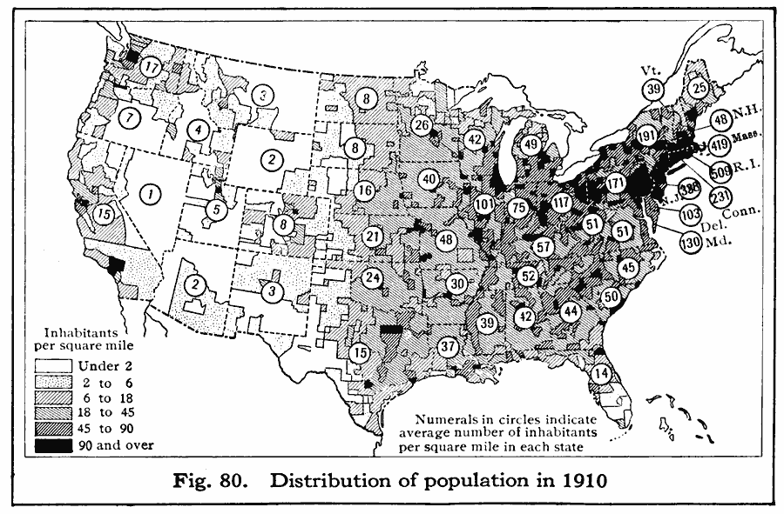
Findings
National Parks:
Environmental: west coast has more national parks, which makes it easier to meet environmental quotas set by zoning policies

Slide 7
Findings
2. Euclid v. Ambler
Discrimination and economy: set precedent allowing for gentrification
Euclid wanted to conserve quaintness of the village
Ambler was concerned with industrializing the region and making more housing
3. Civil Rights
Discrimination: desegregation was more difficult in the east and south
West coast adjusted to desegregation and neighborhoods were already less segregated

Slide 8
Findings
4. Historic Preservation
less historical sites on west coast
East coast had more historical sites and less room to build affordable housing
5. Policymakers
Unity vs disunity
Sen. Scott Wiener California and Gov. Kate Brown Oregon
6. Advocacy groups
Advocacy groups that focus on zoning reform exist on the west coast
Bay Area Renters’ Federation (BARF)- helped write SB 50

Slide 9
Thanks!
Any questions?

Slide 10
Works Cited
“About the Foundation.” National Park Foundation, March 17, 2020. https://www.nationalparks.org/about-foundation.
Andrew H. Whittemore (2017) Racial and Class Bias in Zoning: Rezonings Involving Heavy Commercial and Industrial Land Use in Durham (NC), 1945–2014, Journal of the American Planning Association, 83:3, 235-248, DOI: 10.1080/01944363.2017.1320949 https://doi-org.arcadia.idm.oclc.org/10.1080/01944363.2017.1320949
Batchis, Wayne. 2010. “Enabling Urban Sprawl: Revisiting the Supreme Court’s Seminal Zoning Decision Euclid V. Ambler in the 21St Century.” Virginia Journal of Social Policy & the Law 17 (3): 373–403. http://search.ebscohost.com.arcadia.idm.oclc.org/login.aspx?direct=true&db=asn&AN=52596209&site=ehost-live.
Caroline Nagel, Josh Inwood, Derek Alderman, Ujju Aggarwal, Claire Bolton, Steve Holloway, Richard Wright, Mark Ellis, Priscilla McCutcheon, Katherine Hankins, Andy Walter, Kate Derickson, The legacies of the U.S. Civil Rights Act, fifty years on, Political Geography, Volume 48, 2015, Pages 159-168, ISSN 0962-6298,https://doi.org/10.1016/j.polgeo.2015.06.004. (http://www.sciencedirect.com/science/article/pii/S0962629815000463)
Chang-Tai Hsieh & Enrico Moretti, 2019. "Housing Constraints and Spatial Misallocation," American Economic Journal: Macroeconomics, vol 11(2), pages 1-39.
Dillon, Liam. “California Could Bring Radical Change to Single-Family-Home Neighborhoods.” California could bring radical change to single-family-home neighborhoods. The Los Angeles Times, May 13, 2019. https://www.latimes.com/politics/la-pol-ca-single-family-zoning-changes-senate-bill-50-legislation-20190513-story.html.

Slide 11
Dougherty, Conor. Golden Gates Fighting for Housing in America. New York: Penguin Press, 2020.
Dyble, Louise Nelson. “Review Essay: The Continuing Saga of Zoning in America: Michael Allan Wolf, The Zoning of America: Euclid v. Ambler. Lawrence, KS: University Press of Kansas, 2008. David M. P. Freund, Colored Property: State Policy and White Racial Politics in Suburban America. Chicago: University of Chicago Press, 2007. Jonathan Levine, Zoned Out: Regulation, Markets and Choices in Transportation and Metropolitan Land Use. Washington, D.C.: Resources for the Future, 2007.” Journal of Planning History 9, no. 2 (May 2010): 140–46. doi:10.1177/1538513210371446. https://doi-org.arcadia.idm.oclc.org/10.1177%2F1538513210371446
Edward J. Jepson Jr. & Anna L. Haines (2014) Zoning for Sustainability: A Review and Analysis of the Zoning Ordinances of 32 Cities in the United States, Journal of the American Planning Association, 80:3, 239-252, DOI: 10.1080/01944363.2014.981200 https://doi-org.arcadia.idm.oclc.org/10.1080/01944363.2014.981200
“Federal Historic Preservation Laws, Regulations, and Orders.” National Parks Service. U.S. Department of the Interior, October 28, 2019. https://www.nps.gov/subjects/historicpreservation/laws.htm.
Florida Center for Instructional Technology. Educational Technology Clearinghouse, n.d. https://etc.usf.edu/maps/pages/4300/4399/4399.htm.
Gelinas, Nicole, Jason L. Riley, Rafael A. Mangual, Connor Harris, and Alex Armlovich. “Lone Star Slowdown?” Manhattan Institute, December 13, 2018. https://www.manhattan-institute.org/lone-star-slowdown-texas-housing.
Hamilton, Marci A. "EUCLID V. AMBLER REALTY, 272 US 365 (1926)."

Slide 12
“How Lawmakers Are Upending the California Lifestyle to Fight a Housing Shortage.” Los Angeles Times. Los Angeles Times, October 10, 2019. https://www.latimes.com/california/story/2019-10-10/california-single-family-zoning-casitas-granny-flats-adus.
Hughes, L. Keith. "Use of Zoning Restrictions to Restrain Property Owners from Altering or Destroying Historic Landmarks." Duke Law Journal 1975, no. 4 (1975): 999-1019. doi:10.2307/1372090.
Kahlenberg, Richard D., Richard D. Kahlenberg, Richard D. Kahlenberg, Conor P. Williams, Robert Shireman, Jamila Taylor, Simon Greer, and Richard D. Kahlenberg. “How Minneapolis Ended Single-Family Zoning.” The Century Foundation, October 24, 2019. https://tcf.org/content/report/minneapolis-ended-single-family-zoning/.
Kasakove, Sophie. “Red State Governments Ban Blue Cities From Passing Bills to Make Housing Affordable.” Pacific Standard, July 23, 2019. https://psmag.com/social-justice/red-state-governments-ban-blue-cities-from-passing-bills-to-make-housing-affordable.
Keep-Barnes, Jai. 2017. “Inclusionary Zoning as a Taking: A Critical Look at Its Ability to Provide Affordable Housing.” Urban Lawyer 49 (1): 67–107. https://arcadia.idm.oclc.org/login?url=http://search.ebscohost.com/login.aspx?direct=true&db=asn&AN=122358150&site=ehost-live
Loh, Tracy Hadden. “Here's How Much of the Washington Region Is off-Limits to Growth.” Greater Greater Washington, December 17, 2018. https://ggwash.org/view/70211/zoning-for-incremental-growth-how-is-our-region-doing.
Mills, David E. "Is Zoning a Negative-Sum Game?" Land Economics 65, no. 1 (1989): 1-12. doi:10.2307/3146258. https://www-jstor-org.arcadia.idm.oclc.org/stable/3146258

Slide 13
Naughton-Treves, Lisa. “Participatory Zoning to Balance Conservation and Development in Protected Areas.” Integrating Ecology and Poverty Reduction, February 2011, 235–51. https://doi.org/10.1007/978-1-4614-0186-5_17.
Sax, Joseph L. "Helpless Giants: The National Parks and the Regulation of Private Lands." Michigan Law Review 75, no. 2 (1976): 239-74. doi:10.2307/1287880.
Schmidt, Stephan, and Kurt Paulsen. “Is Open-Space Preservation a Form of Exclusionary Zoning?: The Evolution of Municipal Open-Space Policies in New Jersey.” Urban Affairs Review 45, no. 1 (September 2009): 92–118. doi:10.1177/1078087408331122. https://doi-org.arcadia.idm.oclc.org/10.1177%2F1078087408331122
Shlay, Anne B., and Peter H. Rossi. "Keeping up the Neighborhood: Estimating Net Effects of Zoning." American Sociological Review 46, no. 6 (1981): 703-19. http://www.jstor.org.arcadia.idm.oclc.org/stable/2095075.
Siegel, Shirley Adelson. "Relation of Planning and Zoning to Housing Policy and Law." Law and Contemporary Problems 20, no. 3 (1955): 419-35. doi:10.2307/1190477. https://www-jstor-org.arcadia.idm.oclc.org/stable/1190477
Stromberg, Brian, and Lisa Sturtevant. "What Makes Inclusionary Zoning Happen?." Washington, DC: Center for Housing Policy (2016).
Wamsley, Laurel. “Oregon Legislature Votes To Essentially Ban Single-Family Zoning.” NPR. NPR, July 1, 2019. https://www.npr.org/2019/07/01/737798440/oregon-legislature-votes-to-essentially-ban-single-family-zoning.
“Washington State to Consider Ban on Single Family Zoning.” AP NEWS. Associated Press, February 18, 2020. https://apnews.com/cb11c6d356b69413cfcd769c4dccaffc.
Wolf, Michael Allan. 2008. The Zoning of America: Euclid v. Ambler. Lawrence: University Press of Kansas.

