Slide 1
Understanding Universal Coverage:
An Overview of Universal Health Care & Studies of Real-World Implementations
Amanda Dombroski
1 May 2020

Slide 2
Significance
Dispel the confusion and misunderstandings surrounding the idea of universal health care coverage
Glean better understanding of universal health care and how the methods are best suited to the citizenry being served
Hypothesis
Universal health care coverage can be found in a variety of shapes and size, as its overarching purpose is to provide accessible, efficient, and equitable health care coverage to the population
What is universal health care coverage, how is it implemented, and what can be gleaned through analysis of real-world case studies?

Slide 3
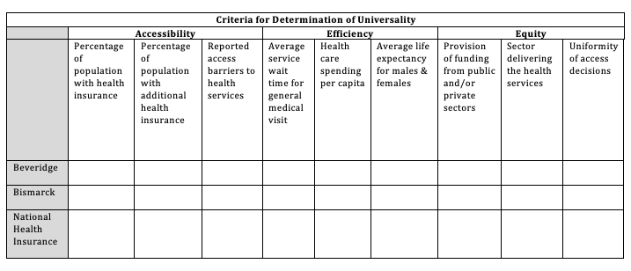
Analytic Framework

Slide 4
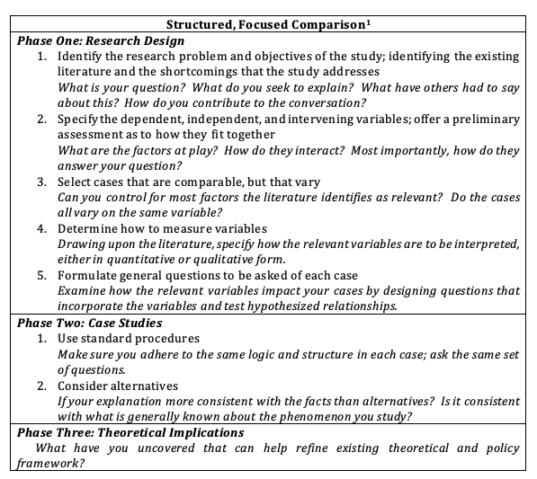
Method
Phase I
Literature review explains what universal coverage is and discusses three models identified by scholars
Evaluation of universal health care coverage models on grounds of accessibility, efficiency, and equity
Identified countries where the models were developed – UK, Germany, Canada
Contextualization of variables - accessibility, efficiency, equity
General questions of each case
Phase II
Cases studies of UK, Germany, and Canada
Analysis

Slide 5
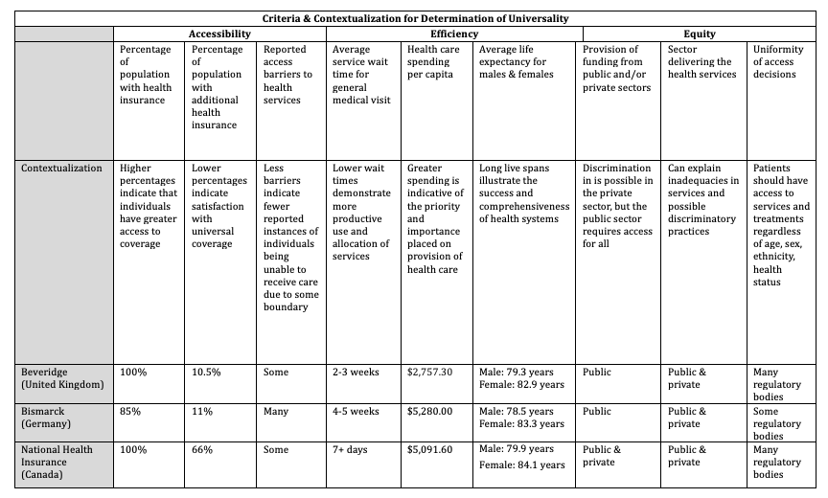
Findings

Slide 6
Conclusions & Implications
Health care systems that work in one country will not necessary work in another
Generally, citizens seem relatively pleased with their country’s universal health care coverage
Main complaint tends to be wait time
There are barriers to access in each case studied, whether they be geographic, financial, or cultural
Universality does not necessarily mean accessibility
Increased health care spending does not always correlate to overall success of the system
Universal health care does not equate to the government alone owning and regulating every aspect of health

