Slide 1
Democratization in The Post-soviet space: A case study of Georgia and Ukraine
By: Serena Anton

Slide 2
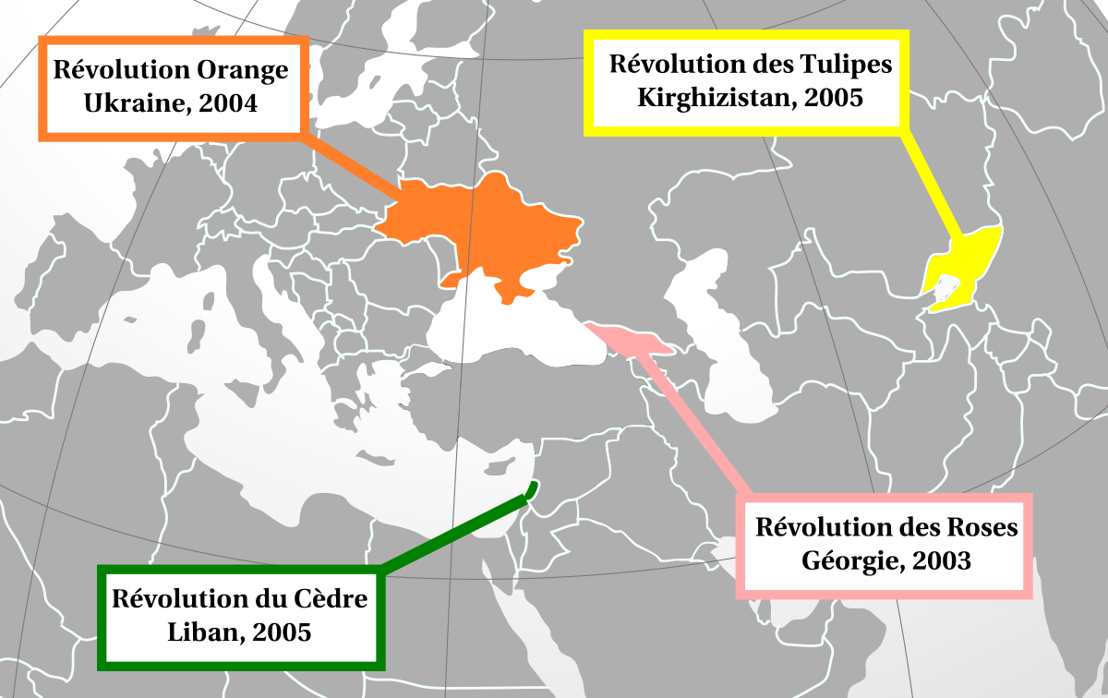
Background Information
In the early 21st century, a period of mass public protest, known as the Color Revolutions, arose across the Post-Soviet Region.
Research Question: Why are there disproportionate levels of democracy across the Post-Soviet Space?
Thesis: Overall, domestic actors, specifically elites, play a major role in a state’s democratic transition but the analytic framework fails to account for foreign military involvement. This argument can be seen in the democratic transition processes of The Republic of Georgia and Ukraine.

Slide 3
Elite Theory | Democratic Transition Theory
Definition: Power is concentrated and shared by a small group of people (the elites) and the masses do not have power (Lasswell 1950) | Definition: Democratic consolidation theory is the challenge of securing and sustaining democracies against the threat of authoritarian regression (Schedler 1998).
Variables: Formation of Government, Formation of Policy, Changing of the Mask | Variables: Civil Liberties, Political Party Prevalence, Socio-Economic Status
Indicators: Number of Newly Elected Officials vs. Number of Previous Communist Officials, Number of Protected Industries, Individuals, and power in policy-making, and the Number of new elites created during transition period vs. number of elites whom stayed strong during the transition period. | Indicators: Freedom House Ranking and Reports of Ballot Stuffing, Number of Popular Elections, Success of unbiased election conduct. Presence of Military, Process of choosing Judges, and the number of civilian led political parties Number of Welfare Programs and Success Rate of said Programs The Corruption Index and the rates of Income Inequality within the state.

Slide 4
Methodology
Structured and Focused Comparison Approach
This method allows for intensive study concerning a few number of cases which can yield important details concerning important foreign and public policy (Kachuyevski 2018).
Questions to be asked of each case:
What is the style of governance?
Are there new or old elites?
What is their freedom house score?
Is there free media?
Is there political party prevalence
What is the type of judiciary?
Are there minority rights?
Is there police brutality?
Is there corruption?
Is there poverty?

Slide 5
Variable | The Republic of Georgia | Ukraine
Style of Governance | Parliamentary Democratic Republic under a multi-party system | Unitary Republic under a semi-presidential system
New vs. Old Elites | New Elites | Old Elites
Elite Influence | Large Amount of Elite Influence | Large Amount of Elite Influence
Freedom House Score | 61 | 62
Free Press | Yes | Yes
Free and Fair Elections | Yes | Yes
Political Party Prevalence | No | Yes
Type of Judiciary | Dependent | Dependent
Minority Rights | Yes but there are issues | Yes but there are issues
Police Brutality | Yes | Yes but has gotten better
Corruption | Yes (High Corruption) | Yes
Poverty | Large Amount of Poverty | Moderate Amount of Poverty

Slide 6
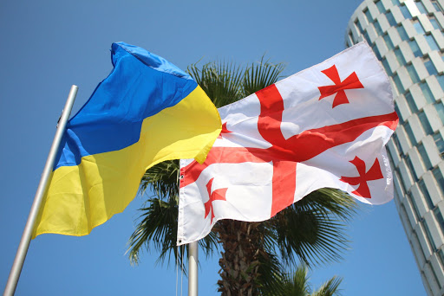
Findings
Elite theory and Democratic Consolidation theory do a great job explaining the behavior of domestic actors, particularly elites, and their role during the democratization process of The Republic of Georgia and Ukraine.
But there needs to be more research concerning Russian military intervention and its affect on democratic consolidation within Ukraine and the Republic of Georgia
Russian Forces have compromised democratization, specifically the validity of elections.

