Slide 1
Murdoch Murdoch: A Case Study of Threats to Ontological Security in Far Right Propaganda
By Julian Morein

Slide 2
Overview
This thesis will analyze how far right propaganda attempts to radicalize viewers using the ethno-nationalist web series Murdoch Murdoch (MM) as a case study
This series has been cited by groups like the SPLC as well as other visible figures within the far right as particularly powerful propaganda
By analyzing the visual and linguistic signs used in the series this thesis exams how MM targets viewer's ontological security by presenting social change as threatening to the viewer’s sense of self
Two key findings
MM frames white identity as synonymous both with national identity and familial identity
MM redefines the term “racist” to mean honest and scientific

Slide 3
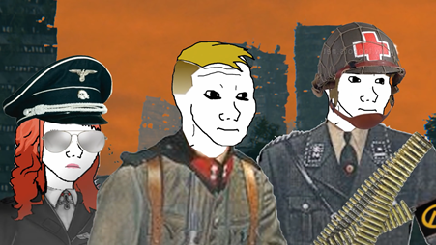
Background
MM follows three characters all named a variation of Murdoch (Murdoch, Dr. Murdoch, and Murdoch-chan)
The series employs a crude South Park style animation aimed at a Millenial/Generation Z audience
Originally appearing on Youtube the series is now hosted on it’s own website
This data set is specifically limited to a set of seven episodes called the Great Meme War that portray a protracted war narrative between Ethno-Nationalism and ZOG

Slide 4
Analytic Framework
Ontological Security
Ontology means the study of one’s sense of self
Ontological Security holds that the nation-state is the key way citizens find a sense of self and security (Lacey 2019, 98)
Nation-states have, to some extent, unique histories and socio-economic conditions that provide citizens, especially the most advantaged, a sense of normalcy and security (Id)
Citizens also see protecting citizens as the duty of the nation-state
Far right propaganda therefore seeks to challenge its audiences sense of self and therefore it’s security by presenting demographic or political changes as direct threats to security (Id)

Slide 5
Methodology: Ethnographic Critical Discourse Analysis
Method developed by Stanton Wortham and Angela Reyes.
ECDA seeks to analyze how different “signs,” either visual or textual, come together over many discursive events to presuppose what social action is occurring (Wortham and Reyes 2015, 40-41).
These signs are referred to as “indexicals” meaning any sign whose meaning is context dependant (Braun 2015)
MM’s key indexicals:
Deictics
Emblem

Slide 6
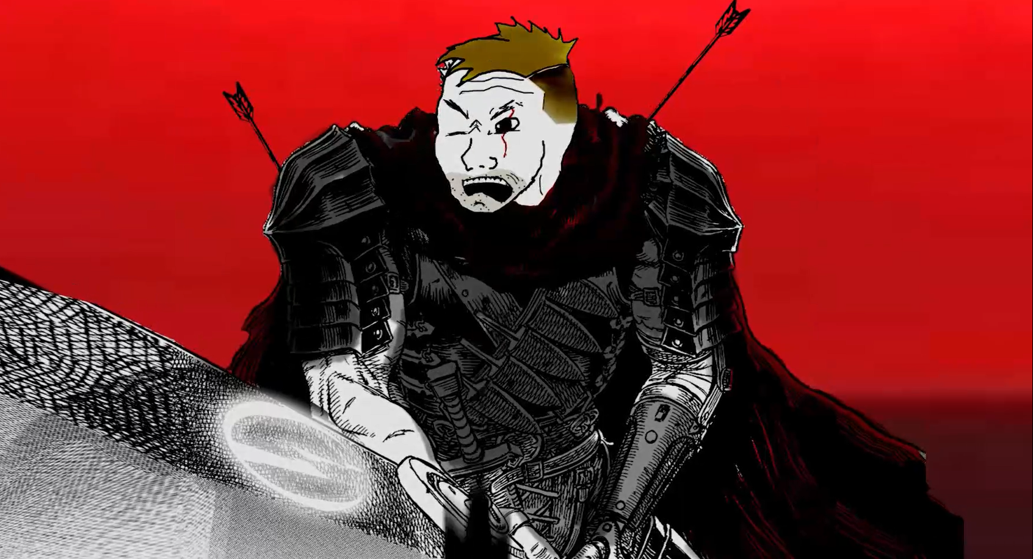
Findings: Absolute Dichotomies
MM frames politics as a binary choice between two options:
The Alt-Right
Racist
Truthful
Protect white America
ZOG
Progressive
Dishonest
Greedy
Seek to “destroy” the the white race

Slide 7
How Does MM Create This Binary Choice?
Through a combination of person, temporal, and spatial deictics MM frames the Alt-Right as protectors of America
Person
MM frames one’s race as synonymous with one’s family
Destroying one’s family in MM is akin to destroying one’s race
Familial language creates a sense of cohesion among racist characters
ZOG is a broad group that consists of anything not explicitly ethno-nationalist
Temporal
ZOG is framed as an agent of progress whereas the Alt-Right maintain the old
Spatial
Distinction made between two possible Americas

Slide 8
Familial Language

Slide 9
The Monolithic Other
Below is a data table of all groups/individuals/ideologies that are explicitly cited as part of ZOG

Slide 10
Redefining “Racist”
MM redefines “racist” to mean truthful and honest
The truthful racist is then often paired against a dishonest and greedy member of ZOG
By repeatedly presenting conflict through this dichotomy MM further enregisters the two sides as holding unequal positions. One is loyal to the truth one is loyal to money
“It’s not about book sales, it’s about the truth” - Dr. Murdoch

Slide 11
Findings: Redefining “Racist”
This data table shows key scenes in which a character identified as racist is pared directly against those in opposition

Slide 12
Conclusions and Cross Event Interpretations
By framing social and political change as destructive to white identity MM’s approach to radicalization fits into a broader pattern in far right media including:
Presenting the other as a threat to white security (Wilson 2015, 110).
Using euphemism and redefinition to create positive associations with horrific concepts (Griffin 2015, 40).
Framing themselves as agents of truth against dishonest mainstream news sources (Figenschou et al 2018, 1222; Nygaard 2019).

Slide 13
Any Questions?

