Slide 1
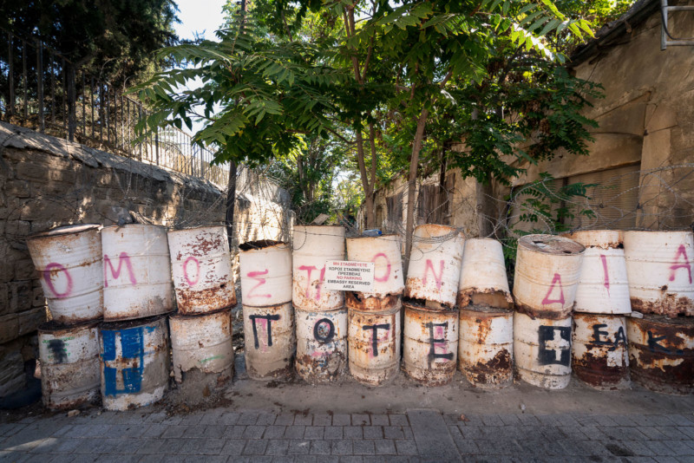
The Cyprus “Problem”
How Civil Society Has Found A Path to Peace in a Decades Old Conflict

Slide 3
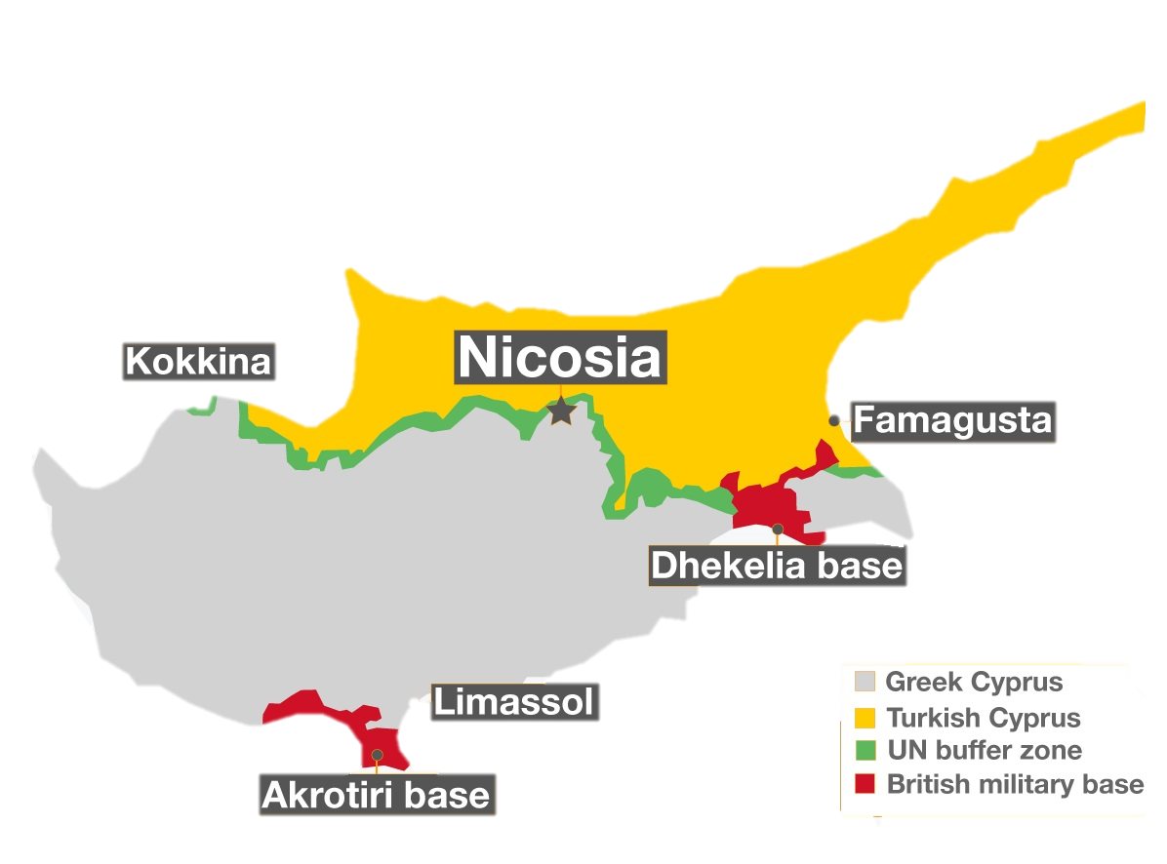
Cyprus Profile
60 mi to Syria
50 mi to Turkey
350 mi to Greece
Defining the Cyprus Problem
200 mi to Israel

Slide 4
Research Questions
What are the major forces that have shaped modern Cyprus and the development of the Cyprus problem?
What forces have in the past and continue to shape the development of Cyprus as a nation?
To what extent have new actors been introduced as solutions to the Cyprus problem?
How, why, and to what extent has Cyprus’ division been shaped by outside intervention?
To what extent does the Cyprus problem remain a “frozen conflict” today?

Slide 5
Literature Review
Peacemaking and Peacekeeping in the Cyprus Problem
Function of Civil Society Organizations in Peace Process in Cyprus
Cyprus: An unstable state, in need of a solution
Focuses on international solutions
Cyprus: A state that has found a satisfactory solution out of the status quo
“comfortable” conflict
Cyprus: Path to peace as in the way of a true solution
Distance from international frame
Notes:
Beyond success of CSOs -> CSO legitimacy as major actors in search for a solution
Taking sources and analyzing what they say for a stance on the main question of “frozen conflict”
My stance: here and section 7/8, back to thesis
International interactions in the way of a true solution that might be possible through civil society

Slide 6
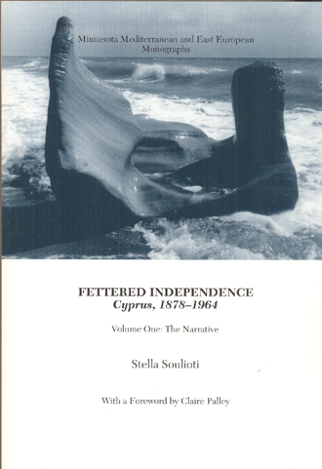
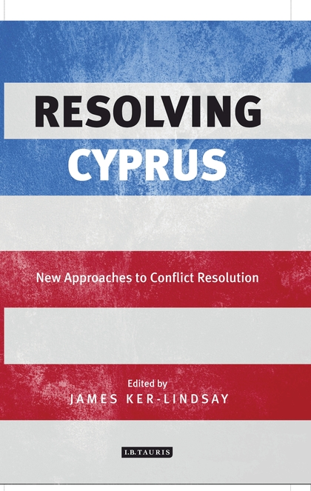
Sources
U.N. Resolutions, Reports, Declarations
Government Documents
Population Studies, Surveys
Media Releases
Opinions on the state of the Cyprus Problem
Peacemaking and Peacekeeping Theory
Civil Society

Slide 7
My Approach
The importance of
the international
actors and context
The more recent
introduction of civil
society and their
new approach

Slide 8
The Cyprus Problem: signs of thaw as it begins to separate from international context
Civil society has found solutions from their place in the conflict at a grassroots, communal level
Civil society remains blocked by a lack of legitimization by international and political establishment actors
The Cyprus problem persists due to the influence from these various outside interest groups, who, while trying to establish a peace, have become part of the persisting problem.
THESIS
Notes:
1. Topic

Slide 9
Outline
Literature Review
Introduction
Literature Review
Development of the Conflict
Context of Independence
Independence: An International Conflict
“Peace” Under UNFICYP
“Co-Exist Side by Side”: The Turkish Republic of Northern Cyprus
New Role of Civil Society
A Divided State
Changing the Game
Conclusion: The Cyprus “Problem,” or A New Peace?

Slide 10
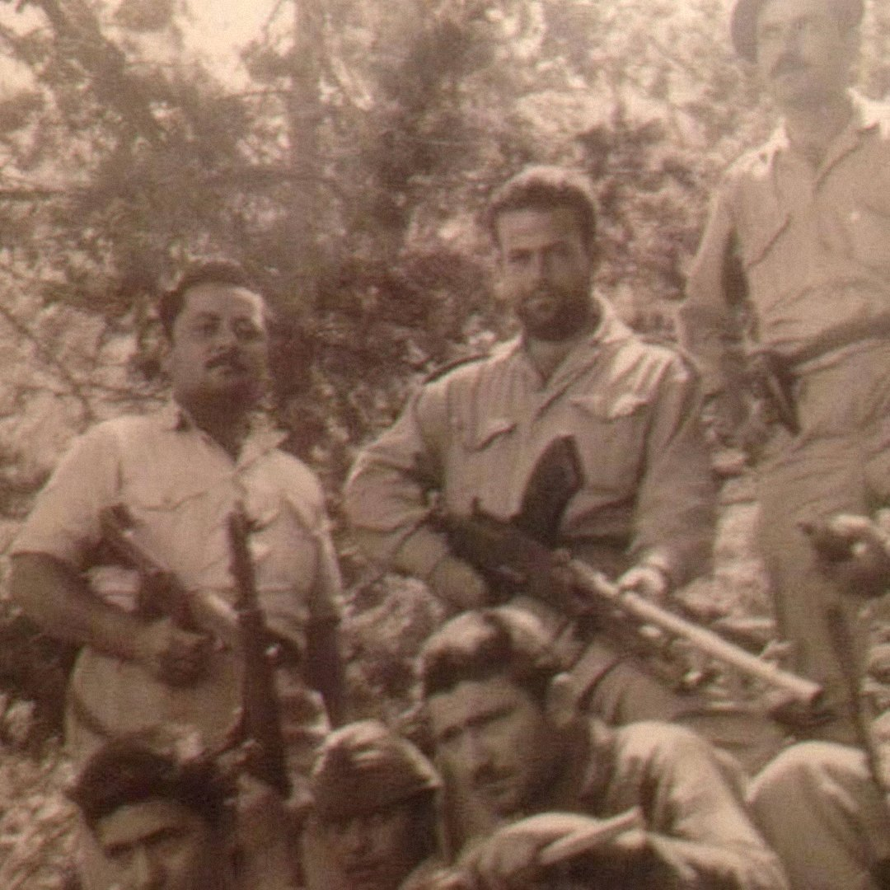
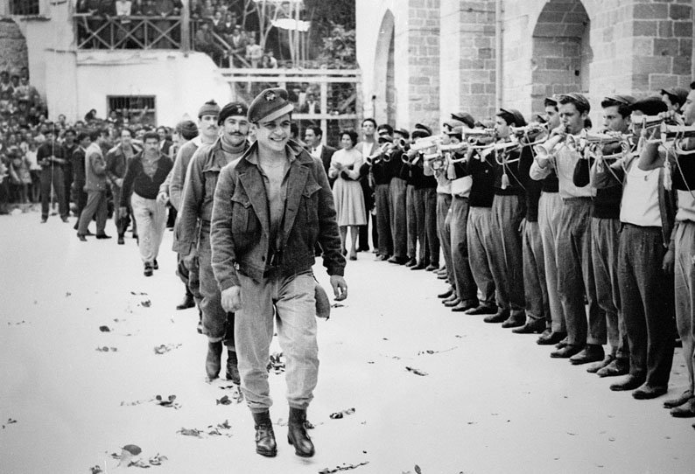
Development of the Conflict
Context of Independence
Early Colonial Rule
1955-59 Cyprus Emergency
Independence: An International Conflict
1960 independence as a compromise
1964: UNFICYP
“Peace” Under UNFICYP
1967: Greek coup
1974: Turkish invasion
Failure of Geneva
“Co-Exist Side by Side”: The Turkish Republic of Northern Cyprus
Continued failure of talks

Slide 11
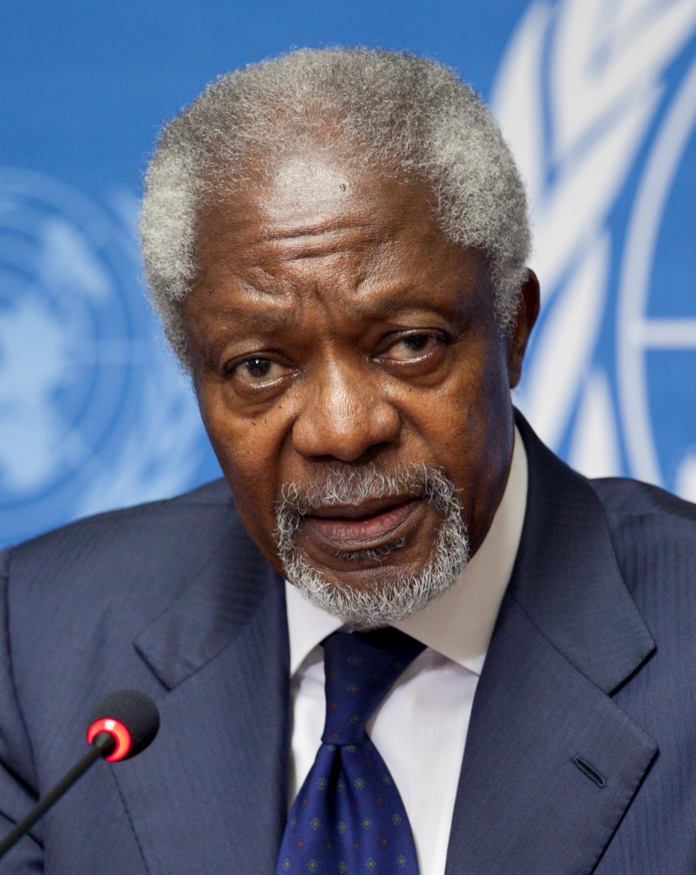
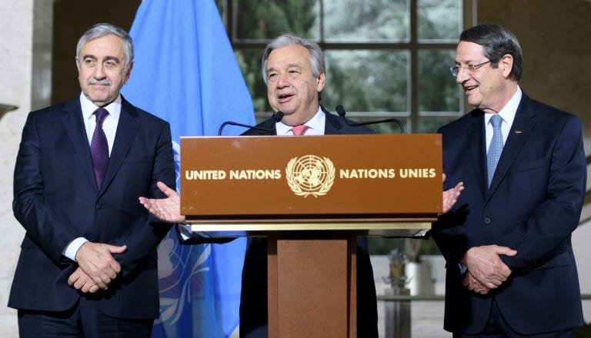
New Role of Civil Society
A Divided State
Deadlock
Issue of the EU
Annan Plan
Changing the Game
Post-referendum: Place of Civil Society
Problems Still Facing Civil Society
Conclusion: The Cyprus “Problem,” or A New Peace?
Neither side willing to move on their core beliefs/wishes
U.N. condemns lack of action but does little to follow through
International relations find its ways into the politics of the division
Current state of the island

Slide 12
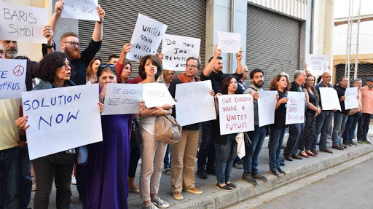
Main Conclusions
To what extent does the Cyprus problem remain a “frozen conflict” today?
Broader Lessons
Official progress: standstill
Elsewhere: ripe for change
History is still in the making
Importance of trust-building
Power of small actors

