Slide 1
Why Adolescent Athletes are More Susceptible to the Effects of Stress on Injury Vulnerability
Presented by: Shannon Ryan

Slide 2
Research Question
How are adolescents more susceptible to the stress-injury relationship in regards to the neurological effects of stress?

Slide 3
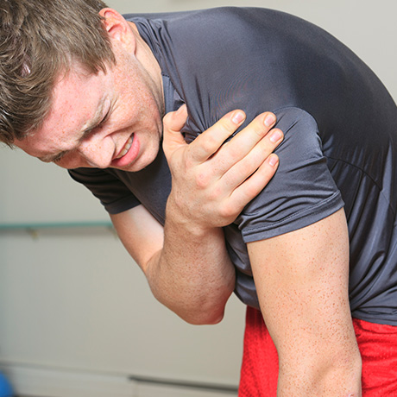
Current Controversy
Nearly 8.6 million injuries occur each year overall, with approximately 65% consisting of adolescent athletes (Sheu 2016).

Slide 4
Operational Definitions
Stress: daily hassles and cumulative life stress (Wiese-Bjornstal 2010)
Adolescent: typically b/w 10-19
Injury: a painful episode caused by trauma or overload that prevented the athlete from participating in at least one full training session or game (Frisch et al 2009)
Injury Vulnerability: likelihood of sustaining an injury

Slide 5
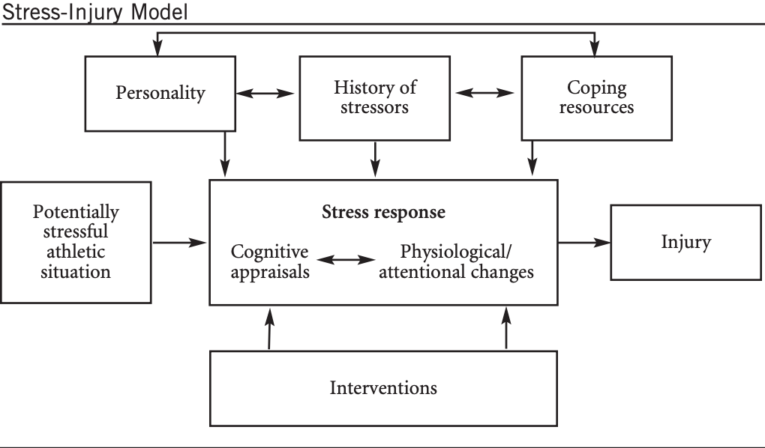
Leading Theory
Williams and Anderson 1998

Slide 6
Missing Link
Stress Response
Stress-induced Neuroanatomical Alterations
Neurobehavioral Outcomes
Injury Vulnerability

Slide 7
Importance of Adolescence
Rapid brain development and increased plasticity
Stress hormone receptors and heightened stress reactivity
Hierarchical brain development
(Tottenham and Galvan 2016)

Slide 8
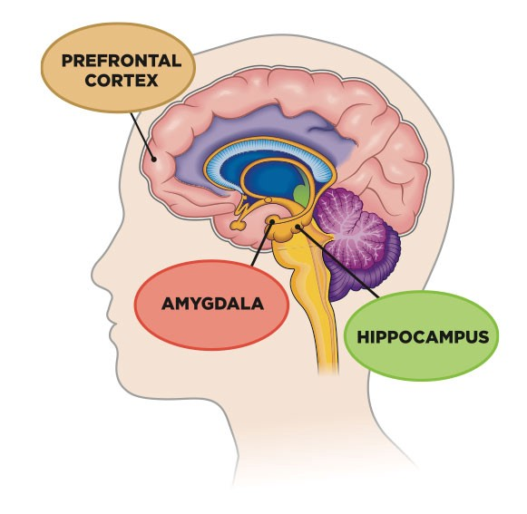
Affected Brain Regions
Amygdala: emotional stress and learning
Difficulty with affect regulation
Hippocampus: short-term learning and memory, emotional functioning, stress reactivity
Difficulty regulating emotional reactions to stressful situations
Prefrontal Cortex: executive functioning, attention set shifting, response inhibition
Difficulty shifting attention and inhibiting inappropriate motor responses

Slide 9
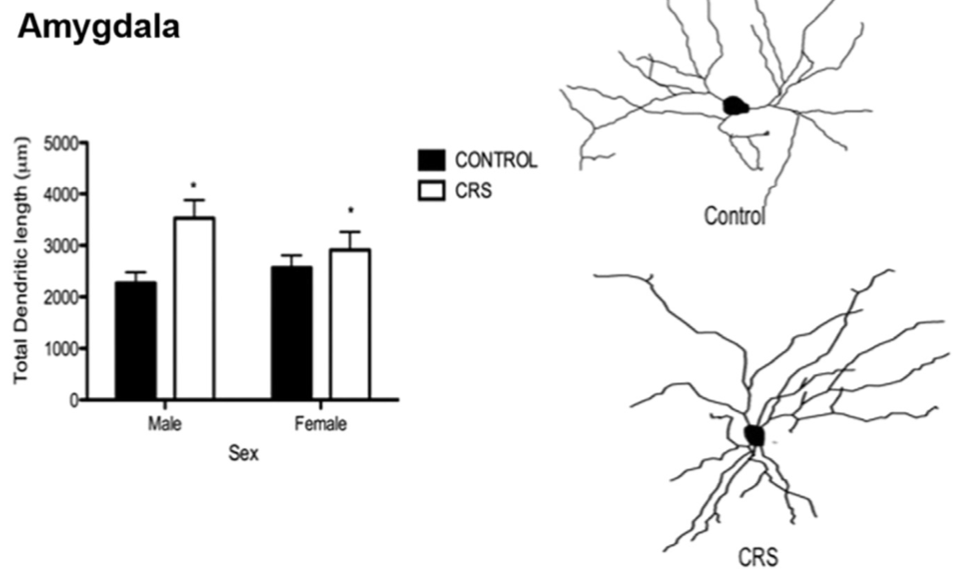
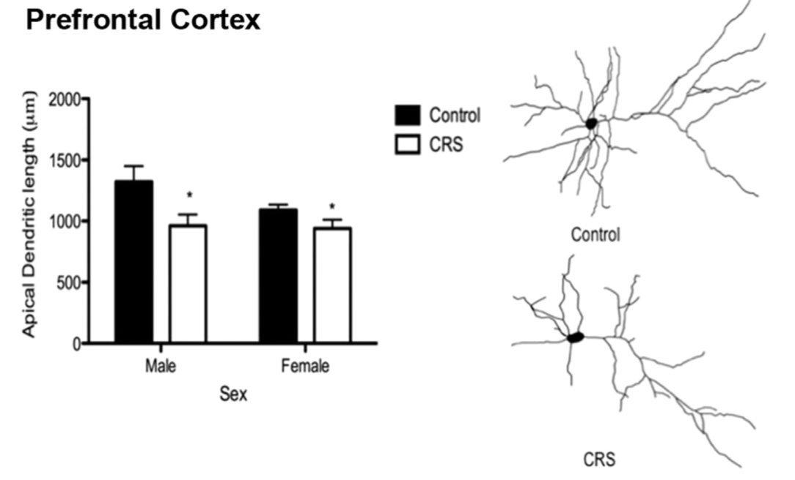
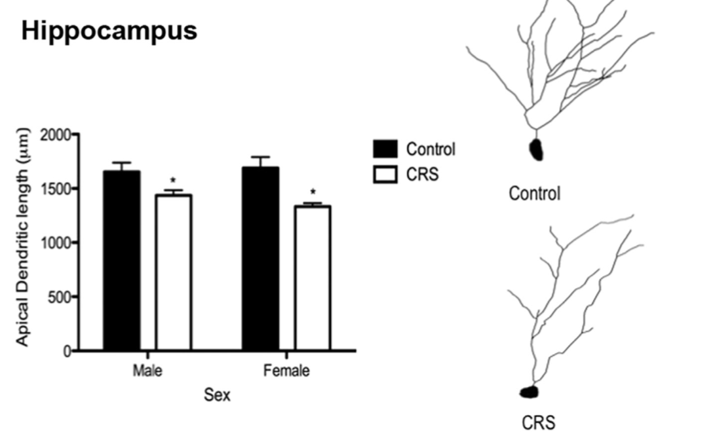
fMRI Evidence of Restructuring
Romeo 2017

Slide 10
Injury Vulnerability: Proposed Model
Stress:
Daily Hassles
Life Stress
Neuroanatomical Alterations:
Amygdala
Hippocampus
PFC
Neurobehavioral Outcomes:
Attention
Learning & Memory
Emotional Responses
Injury Vulnerability

Slide 11
Future Implications and Directions
Creating and recognizing at-risk profile
Applying stress reduction and coping mechanisms
Ensuring complete post-injury recovery before return to play

Slide 12
References
Frisch, A., Seil, R., Urhausen, A., Croisier, J. L., Lair, M. L., & Theisen, D. (2009). Analysis of sex-specific injury patterns and risk factors in young high-level athletes. Scandinavian Journal of Medicine & Science in Sports, 19(6), 834–841.
Romeo, R. D. (2017). The impact of stress on the structure of the adolescent brain: Implications for adolescent mental health. Brain Research, 1654(Part B), 185–191.
Sheu, Y., Chen, L.-H., & Hedegaard, H. (2016). Sport And Recreation Related Injury Episodes In The U.S. Population. Medicine & Science in Sports & Exercise, 48, 868.
Tottenham, N., & Galván, A. (2016). Stress and the adolescent brain: Amygdala-prefrontal cortex circuitry and ventral striatum as developmental targets. Neuroscience and Biobehavioral Reviews, 70, 217–227.
Wiese-Bjornstal, D. M. (2010). Psychology and socioculture affect injury risk, response, and recovery in high-intensity athletes: A consensus statement. Scandinavian Journal of Medicine & Science in Sports, 20(Suppl 2), 103–111.
Williams, J. M., & Andersen, M. B. (1998). Psychosocial antecedents of sport injury: Review and critique of the stress and injury model. Journal of Applied Sport Psychology, 10(1), 5–25.

