Slide 1
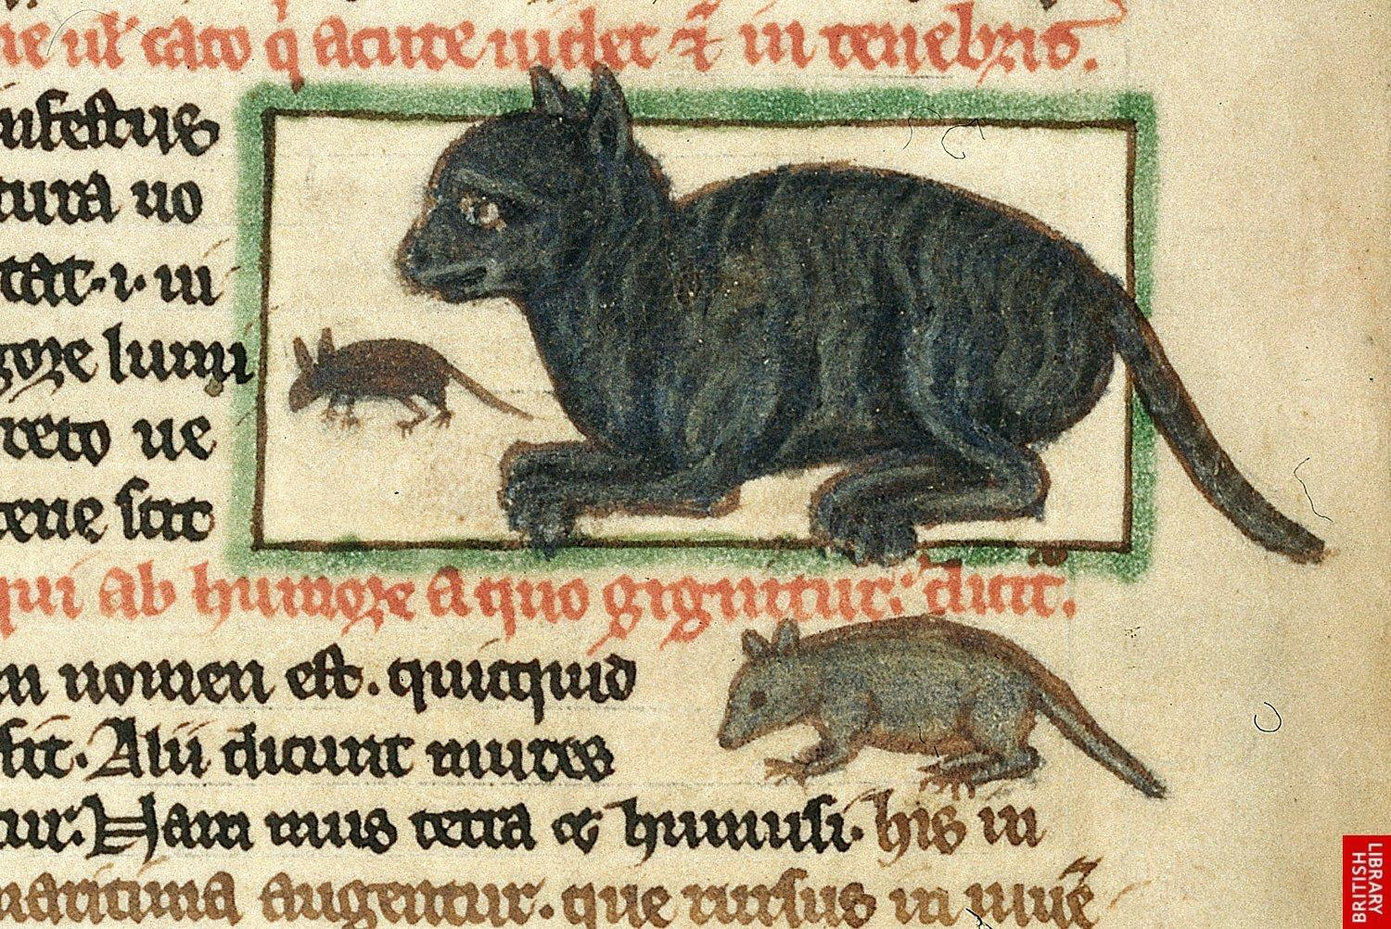
Rational Creatures: Examining the Cat-Dog Divide in the Medieval World
Notes:
http://www.medievalists.net/2013/10/why-cats-were-hated-in-medieval-europe/
Taking a look at the Medieval period, why are cats considered the “quintessential pet in Islam,” and dogs not? Why are dogs considered practical pets in Christendom, and cats not?

Slide 2
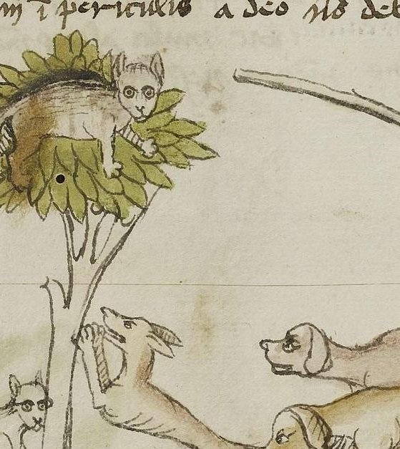
Animal companions in the Medieval world
Northwestern Europe (France & southern England), 13th-15th centuries
Abbasid Caliphate, 12th century - ~1258
Taking a look at the Medieval period, why are cats considered great pets in Islam and dogs not? Why are dogs considered practical pets in Christendom, and cats not?
Scholarly research: discussion of the role of animals as companions, but not specific animal choices
  Few examples of more specific research relied on supposed essential qualities – of the animals and the religions

Slide 3
The preference for cats in the medieval Muslim world and dogs in the medieval Christian world can be explained not by differences in the religions or animals themselves, but rather by a complicated blend of factors ideological, political, and social in the respective environments.

Slide 4
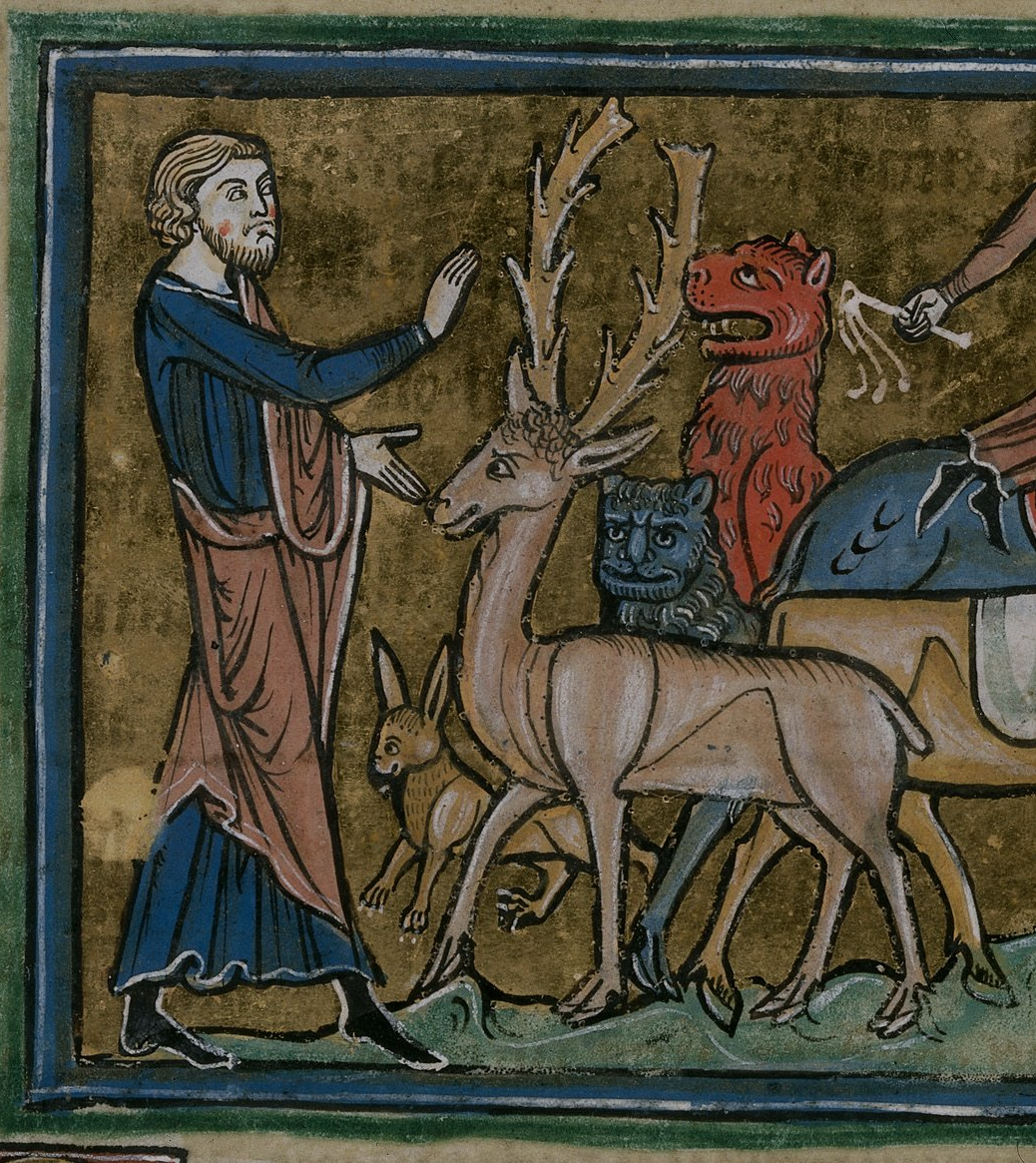
Human exceptionalism
Both Christian and Muslim writings of this period were of the opinion that animals were designated by God as man’s servants
  Thomas Aquinas: “people cannot show animals charity (love) or even friendship, because animals are not rational creatures and friendship is based on reason” (Thomas 2005, p. 93)
  Likewise, Aquinas was of the belief that animals did not possess mortal souls
Notes:
Dogs as representative of the “outside” world (hunting, etc); cats as the “inside” world (mousing, etc)

Slide 5
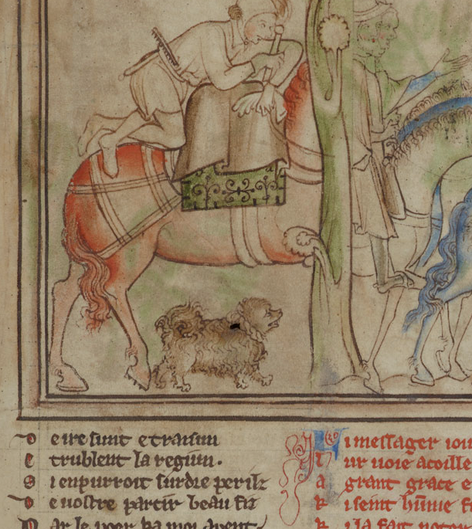
Dogs in Christendom
The dog and the hunt: the dog enables the lord to partake in the “cultural performance” of the hunt, wherein he proves his ability (Crane 2013, p. 102)
The dog is praised for its traits of loyalty, obedience, and foresight
  In some cases dogs were even believed to have curative properties (warmth, saliva)
Críth Gablach – a lord should have his hunting dog, and a wife her pet dog (Walker-Meikle 2012, p. 3)
Notes:
Image from the cambridge university library; life of st edward the confessor (13th century)

Slide 6
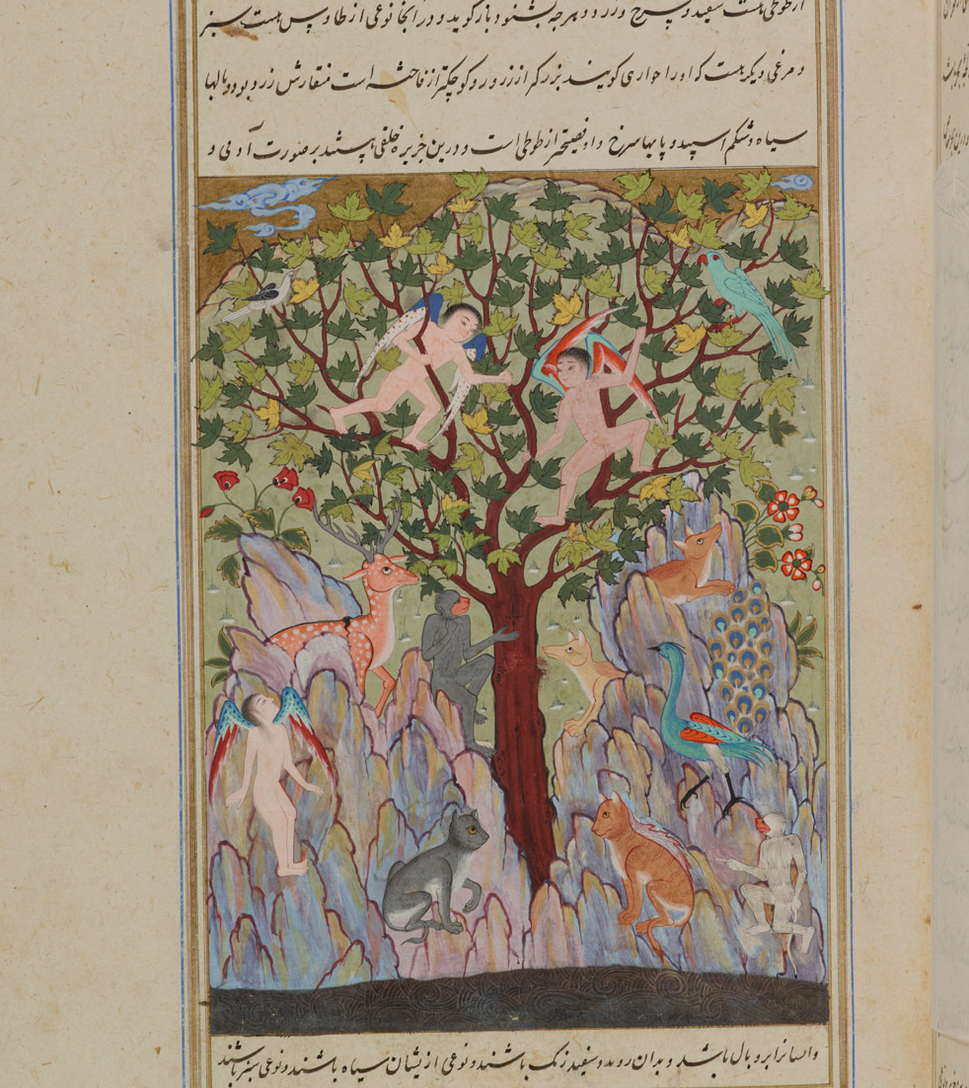
Cats in Islam
“Cats be in more request with them than dogs […] they frequently have them in their arms, in imitation it may be of their prophet Mahomet, who usually carried a cat in his sleeve” (Floor 2003, p. 30)
  Perhaps a reference to the fable of Muhammad and his cat
Cats as an integral aspect of the Muslim city; chief mousers for both food stores and libraries
A Muslim was permitted to “eat food that cats have sampled or perform ablutions [ceremonial washing] with water from which they have drunk” (Campo 2009, p. 131)
Notes:
Image from cambridge university library – cosmology of qazwini; depiction of the animal kingdom places cats in the center, and interestingly, domestic vs wildcat (most common coat color for domestic cats was gray tabby)

Slide 7
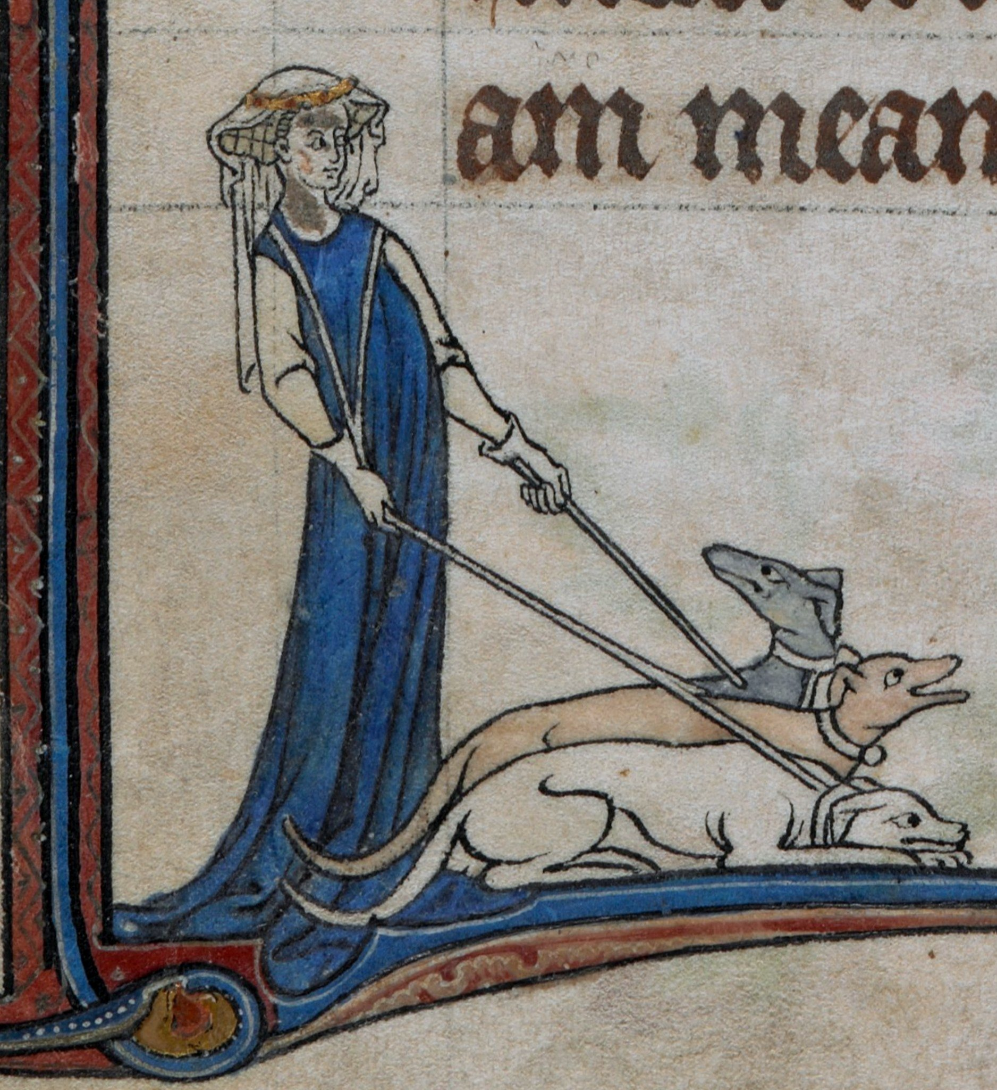
Dogs as tools
Dogs are recognized in Christian society for their use in hunting, hawking, and other violent pursuits
An English book on the dog and its various breeds was adamant that by placing a dog to the breast one might alleviate sickness of the stomach or disease of the chest by virtue of its heat (Walker-Meikle 2012, p. 7)
12th century composer Hildegarde von Bingen praised the dog’s traits of loyalty and foresight – specifically its ability to sense when its owner may be in danger and subsequent urge to protect him
Notes:
Dogs as representative of the “outside” world, the masculine (hunting, etc); cats as the “inside” world, the feminine (mousing, etc)

Slide 8
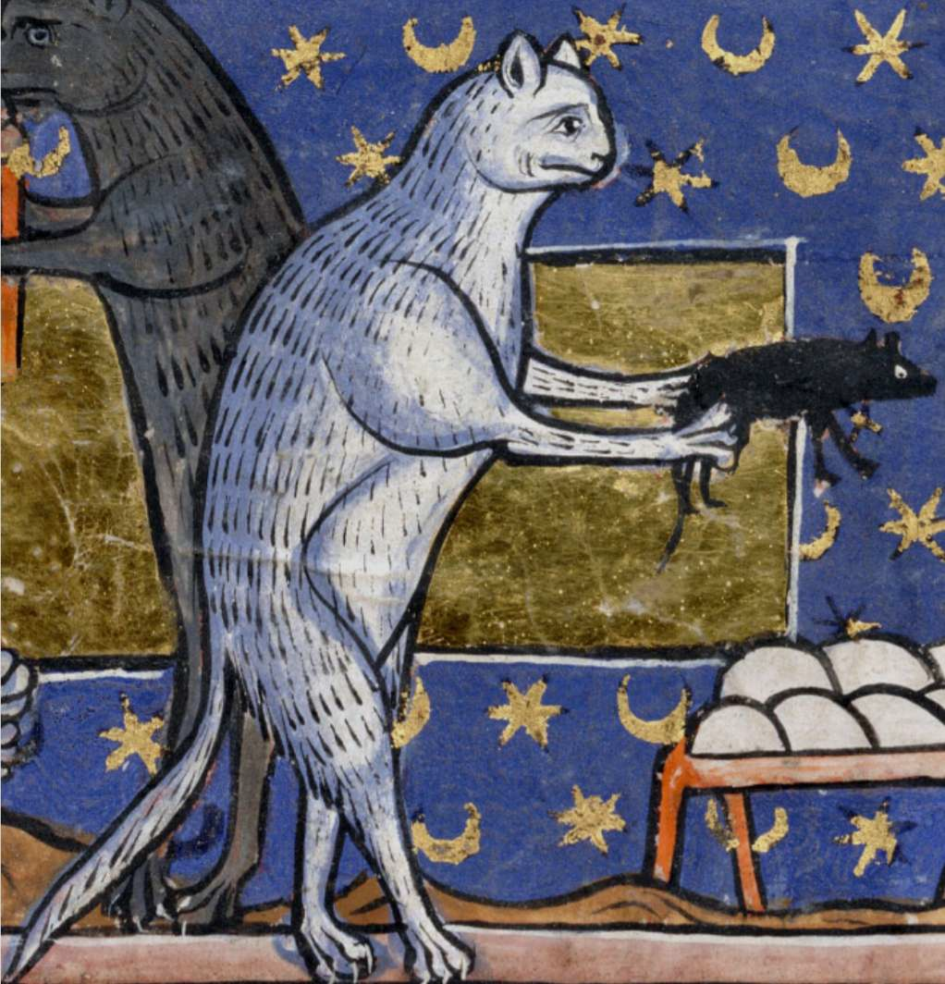
Cats as tools
al-Damiri emphasizes “the cat’s symbiotic relationship with people and (crowded) cities” with regards to pest control as it protects food stores and archived documents (Campo 2009, p. 131)
There was a harmony to the “synchrony of scholar and cat in their house” akin to that of the “knight and warhorse in combat” (Crane 2013, p. 9)
The cat was incredibly useful in very specific areas of society – namely cities and places of learning – but these scenes were more widespread in the Muslim world, with bigger cities and more houses of learning
Notes:
al-Damiri - wrote the Book of Animals
Dogs as representative of the “outside” world (hunting, etc); cats as the “inside” world (mousing, etc)

Slide 9
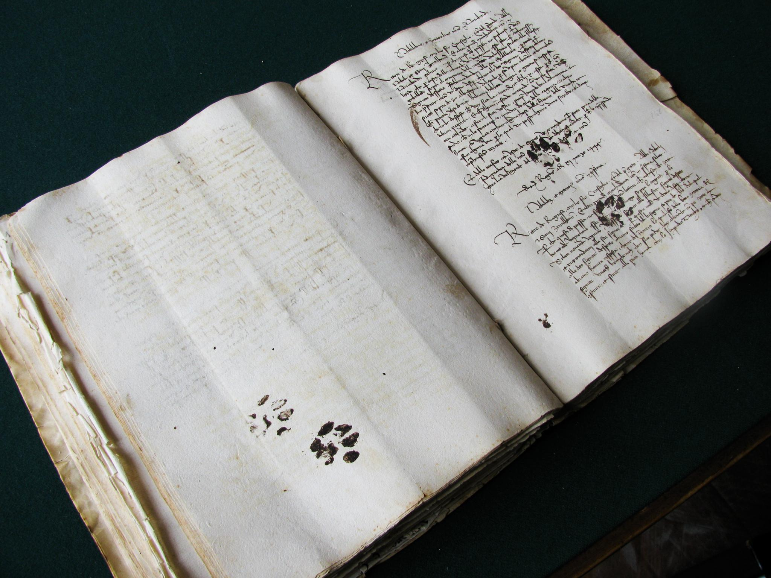
Notes:
This is the best argument for the root not being in the religions as concepts themselves: otherwise you’d be hard-pressed to find a cat in a Christian monastery

Slide 10
'I am a most faithful watchwoman, ever-vigilant in guarding the halls; in the dark nights I make my rounds of the shadowy corners — my eyes’ light is not lost even in black caverns. For unseen thieves, who ravage the heaped-up grain, I silently lay snares as fatal obstacles. Though I am a roving huntress and will pry open the dens of beasts, I refuse to pursue the fleeing herds with dogs, who, yapping at me, instigate cruel battles. I take my name from a race that is hateful to me.'

Slide 11
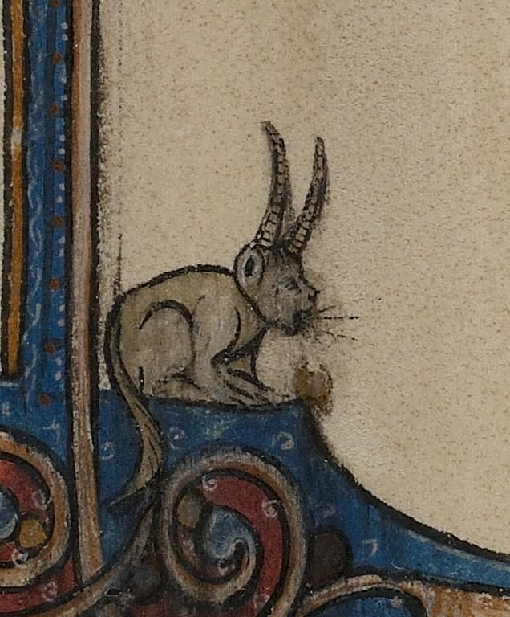
Ideological roots: Christianity
Gender:
  Chaucer, the Manciple’s Tale – the cat and housewife “both being captives and lustful” (Walker-Meikle 2012, p. 11)
  The indoor versus outdoor sphere: dogs associated with the hunt, the lord; cats with the book, the lady
Hildegarde von Bingen, again, describes the cat as unfaithful and loyal only to whomever will feed him

Slide 12
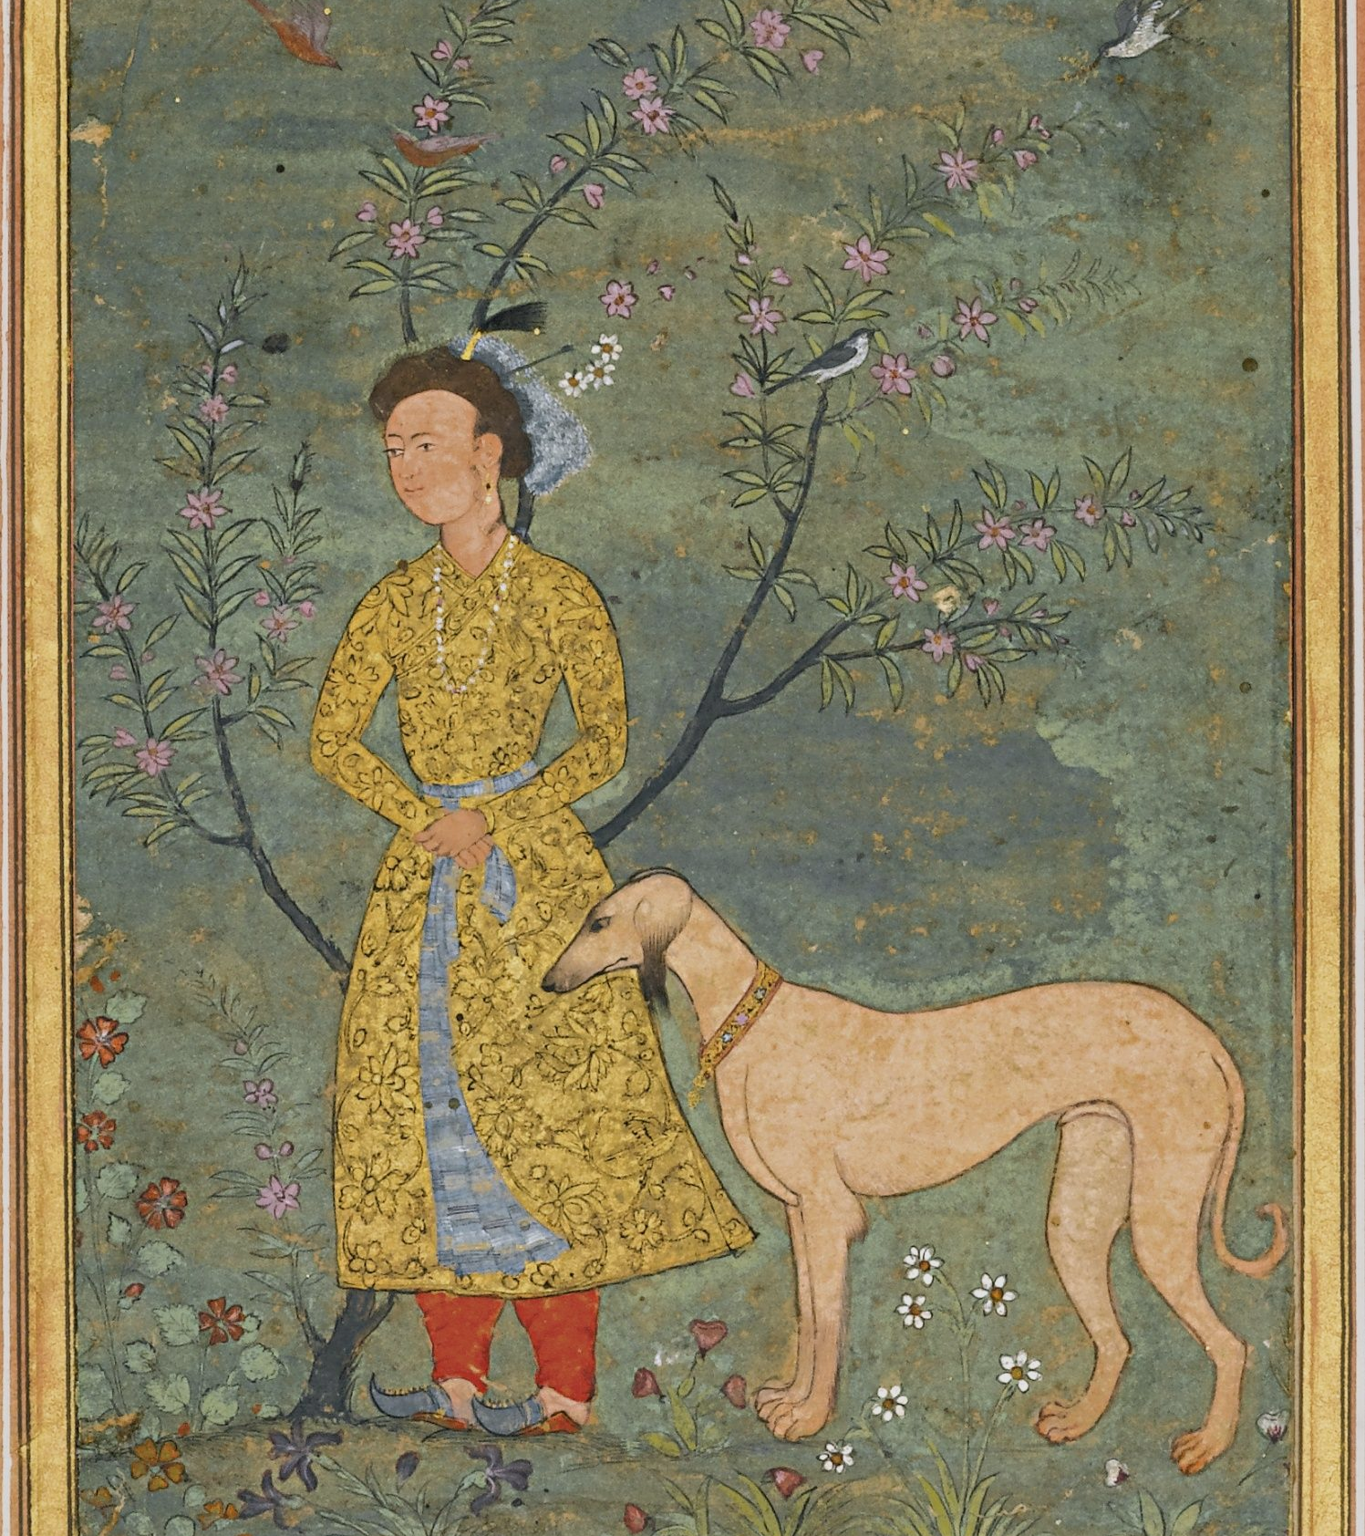
Ideological roots: Islam
Conflict in the Arabian peninsula between a growing Islam and an established Zoroastrianism provided the motive for a shift in animal perception
  The pronounced Muslim preference for cats as companions went against the Zoroastrian precedent of the “demonic character ascribed to the domesticated cat” (Floor 2003, p. 28)
  Later Muslim literature would depict a scenario post-Muhammad’s death in which “instead of angels [guiding him], dogs came and began to devour the Prophet’s body” (von Grunebaum 1969, p. 47)
Notes:
Kim Fortuny compared the growing taboo against dogs and praise of cats to the demonization of snakes on the part of Judaism against conflicting Mesopotamian religions
Twofold plan of a t t a c k
Thereafter established an annual killing of dogs in revenge
Tale only appears 200 years after Muhammad’s death
Qur’an itself only mentions dogs five times, usually as “conduits of grace”
Demonization of dogs clearly not an inherent quality of Muslim theology

Slide 13

Theory versus practice
Christian theological literature of this period laments the folly of overindulging a pet, but the actions of the average man contradicts the theological arguments
  Felines in Christendom usually associated with women or, more often monks – Pangur Bán (Thomas 2005, p. 93)
    There was a harmony to the “synchrony of scholar and cat” similar to that of the “knight and warhorse” (Crane 2013, p. 9)
  Muslim veterinary writers advise “stroking with the hands, scratching, touching and suchlike basic actions” are essential tasks of the dog owner (Alkhateeb Shehada 2013)
Notes:
Very respectable Medieval lady with her doggo – Christine de Pisan, a well-respected noblewoman of the time who made no effort to hide her pet dogs in self-portraits
Most obvious uses for dogs used as justification: hunting, tracking, trainability, but also these suspected curative properties
Cats much more difficult to justify, except where libraries are concerned
Idea of the indoor vs outdoor sphere again (cats being indoor)

Slide 14
Conclusion
Any discussion of historical animal ownership first requires a separation of modern ideas about animal welfare
  A difference in beliefs re: animal welfare does not imply a lack of care for animals
Both the duality of cat and dog and the duality of Islam and Christianity are man-made
Even the most mundane of biases can have a profound effect on the efficacy of historiography

Slide 15
Works Cited
Alkhateeb Shehada, Housni. Mamluks and Animals: Veterinary Medicine in Medieval Islam (Leiden: Brill, 2012).
Campo, Juan Eduardo. Encyclopedia of Islam. (New York: Infobase Publishing, 2009), 131-132.
Crane, Susan. Animal Encounters: Contacts and Concepts in Medieval Britain (Philadelphia: University of Pennsylvania Press, 2013).
Floor, Willem. “A Note on Persian Cats.” Iranian Studies 36, 1 (2003): pp. 27-42.
Fortuny, Kim. “Islam, Westernization, and Posthumanist Place: The Case of the Istanbul Street Dog.” ISLE: Interdisciplinary Studies in Literature and
Environment 21, 2 (2014), pp. 271-97.
Luard, H.R. Lives of St. Edward the Confessor (London: Longman, Brown, Green, Longmans, and Roberts, 1858).
Thomas, Richard. “Perceptions Versus Reality: Changing Attitudes Towards Pets in Medieval and post-Medieval England.” Just skin and bones? New
perspectives on human-animal relations in the historical past (Oxford: Archaeopress, 2005), pp. 93-101.
Tlili, Sarra. “Animal Ethics in Islam: A Review Article.” Religions 9, 269 (2018).
Wadiwel, Dinesh. The War Against Animals (Leiden: Brill, 2015).
Walker-Meikle, Kathleen. Medieval Cats (London: British Library, 2011).
Walker-Meikle, Kathleen. Medieval Pets (Woodbridge: Boydell Press, 2012).

