Slide 1
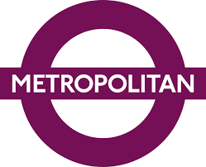
Amanda Dombroski
24 April 2020
Notes:
Describe project in a couple of sentences

Slide 2
How and to what extent did the development of the London Underground effectively lead to the metropolitan development of Greater London?
The Metropolitan Railway and Metro-Land played a significant role in the development of the modern day metropolis and set a precedent for future transportation infrastructure and suburbanization in Greater London and beyond.

Slide 3
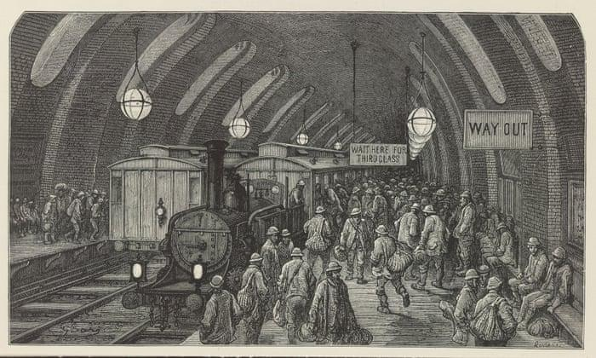
Section 1: Introduction
Pre-Underground
Population growth
1.11 million people late 18th century to 6.58 million people in 19th century
Industrial Revolution
Transportation Revolution & railway boom
London Underground as a first
Purpose
Address overcrowding and congestion
Create more interconnected city
Effect
Dissolution of surface & subterranean distinctions
Lessening of social & financial stratas
Established precedent for rail infrastructure development

Slide 4
Section II:
Historiography
The Revolutionary Railway
Poster child for metropolitan development
Reinvention of the metropolis
Reconfiguration of social class, geographic distance, & other previously divisive characteristics
Introducing a New Decentralized & Suburban Greater London
London as the City of Villages
Proliferation of transportation infrastructure locally & nationally
City centre and the periphery developed interdependently, not independently

Slide 5
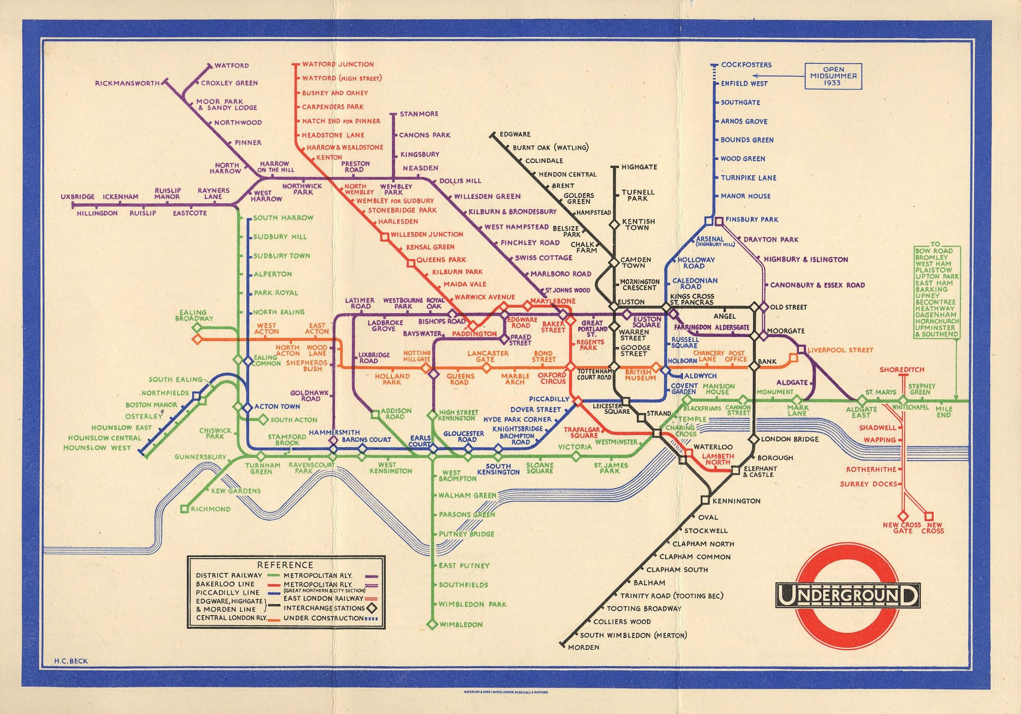
Section 3: The Modern Metropolis
From private lines to consolidated whole
Growing emphasis on competition, not cooperation
1920, Ministry of Transport proposed amalgamation of all of capital’s railways
London Passenger Transport Board (1933) to Transport for London (2000)
Frank Pick - ‘rational, scientific, and efficient’ management and operation
Harry Beck’s Underground Map
Validates the conceptualization of urban transport as logical & necessary progression for concentration & centralization of Greater London
The future of the London Underground
Further rail development to reflect the needs of the dynamic city
Crossrail/Elizabeth Line, Underground modernizations & extensions

Slide 6
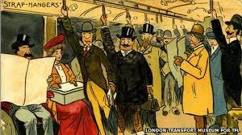
Section 4: The Movement Underground
Led to the stratification of urban populace & paradoxically unified the city through the creation of an accessible shared travel experience for all riders
Extensive and expansive to point there was temptation to overemphasise and oversimplify its role in the creation and growth of suburbs
Attitude of ‘if we build it, they will come’

Slide 7
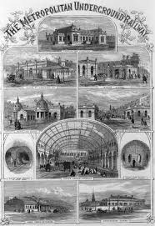
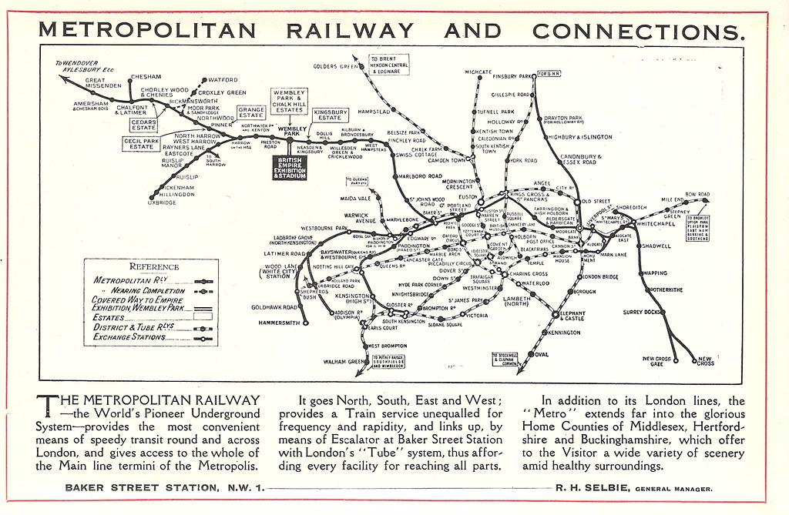
Section 5: The Metropolitan Railway
What is this & why is it significant?
Unprecedented & unique
The world’s first ‘underground’ railway - 9 January 1863
Metro-Land
Downfall of the Metropolitan Railway
Formation of London Passenger Transport Board (1933) required railway to become part of the consolidated network
Transport was rapidly deteriorating as result of lack of coordination and increasing competition among railways

Slide 8
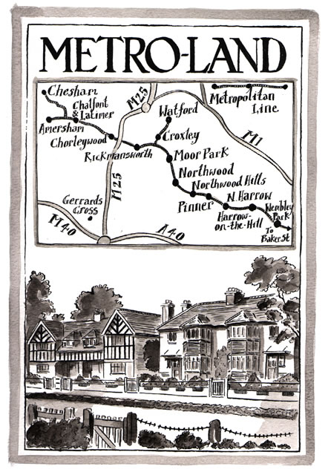
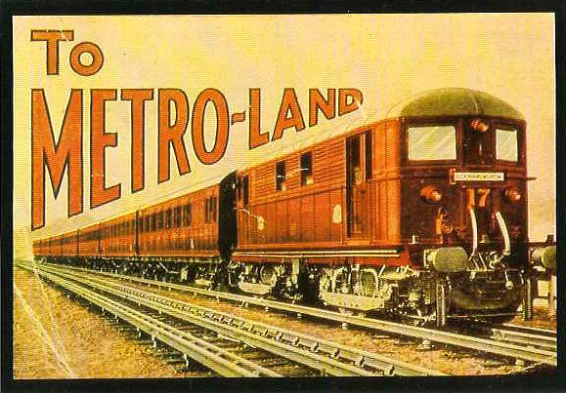
Section 6: Metro-Land
Suburbs!
Garden City Movement
Erosion of boundaries between urban and rural spaces
House in the suburbs as a step up on the social ladder
Building Metro-Land
Exempt from Land Clauses Act of 1845, which would require railways that terminated in London to dispose of surplus land
Metropolitan Railway Surplus Lands Committee
Significance of Metro-Land
Entirety of North-West London
Led to competition among local and national railways to get people to settle suburbs accessible by their service

Slide 9
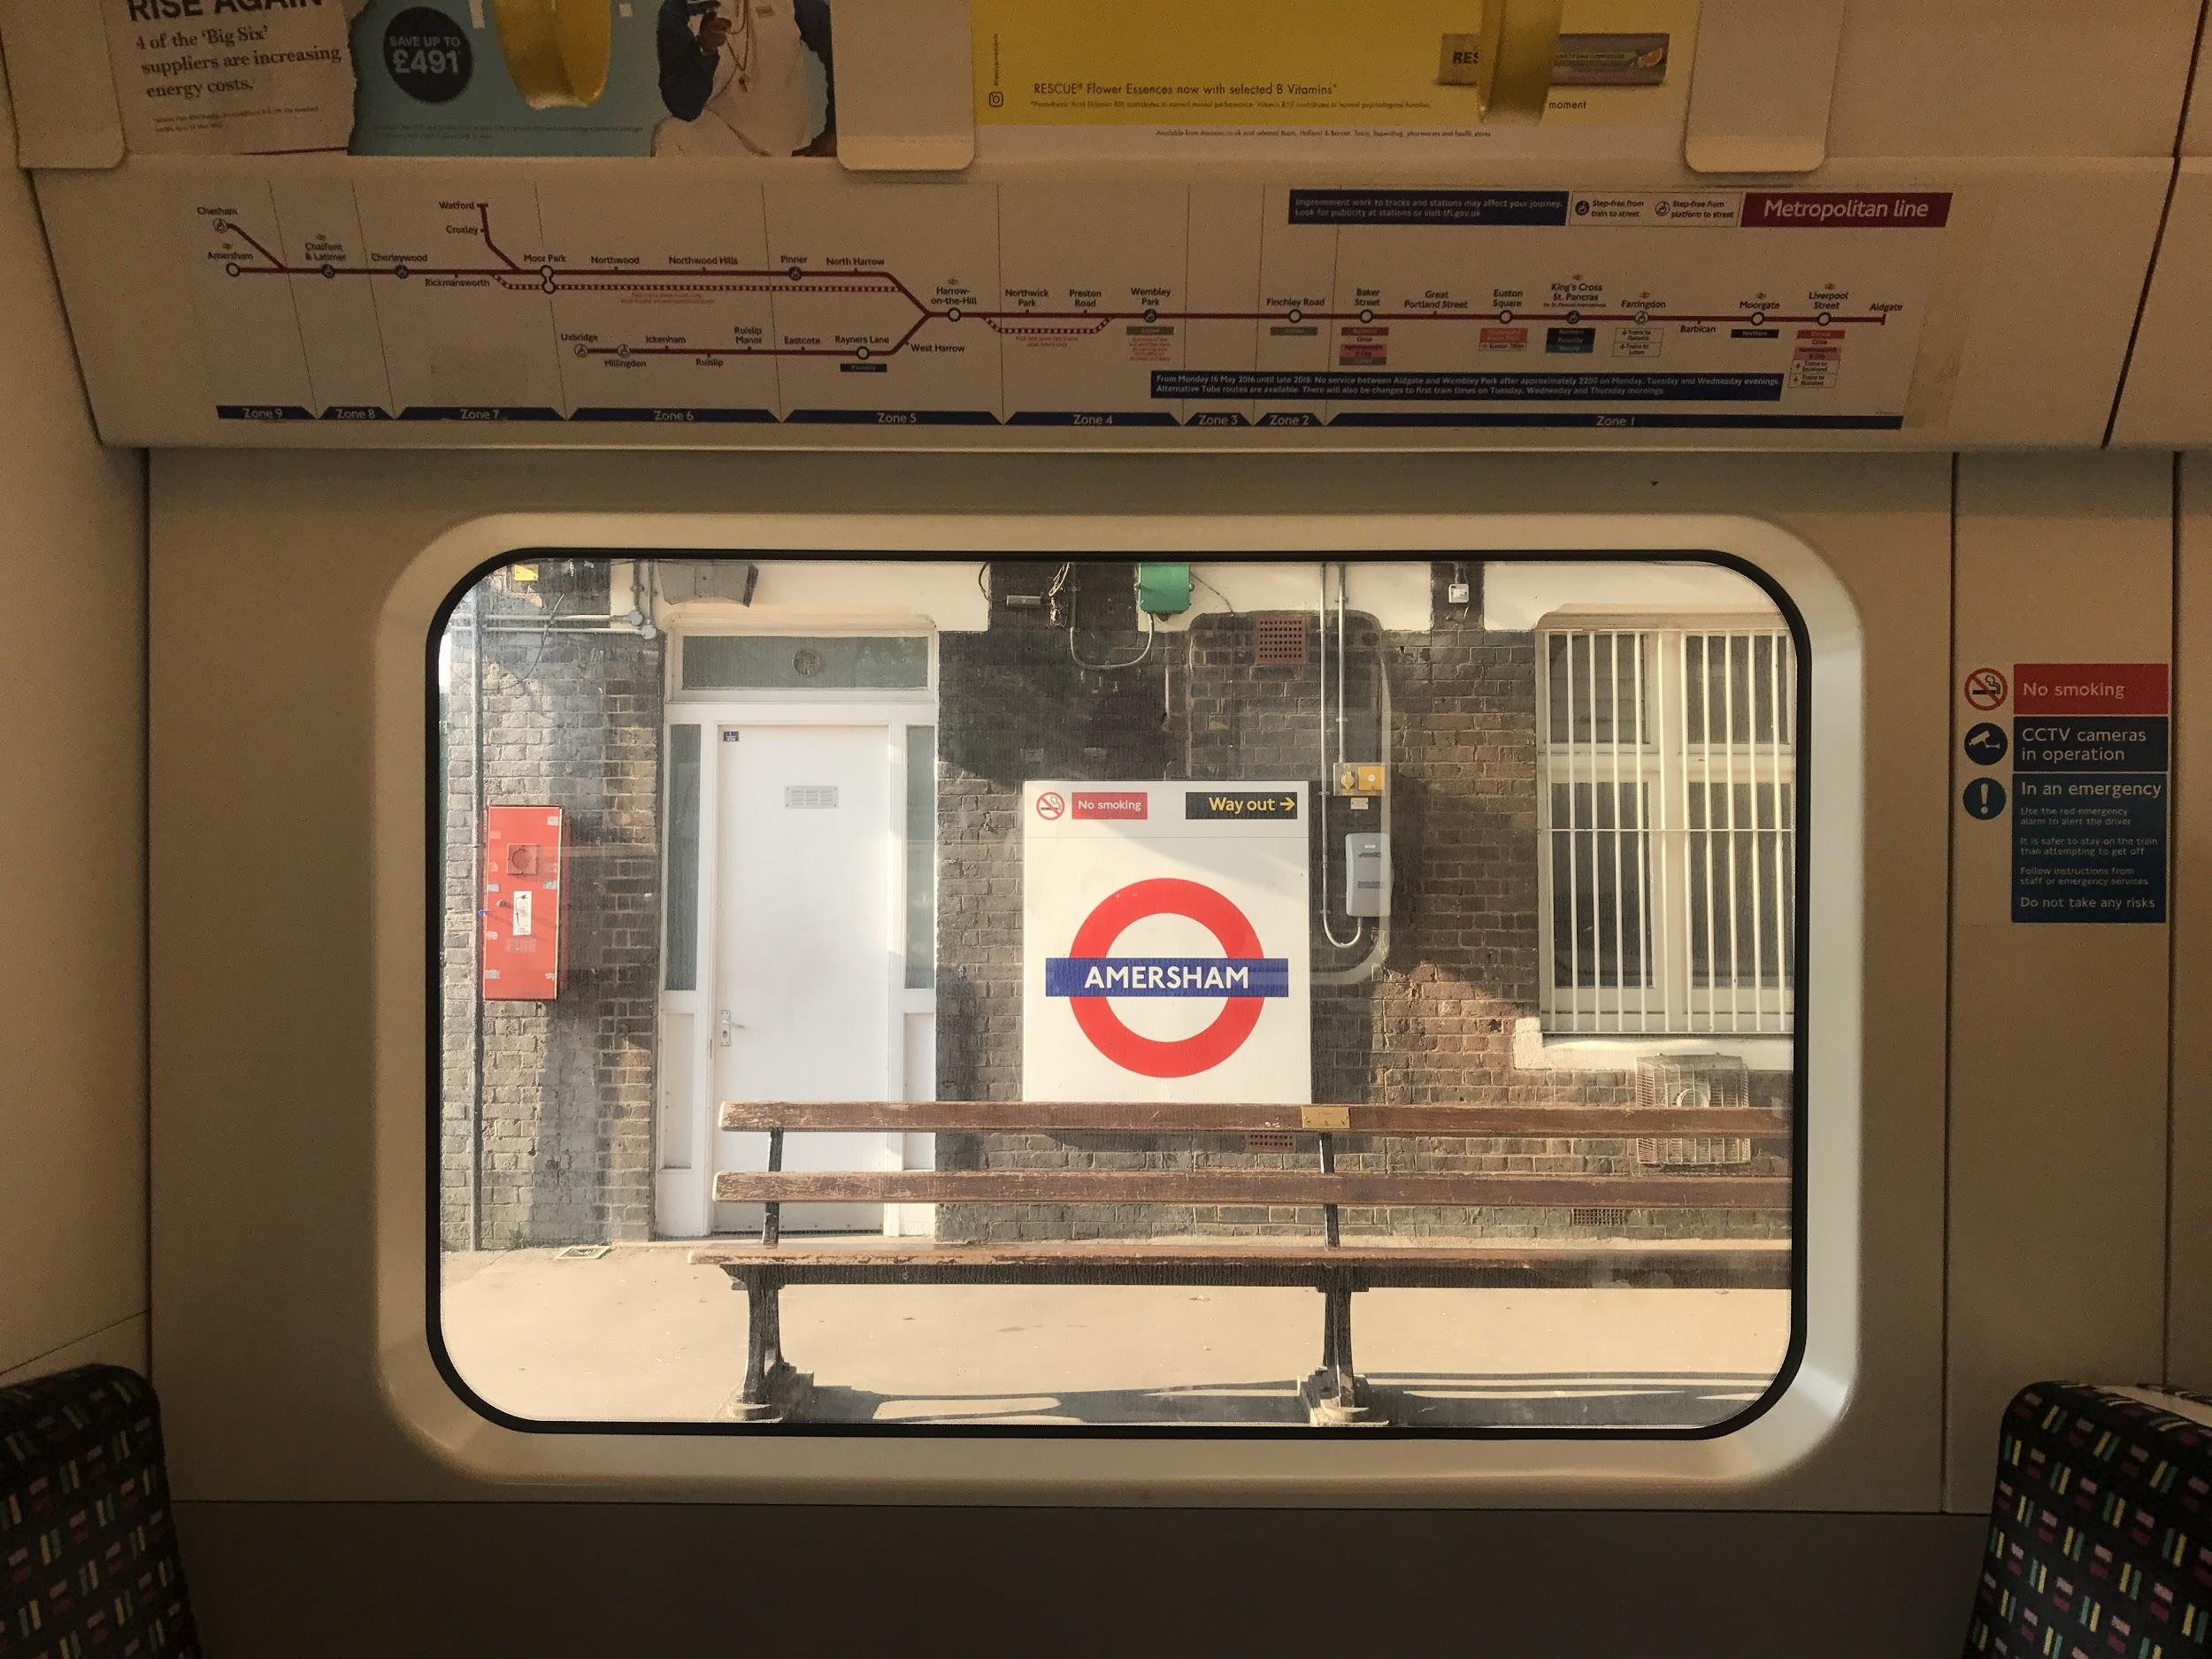
Section 7: Conclusion
Growth of city and empire
Limits on the metropolis
Ushered in an era of new modernity
Geographic, social, cultural
Metropolitan Railway as visionary for further rail develop in London & elsewhere
Underground as typification of London

Slide 10
Takeaways & Further Research
Complexities of public transportation infrastructure and the ignorance of the modern user
The London Underground as a comprehensive experience & defining brand
Differences in the role of public transportation between British suburbia and American suburbia
Role of government, politics, and public attitudes in the creation of not only an interconnected city, but a nation defined by railway connectivity

