Slide 1
Weight Stigma in Different Aspects of Life
Presented by Emanuel Noyola

Slide 2
Background
Title VII of the Civil Rights Act of 1964
1991 American Airlines case
Taylor v. Burlington Northern Railroad Holdings, 2018
(Title VII of the Civil Rights Act of 1964., 2009); (Kleiman, C., 1991); (Taylor v. BURLINGTON NORTHERN RR HOLDINGS INC., 904 F. 3d 846 - Court of Appeals, 9th Circuit 2018 - Google Scholar, 2018)

Slide 3
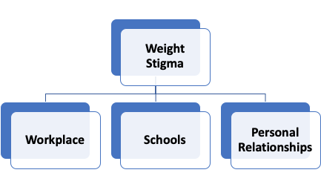
The Current Issue
Weight stigma is the discrimination or bias against an individual who is perceived to be heavy, overweight, or obese.
The question: Weight discrimination in everyday life, what are its effects in the workplace, schools, and personal relationships?

Slide 4
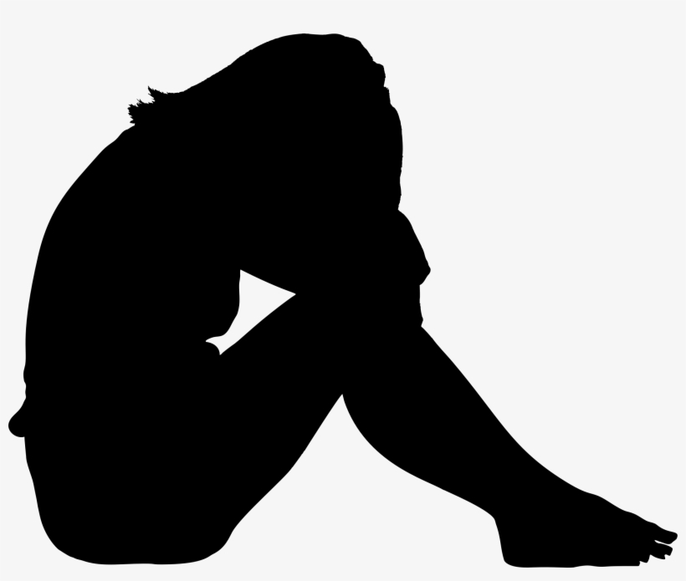
Workplace
Both males and females are affected. BUT females are the most impacted group
Job advancement and promotions affected
(Roehling et al., 2007); (Flint et al., 2016)

Slide 5
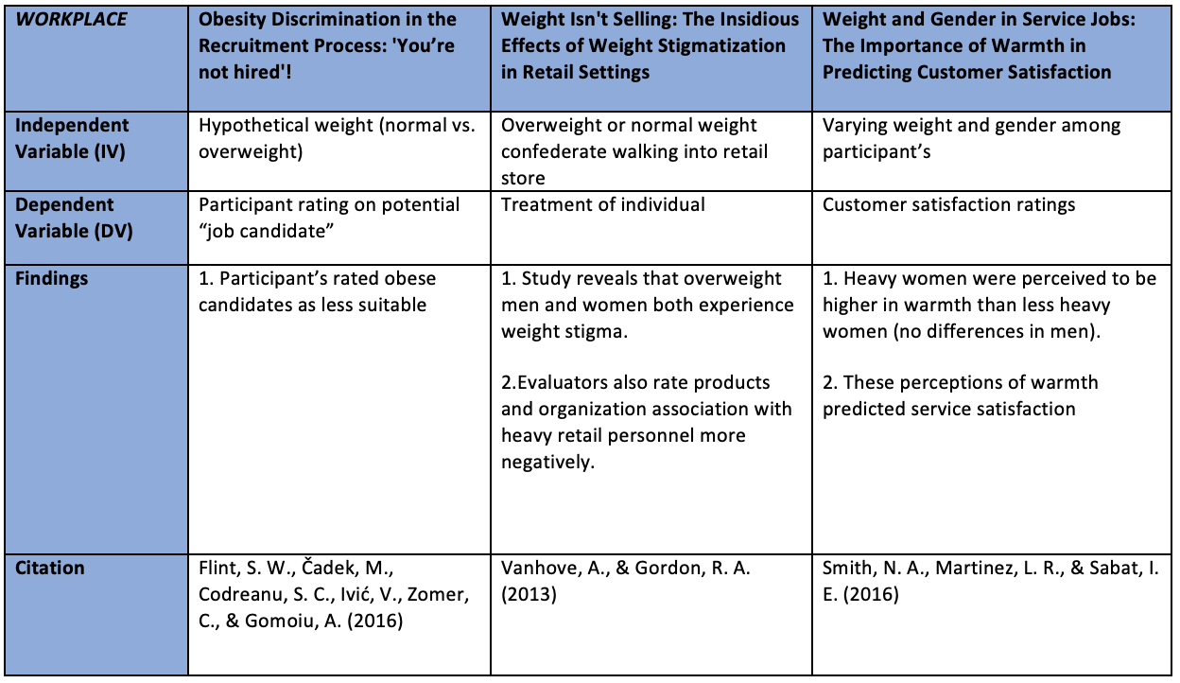

Slide 6
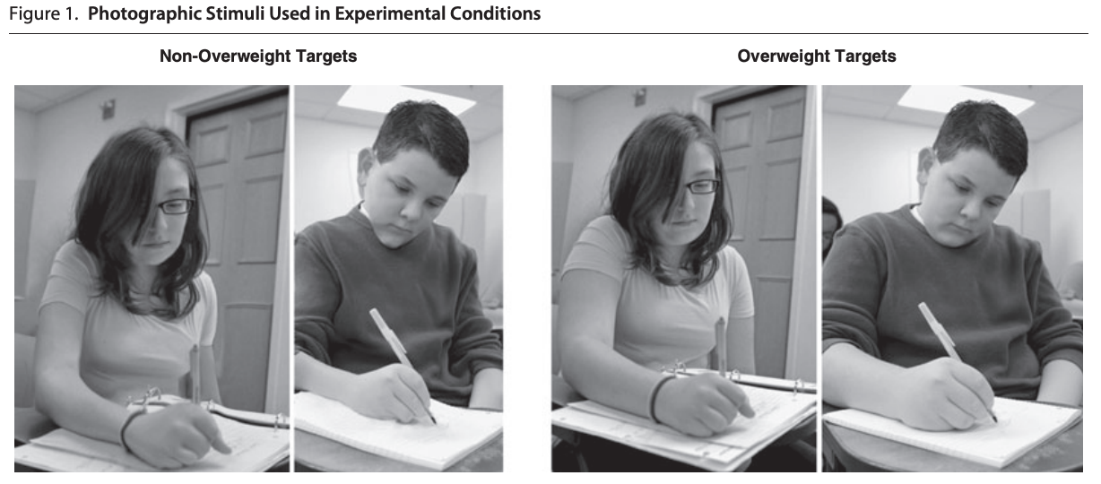
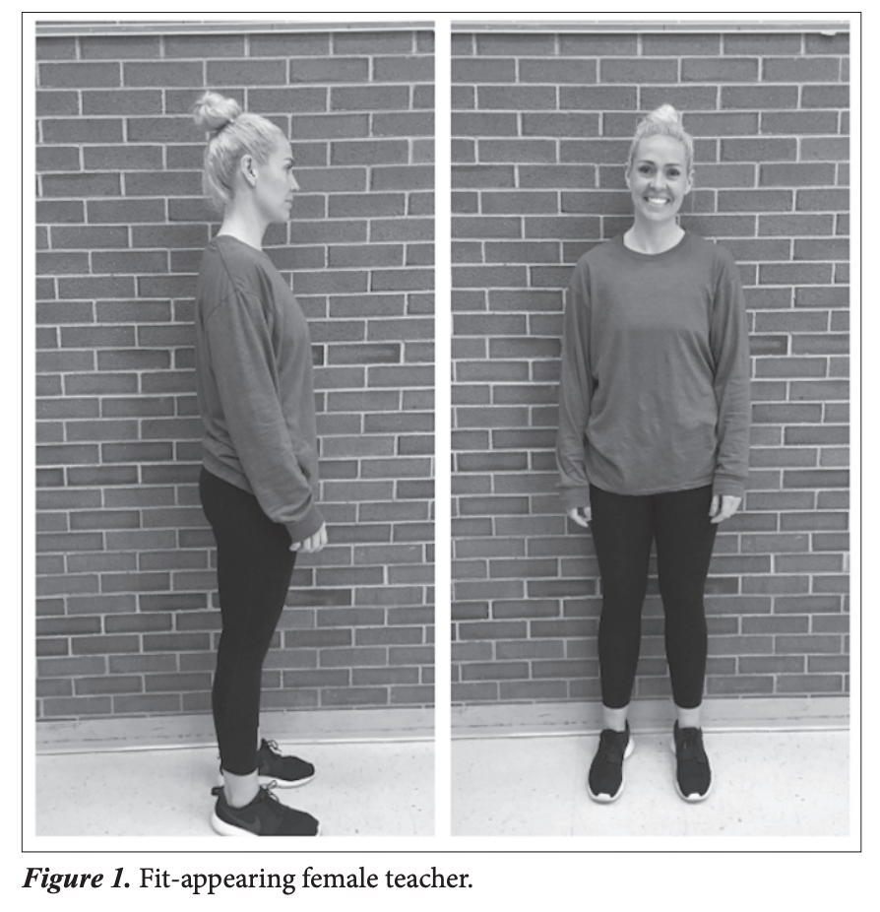
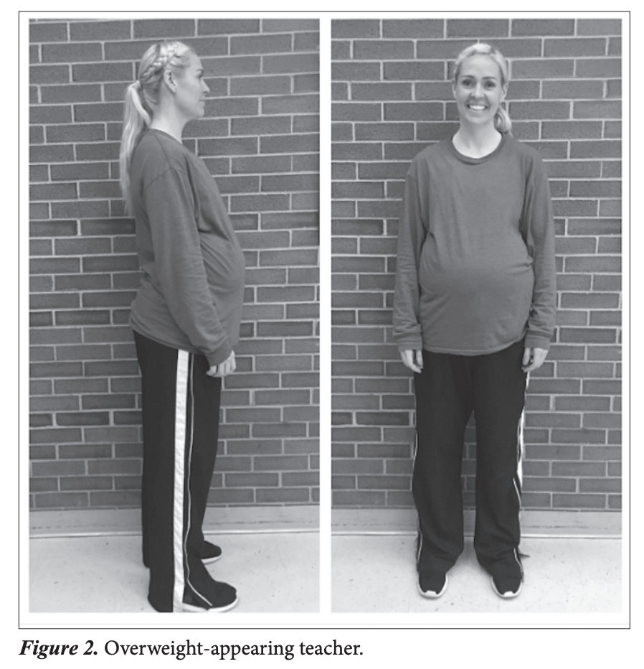
Schools
Both students and teachers are victims
Both groups discriminate
(McKown et al., 2019)
(Peterson et al., 2012)

Slide 7
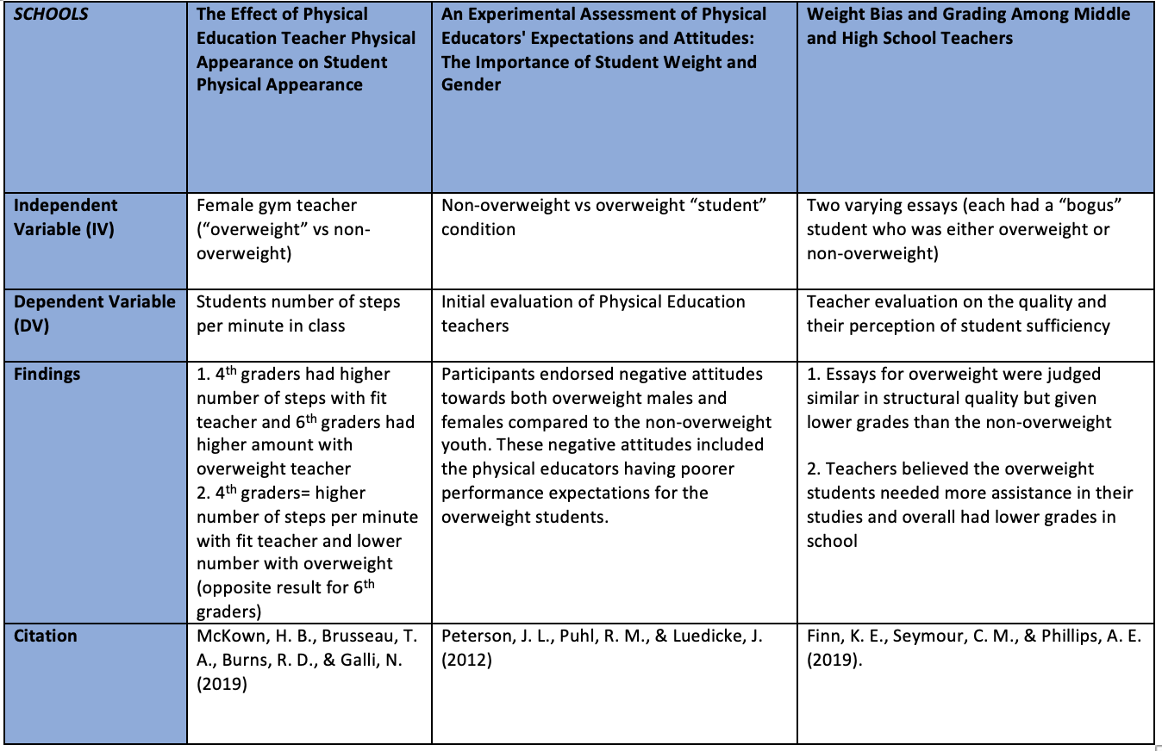

Slide 8
Personal Relationships
Weight itself isn’t an issue among relationships- it’s when the couples are mixed-weight where there starts to be issues
Perceived partner support helps reduce this in their daily lives
(Kleuver Romo & Dailey, 2014); (Burke et al., 2012)

Slide 9
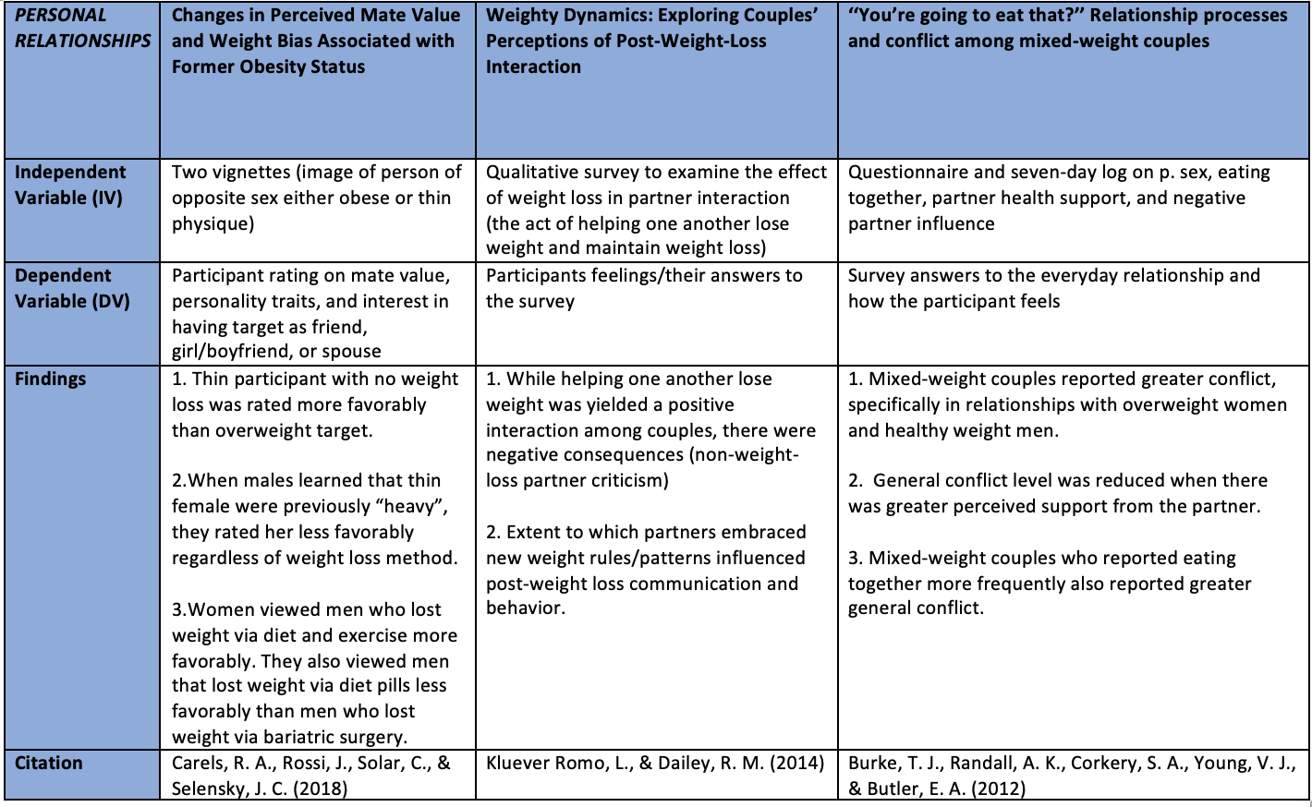

Slide 10
At-Risk Groups
Women postpartum are groups that also experience weight discrimination
(Incollingo et al, 2019)
Medication side effects sometimes lead to unwanted weight gain

Slide 11
Key Takeaways
The ongoing issue of weight discrimination in everyday life needs to be addressed through public health awareness since it can be detrimental to the victims and their overall life satisfaction.
Workplace laws need to be rewritten so that all overweight or obese individuals are a protected class.

Slide 12
References
Burke, T. J., Randall, A. K., Corkery, S. A., Young, V. J., & Butler, E. A. (2012). “You’re going to eat that?” Relationship processes and conflict among mixed-weight couples. Journal of Social and Personal Relationships, 29(8), 1109-1130.
Carels, R. A., Rossi, J., Solar, C., & Selensky, J. C. (2018). Changes in perceived mate value and weight bias associated with former obesity status. Stigma and Health,3(4), 338-347. doi:10.1037/sah0000071
Finn, K. E., Seymour, C. M., & Phillips, A. E. (2019). Weight bias and grading among middle and high school teachers. British Journal of Educational Psychology. doi:10.1111/bjep.12322
Flint, S. W., Čadek, M., Codreanu, S. C., Ivić, V., Zomer, C., & Gomoiu, A. (2016). Obesity Discrimination in the Recruitment Process: “You’re Not Hired!”. Frontiers in Psychology, 7. doi:10.3389/fpsyg.2016.00647
Incollingo Rodriguez, A. C., Tomiyama, A. J., Guardino, C. M., & Dunkel Schetter, C. (2019). Association of weight discrimination during pregnancy and postpartum with maternal postpartum health. Health Psychology, 38(3), 226.
Kluever Romo, L., & Dailey, R. M. (2014). Weighty dynamics: Exploring couples’ perceptions of post-weight-loss interaction. Health Communication, 29(2), 193-204.
Peterson, J. L., Puhl, R. M., & Luedicke, J. (2012). An experimental assessment of physical educators' expectations and attitudes: the importance of student weight and gender. Journal of School Health, 82(9), 432-440.

Slide 13
References (2)
McKown, H. B., Brusseau, T. A., Burns, R. D., & Galli, N. (2019). The effect of physical education teacher physical appearance on student physical activity. Physical Educator, 76(2), 524-546.
Smith, N. A., Martinez, L. R., & Sabat, I. E. (2016). Weight and gender in service jobs: The importance of warmth in predicting customer satisfaction. Cornell Hospitality Quarterly, 57(3), 314-328. https://doi.org/10.1177/1938965515622564
Vanhove, A., & Gordon, R. A. (2013). Weight discrimination in the workplace: a meta-analytic examination of the relationship between weight and work-related outcomes. Journal of Applied Social Psychology, 44(1), 12–22.

