Slide 1
Open Access and IRs: Educating and Empowering the Campus Community
Adam N. Hess, MFA | MLIS
Assistant Professor & Digital Resources Librarian
Arcadia University | Glenside, PA

Slide 2
Open Access and IRs
Today:
Overview of Open Access, Scholarly Communication issues, and Institutional Repositories
Educating & Empowering the Campus
In Academia NOW
IRs; Centers; Initiatives; Funding
OA and IR initiatives and activities at Arcadia
Pitfalls & Challenges
Growth & Sustainability

Slide 3
A & A
Adam:
Librarian, Professor, Digital Projects Specialist
Business, Studio Arts, Special Libraries, Museums…
Artist for the Libraries becomes Librarian for the Arts
Arcadia:
4000+ students, over 50 undergraduate and graduate programs
6 faculty librarians
Institutional Repository…

Slide 4
…some definitions…
Open Access: Free = Good, always
Scholarly Communication: Research, write, contribute, make an impact. Repeat.
Institutional Repository (IR): Digital, online archive capturing the scholarly output of an academic community.

Slide 5
What is Open Access
It starts with the Internet and advancing technologies in digitization and online user access…
This mixes with the deep and varied library and archival holdings of academic institutions…
Add the Creative Commons Licenses for a layer of copyright protection and support…
… and you get Robust, Authoritative, and Impactful Open Access Institutional Resources.

Slide 6
The ‘Access Revolution’
Open access over toll-based access
Research impact over net gains – in fact, seen as personal/career gain
Academic and Research Institutions Join the Revolution
Institutional Statements and Policies on Open Access

Slide 7
What do we mean by OPEN…
Open to contributions and participation
Open and free to access
Open to use & reuse w/few or no restrictions
Transparency

Slide 8
Peter Suber, on Open Access
“Open-access (OA) literature is digital, online, free of charge, and free of most copyright and licensing restrictions.”
Works both inside and outside of traditional publishing models
Supported by a variety of business models
Open ≠ Free

Slide 9
Common Misconceptions
Open access means no copyright
Open access is free
Open access always means the author pays
Open access will destroy peer review
Open access will destroy publishers
Open access has a negative effect on academic promotion

Slide 10
OA Misconceptions
Publish Where You Want: OA does not mean you need to change where you want to publish, it is more about securing enough rights to provide open access to a version of your works.
Remember: Peer-review is a literature review model; OA is a publishing model

Slide 11
Open Access on Campus
At the library:
Librarians
The repository
Other scholarly resources
In the classroom:
Handouts and information sessions
Assignments and projects
Online:
Information portal
Marketing & Promotion
Email blasts

Slide 12
Open Access on Campus
Benefits:
Students: Begin a record of publishing
Faculty: Make a bigger research impact
Common Issues:
Quality & Quantity
Authority & Authorship

Slide 13
Scholarly Communication
An alternate definition: the research and publishing processes in which students, faculty, researchers and other scholars create, evaluate, disseminate, archive, and transform research.
The raising costs of journals, and the decline of authors rights
The issues:
Faculty
Students
Researchers

Slide 14
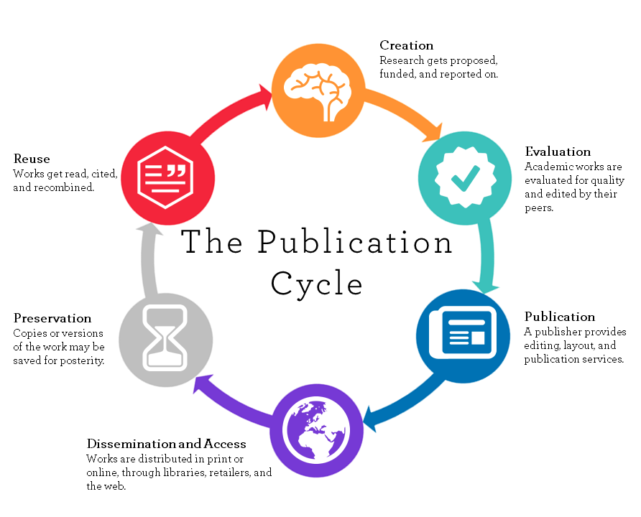
Scholarly Communication Cycle
The University of Winnipeg
(https://library.uwinnipeg.ca/scholarly-communication/index.html)

Slide 15
THE SCHOLARLY COMMUNICATION CRISIS
The Rising Costs of Journals
Authors Rights and the Publishing Agreement
It’s YOUR copyright and intellectual property until you sign it away!
WHAT ARE AUTHORS DOING? RETAINING THEIR RIGHTS, AND PUBLISHING OA
Author Addenda, Creative Commons, and OA Publishers are on the rise…
WHY? Because the impact of your work is reduced as fewer researchers have access to your scholarship because it is locked in journals that libraries can no longer afford.

Slide 16
Open Access & Scholarly Communication
Authors Rights Education
Copyright
Author’s Agreements
Negotiating
Looking for Open Access publishing opportunities and funding
Sherpa/Romeo

Slide 17
Know Your Rights!
Before You Sign Your Authors Agreements…
Publishers may or may not allow works to be shared. Check your agreement carefully to see what the publisher’s policies are. We can help authors determine whether a particular work may be shared or not. Send the author accepted manuscript (AAM) of your work and the publisher’s agreement to scholcomm@arcadia.edu.
After You Sign Your Authors Agreements…
Even if you have already signed an author agreement, you still may be able to share your work. Check your agreement carefully to see what the publisher’s policies are. We can also help, send us the author accepted manuscript and the citation of your work so we can help determine if the work can be shared or not to scholcomm@arcadia.edu.
Perhaps the most useful resource: SHERPA/RoMEO
A database devoted to providing publisher copyright and self-archiving policies.

Slide 18
The Repository
Institutional Repository (an alternate definition):
A digital, online archive capturing the scholarly output of an academic community, for the purposes of permanent access and preservation

Slide 19
Benefits of OA Repositories
Society as a whole benefits from an expanded and accelerated research cycle in which research can advance more effectively because researchers have immediate access to all the findings they need.
The visibility, usage and impact of researchers' findings increases with OA, as does their power to find, access and use the findings of others.
Universities co-benefit from their researchers' increased impact, which also increases the return on the investment of the funders of the research.
For teachers, Open Access means no restrictions on providing articles for teaching purposes. Only the URL need be provided.
Source: Steven Harnad – http://www.eprints.org/openaccess/

Slide 20
Benefits to Researchers
Increased visibility – available to whole world, indexed by Google
Author profiles
Author bibliographies
Collect all institutional materials in one place
Download statistics for each item/author Permanent preservation
Way to provide digital output for printed materials
Facilitating sharing of digital teaching materials and aids

Slide 21
More Benefits
Increased exposure – ScholarWorks is indexed by Google Scholar and other OA directories and resources
Monthly citation counts – authors get monthly stats on views/downloads
Free – there are no costs associated with any of this, we already host this repository
Many Options – we can host a full-PDF of the work, link to an OA copy of the work in another repository, or just post the citation of the work – all have many benefits, and it’s all OPT-IN
No changes in your publishing behavior – publish where you want, there is no mandate to deposit in ScholarWorks, but there is a place if you want one.
Little time and effort needed – the library will do all the heavy lifting, we just need faculty authors to OPT IN and help us identify the proper article and publisher.

Slide 22
The Repository
Setting up the space
Physical
Virtual
Support
The Library
The Faculty
The Administration / The University
The Committee

Slide 23
Open Access and IRs Educating a Campus
Build a foundation of knowledge surrounding open access, scholarly publishing, and authors rights
Develop information portals, handouts, workshops, course sessions, and other targeted outreach and education
Employ ambassadors
Stay current, revise information, create channels for keeping others informed
Pound the pavement

Slide 24
Open Access and IRs Empowering a Campus
Create a stable and attractive space, and invite everyone
Connect the benefits of Open Access and IRs to what authors and scholars care most about (research impact)
Develop pilot projects that create content (and interest) within the repository
Network and advocate on campus to find strategic partners and be ahead of any possible opportunity (like Thesis Day)
Pound the pavement

Slide 25
In Academia What is happening at universities right now
Lots of institutional repositories
Scholarly Communication, Digital Humanities and other scholarship centers and divisions
Events related to OA, IRs and Scholarly Communication
University Open Access Publishing Funds
Integration with existing networks: Faculty Profiles & Library Networks

Slide 26
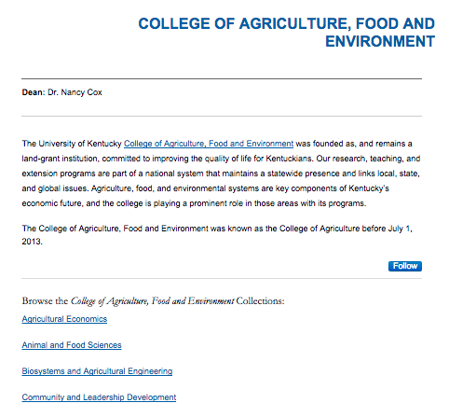
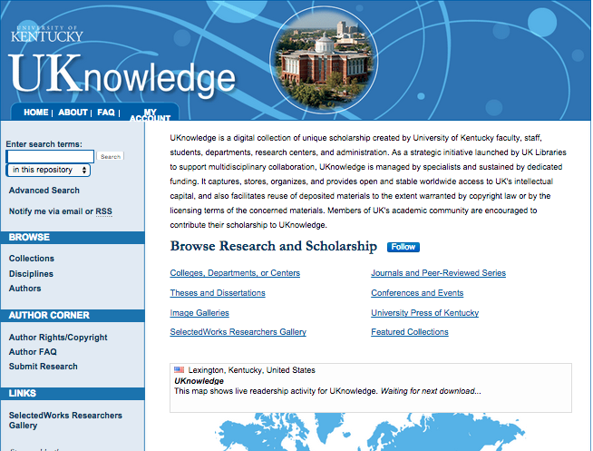
In Academia Repositories at various institutions

Slide 27
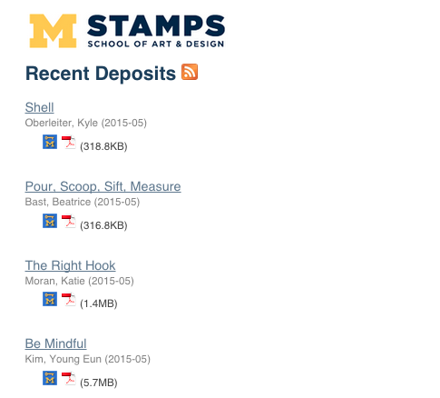
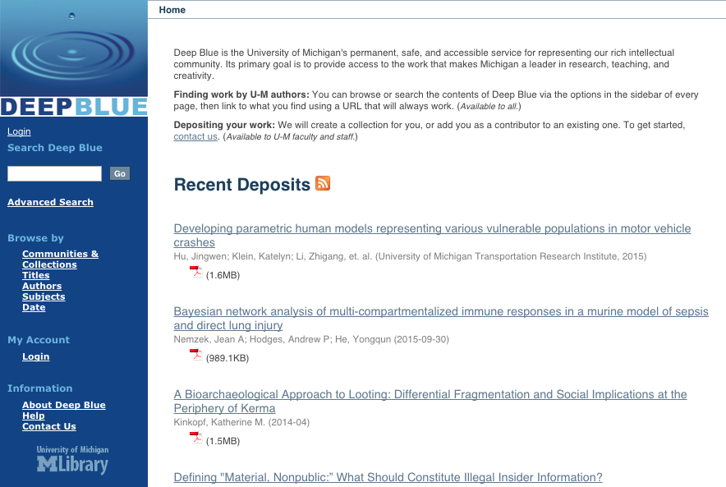
In Academia Repositories at various institutions

Slide 28
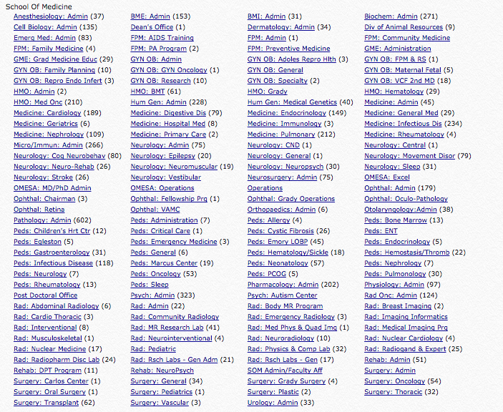
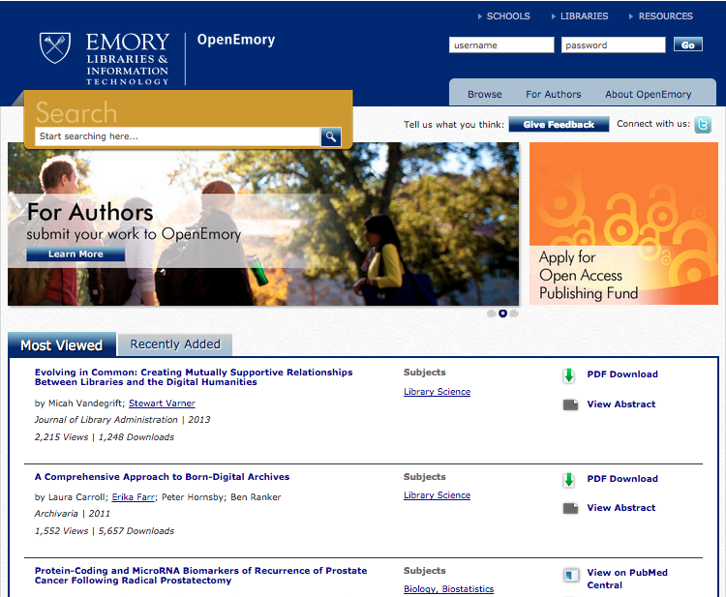
In Academia Repositories at various institutions

Slide 29
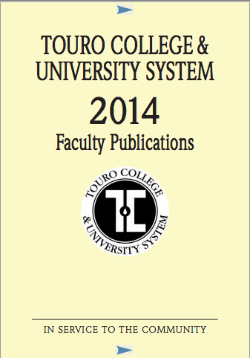
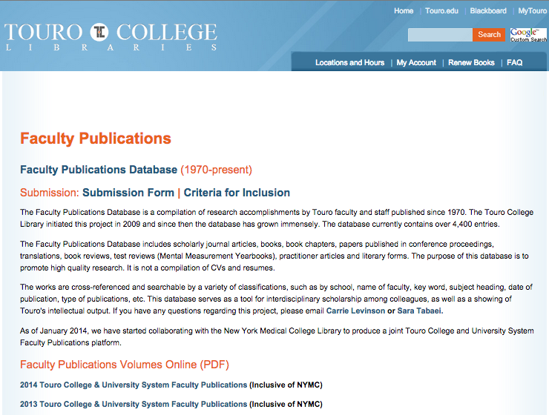
In Academia Repositories at various institutions

Slide 30
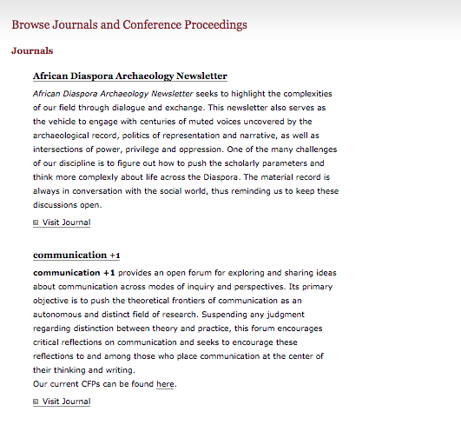
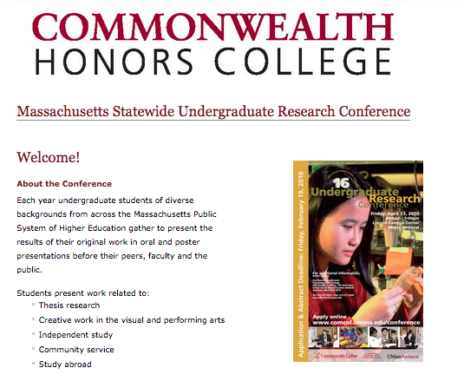
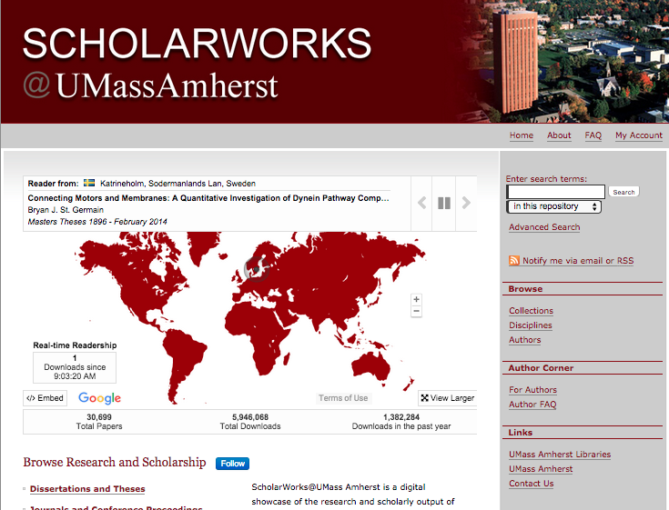
In Academia Repositories at various institutions

Slide 31
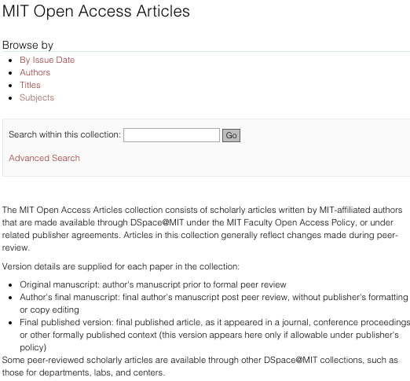
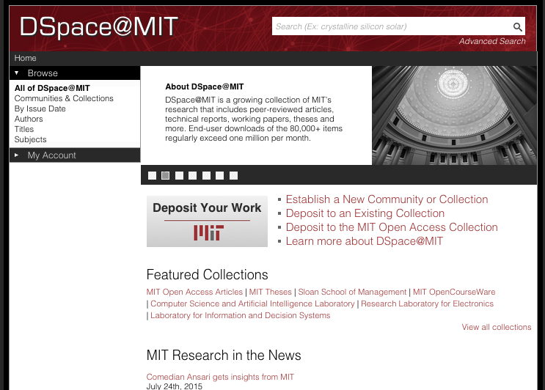
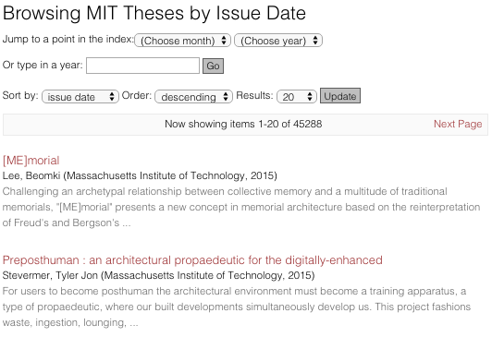
In Academia Repositories at various institutions

Slide 32
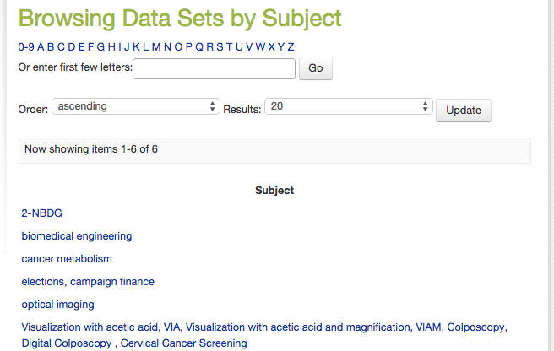
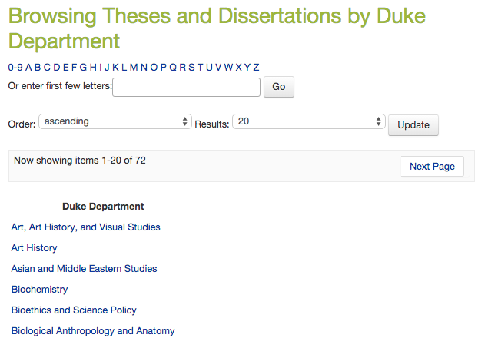
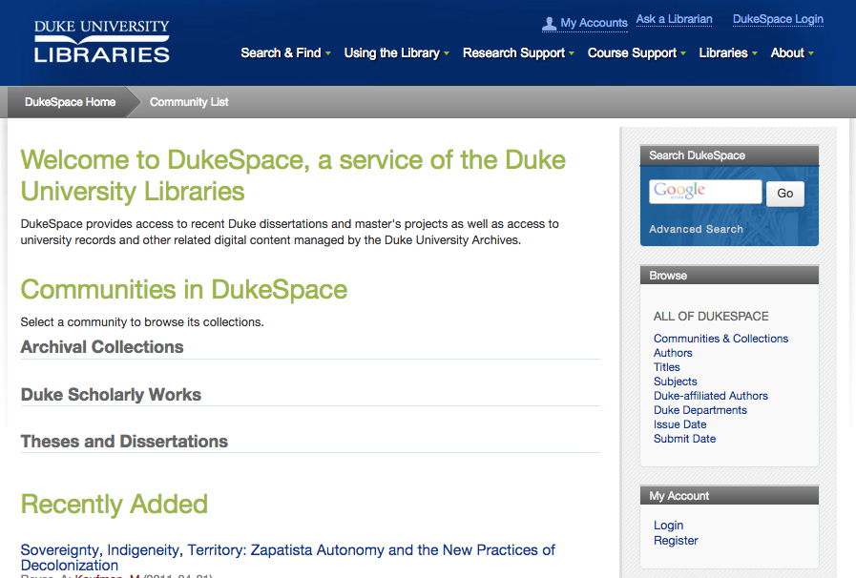
In Academia Repositories at various institutions

Slide 33
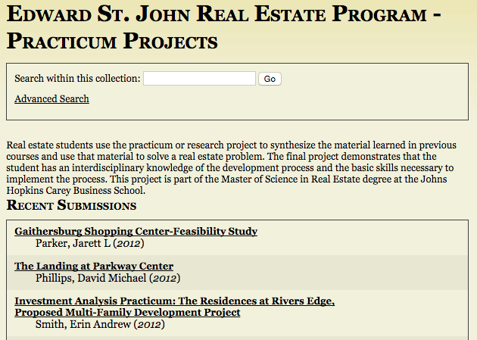
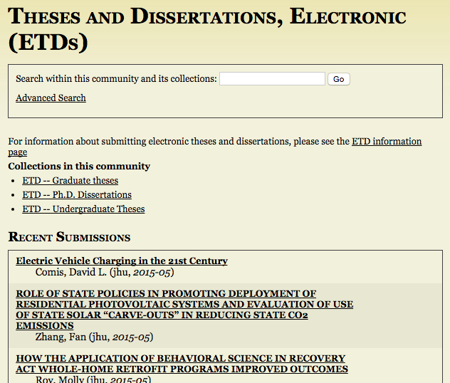
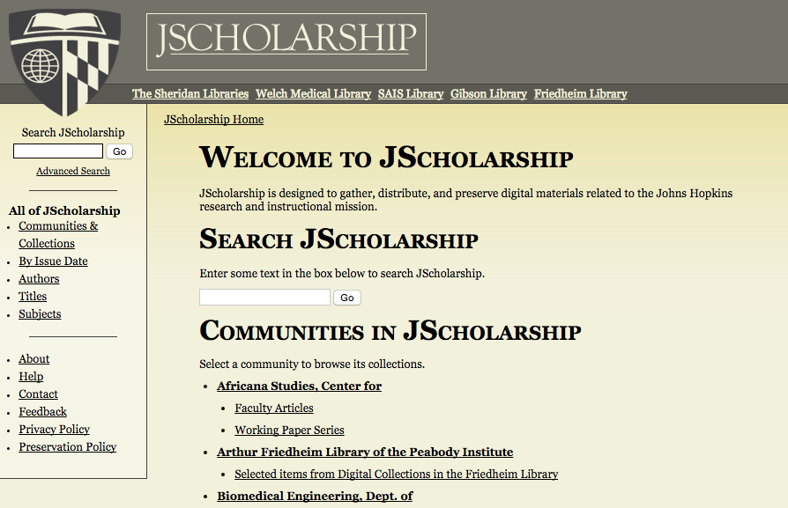
In Academia Repositories at various institutions

Slide 34
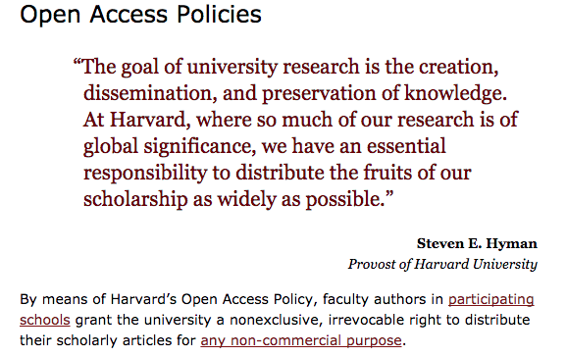
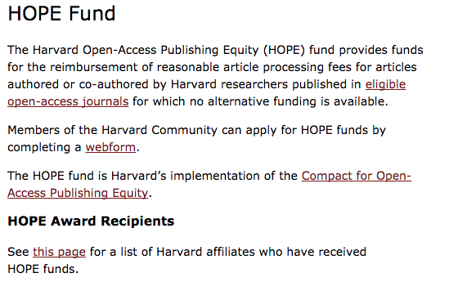
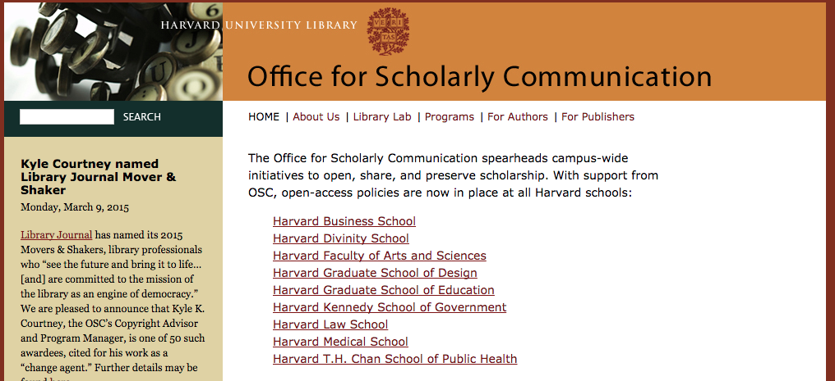
In Academia Scholarly Communication, Digital Humanities and other scholarship centers and divisions

Slide 35
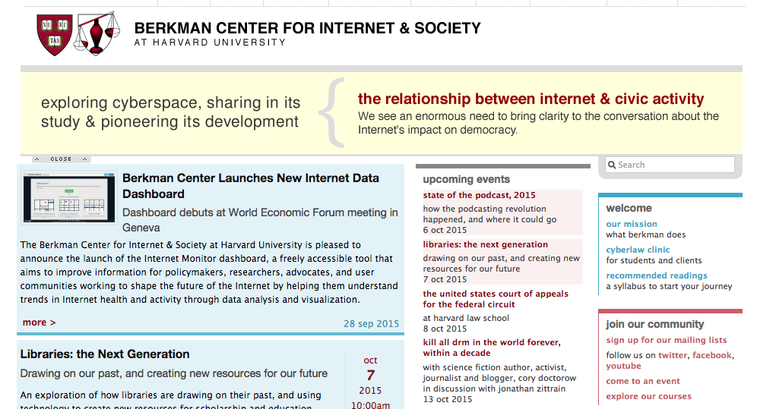
In Academia Scholarly Communication, Digital Humanities and other scholarship centers and divisions

Slide 36
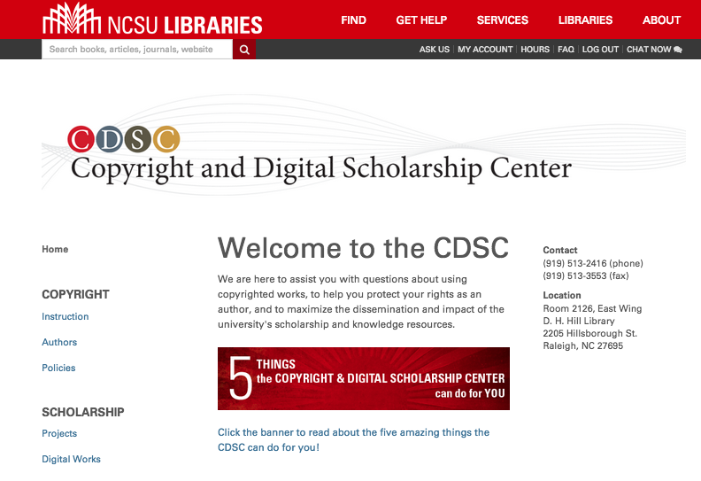
In Academia Scholarly Communication, Digital Humanities and other scholarship centers and divisions

Slide 37
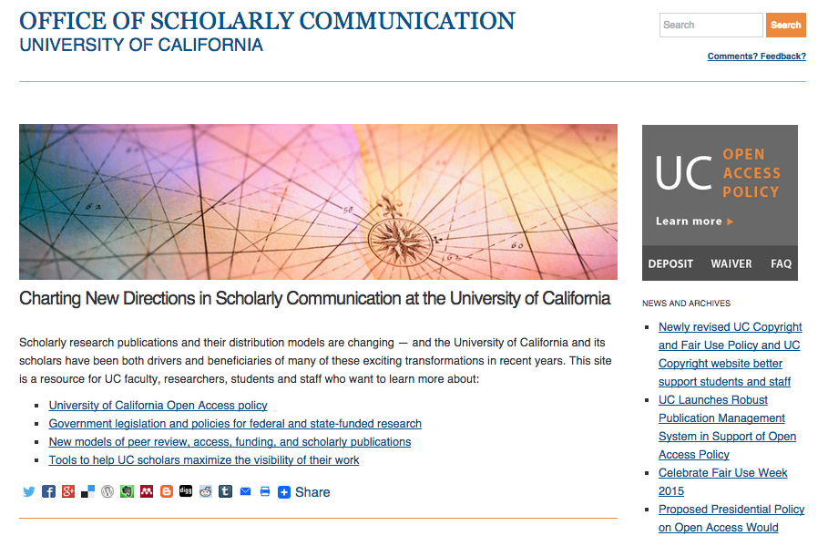
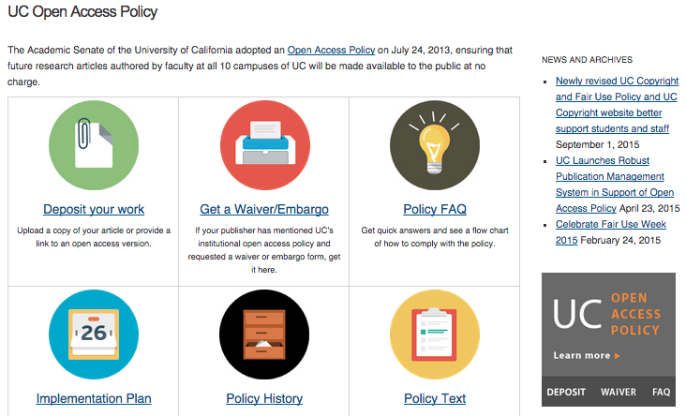
In Academia Scholarly Communication, Digital Humanities and other scholarship centers and divisions

Slide 38
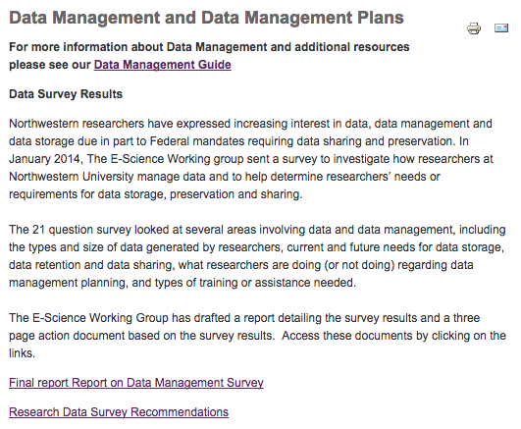
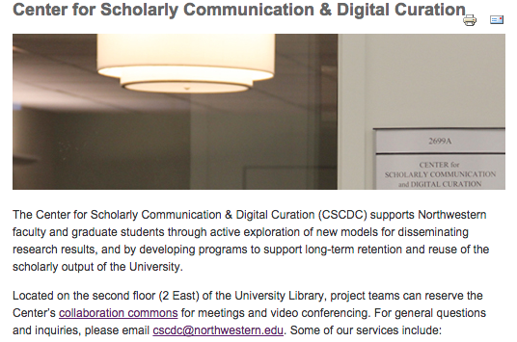
In Academia Scholarly Communication, Digital Humanities and other scholarship centers and divisions

Slide 39
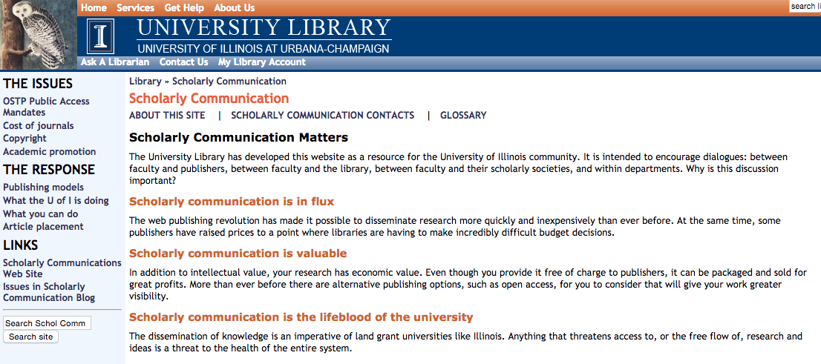
In Academia Scholarly Communication, Digital Humanities and other scholarship centers and divisions

Slide 40
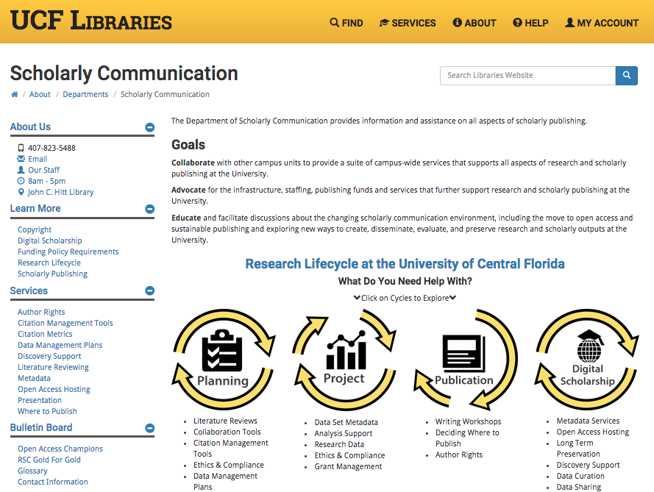
In Academia Scholarly Communication, Digital Humanities and other scholarship centers and divisions

Slide 41
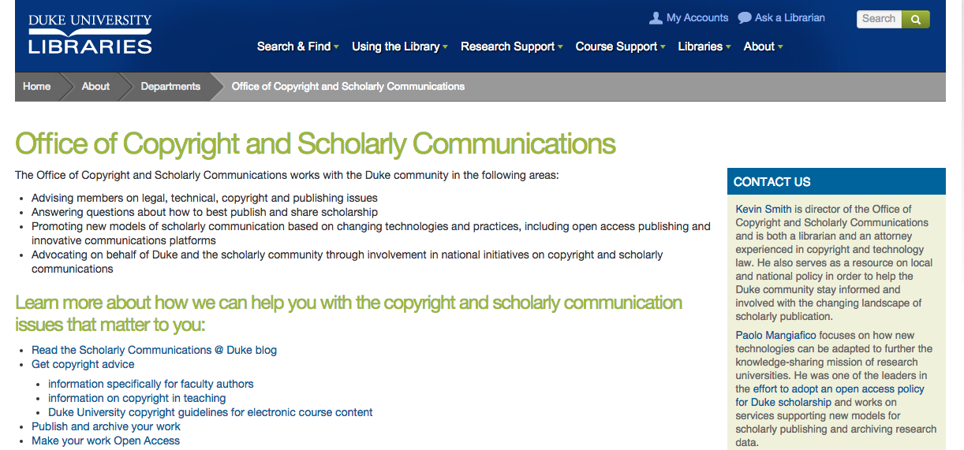
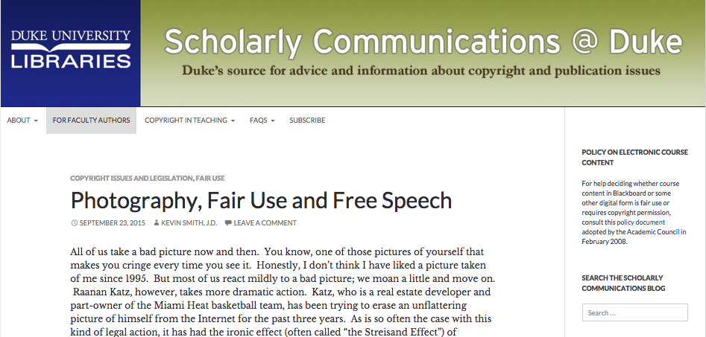
In Academia Scholarly Communication, Digital Humanities and other scholarship centers and divisions

Slide 42
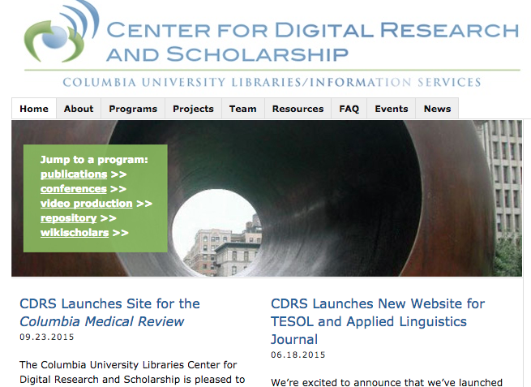
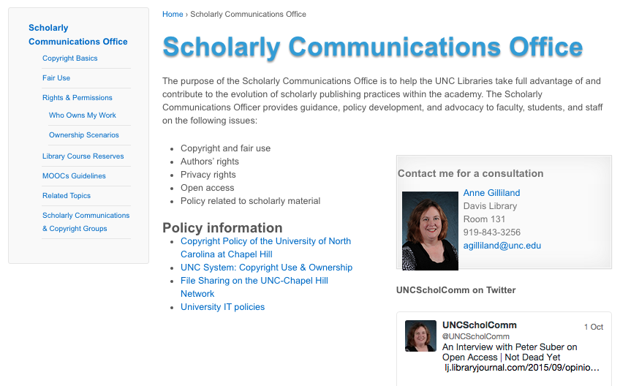
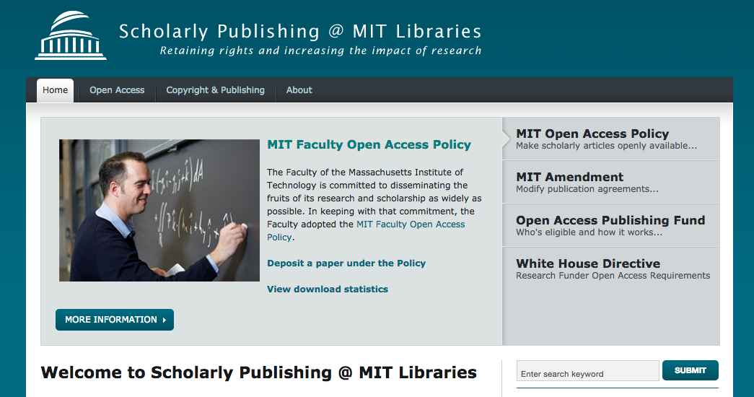
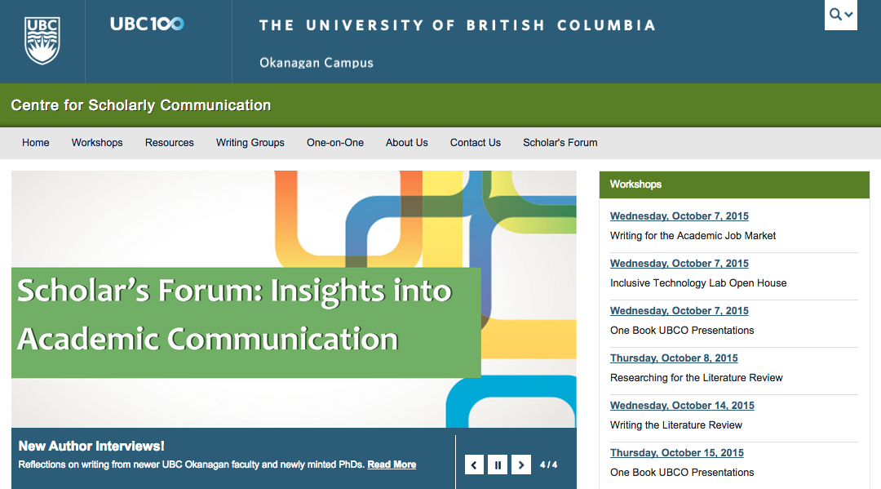
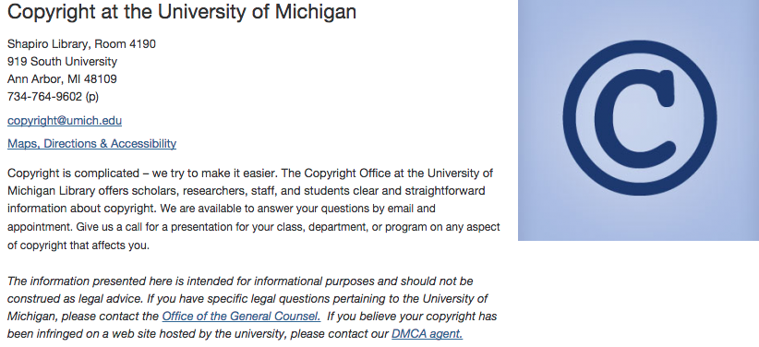
In Academia Scholarly Communication, Digital Humanities and other scholarship centers and divisions

Slide 43
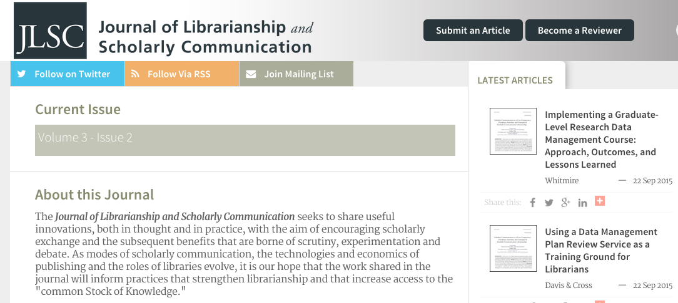
In Academia Scholarly Communication, Digital Humanities and other scholarship centers and divisions

Slide 44
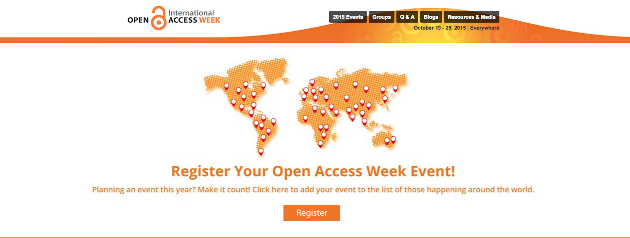
In Academia Events related to OA, IRs and Scholarly Communication

Slide 45
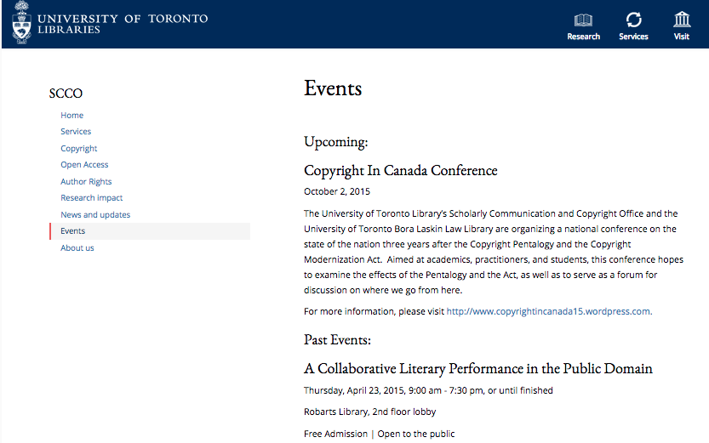
In Academia Events related to OA, IRs and Scholarly Communication

Slide 46
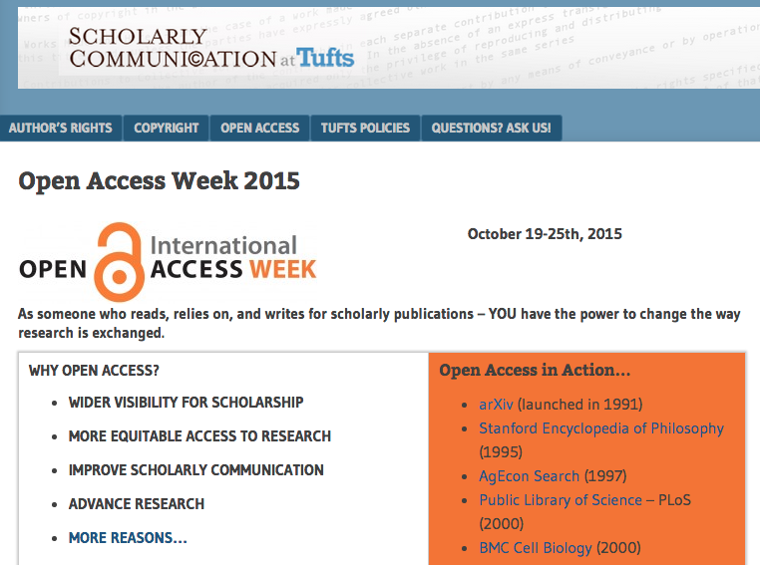
In Academia Events related to OA, IRs and Scholarly Communication

Slide 47
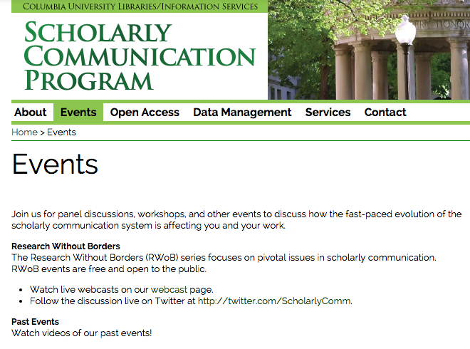
In Academia Events related to OA, IRs and Scholarly Communication

Slide 48
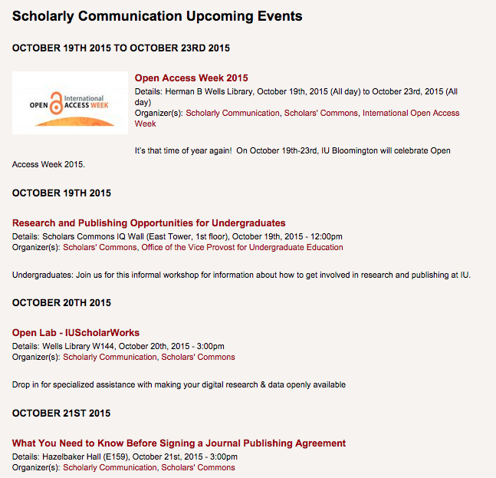
In Academia Events related to OA, IRs and Scholarly Communication

Slide 49
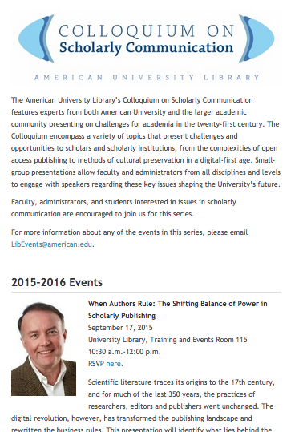
In Academia Events related to OA, IRs and Scholarly Communication

Slide 50
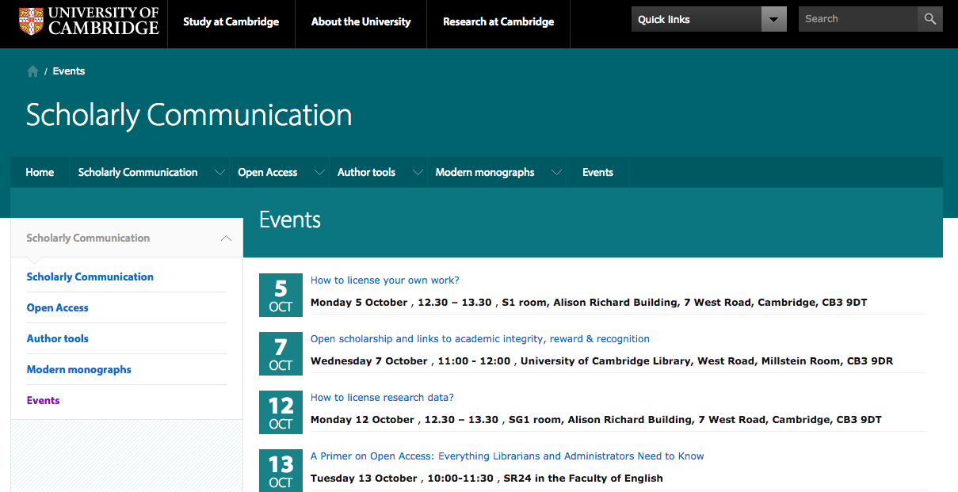
In Academia Events related to OA, IRs and Scholarly Communication

Slide 51
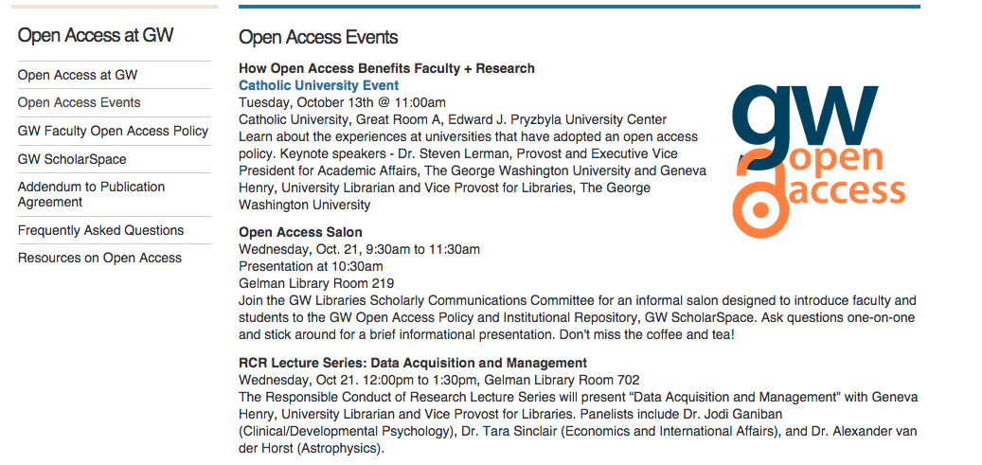
In Academia Events related to OA, IRs and Scholarly Communication

Slide 52
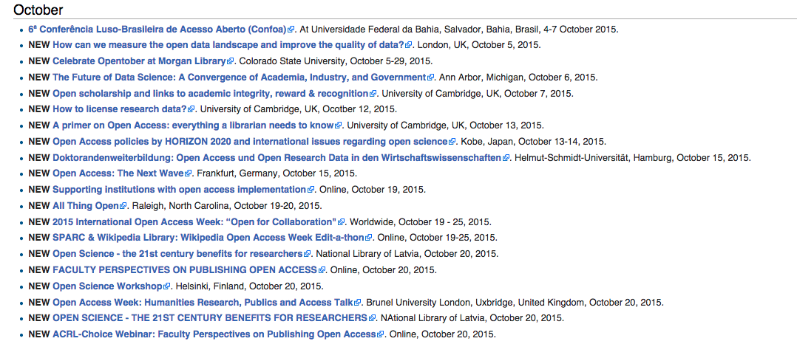
In Academia Events related to OA, IRs and Scholarly Communication

Slide 53
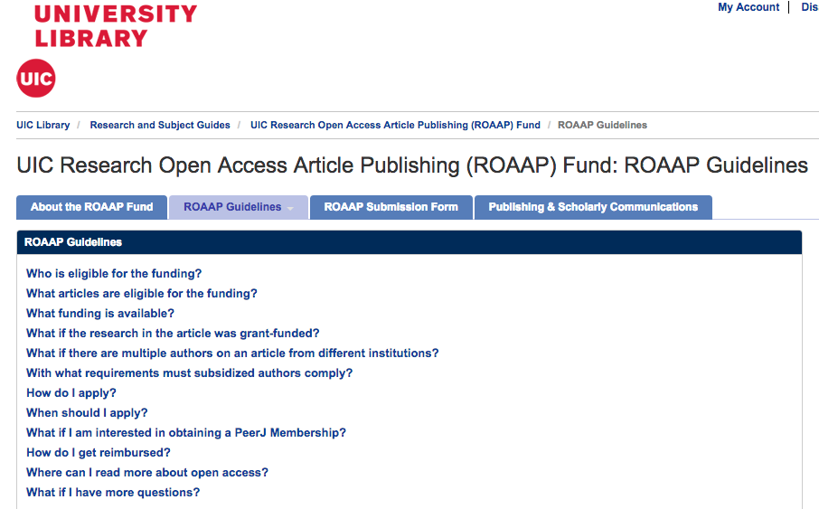
In Academia University Open Access Publishing Funds

Slide 54
In Academia University Open Access Publishing Funds

Slide 55
In Academia Integration with existing networks: Faculty Profiles & Library Networks

Slide 56
In Academia Integration with existing networks: Faculty Profiles & Library Networks

Slide 57
In Academia Integration with existing networks: Faculty Profiles & Library Networks

Slide 58
In Academia Integration with existing networks: Faculty Profiles & Library Networks

Slide 59
In Academia Integration with existing networks: Faculty Profiles & Library Networks

Slide 60
In Academia Integration with existing networks: Faculty Profiles & Library Networks

Slide 61
At Arcadia

Slide 62
ScholarWorks@Arcadia

Slide 63
ScholarWorks@Arcadia

Slide 64
ScholarWorks@Arcadia

Slide 65
ScholarWorks@Arcadia

Slide 66
ScholarWorks@Arcadia

Slide 67
ScholarWorks@Arcadia

Slide 68
ScholarWorks@Arcadia

Slide 69
Scholarly Communication @ Arcadia

Slide 70
Scholarly Communication @ Arcadia

Slide 71
Scholarly Communication @ Arcadia: Sections

Slide 72
Scholarly Communication @ Arcadia: For Faculty

Slide 73
Scholarly Communication @ Arcadia: FAQs

Slide 74
Scholarly Communication @ Arcadia: Glossary

Slide 75
Scholarly Communication @ Arcadia: Other Services
Permissions Checking
Determining which version of your article [Pre-Print; Post-Print, Publishers’ PDF] you can deposit
Looking over author’s agreements
Readership Statistics
Publishing

Slide 76
At Arcadia: Initiatives

Slide 77
At Arcadia Initiatives: Scholarly Communication Faculty Steering Committee
10 members of the faculty from various disciplines
Ambassadors on campus
Current publishers within their fields
Charge: To create a wider forum for discussion and consideration of changes to the system of scholarship; Develop strategies and actions, set timelines, and determine outcomes that will advance the scholarly communications initiatives at Arcadia…
Meets at least once a semester

Slide 78
At Arcadia Initiatives: The Honors Program

Slide 79
At Arcadia Initiatives: Journals

Slide 80
At Arcadia Initiatives: Journals

Slide 81
At Arcadia Initiatives: University Archives

Slide 82
At Arcadia Initiatives: University Relations

Slide 83
At Arcadia Initiatives: Undergraduate works

Slide 84
At Arcadia Initiatives: Undergraduate works

Slide 85
At Arcadia Initiatives: Graduate works

Slide 86
At Arcadia Initiatives: Student works

Slide 87
At Arcadia Initiatives: Student works

Slide 88
At Arcadia Initiative: Faculty

Slide 89
At Arcadia Initiative: Faculty Survey

Slide 90
At Arcadia Initiative: Faculty Workshops

Slide 92
At Arcadia Initiatives: Administrative and Academic Offices

Slide 93
At Arcadia Initiatives: Administrative and Academic Offices

Slide 94
At Arcadia Initiatives: Open Access Week 2015

Slide 95
Pitfalls & Challenges
Faculty, Student, and University interest
Lack of university mandates
University Open Access Policy
Marketing & Promoting
Lack of personnel

Slide 96
Growth & Sustainability
Educating & Empowering the campus
Promote!
Partnerships
Plan

Slide 97
Open Access and IRs: Educating and Empowering the Campus Community
Thank you!
Adam N. Hess, MFA | MLIS
Assistant Professor & Digital Resources Librarian
Arcadia University | Glenside, PA

