Slide 1
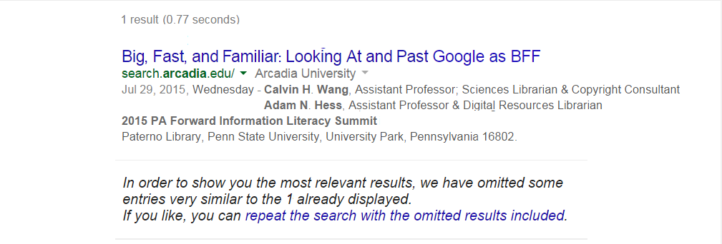

Slide 2
Best Friends Forever
Frequency of contact
Intimacy
Trust
Permanence
“Best Friends Forever.” Wikipedia. Wikimedia Foundation, Inc., n.d. Web. 15 Jun. 2015.

Slide 3
Best Friends Forever
Frequency of contact
Intimacy
Trust
Permanence

Slide 4
Google as BFF
BFF means Big, Fast, and Familiar
Big – It searches a large and growing amount of content.
Fast – It doesn’t just return results quickly, it’s also everyone’s default search engine.
Familiar – Searchers already know how to use it.
Notes:
Article databases are not nearly as big. Bigger doesn’t always mean better, but in the case of Google as BFF it does. Article DBs may be fast, but searchers still have to go to a list, pick one, log in, craft a search, cross their fingers, analyze the search results, etc. Article DBs have familiar qualities, but they are not Google.

Slide 5
Google as BFF
Google as BFF isn’t about using Google’s special search tools (Scholar or Books) or capabilities (Advanced or limiters).
Google as BFF is about looking at Google’s search results critically, the way experienced searchers like librarians already tend to look at them.
Notes:
Article databases are not fast. You have to go to a list, pick one, log in, craft a search, cross your fingers, analyze the search results, etc.

Slide 6
Google as BFF
Google as BFF is primarily about getting a lay of the land—the topical landscape—by analyzing Google search results.
Concepts:
Results Features and Search Attributes
Don’t Lose the Forest for the Tree
The Cognitive Authority Spectrum
Search Results and Frequency Distributions

Slide 7
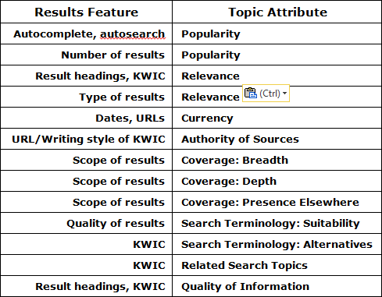
Results Features and Topic Attributes

Slide 8
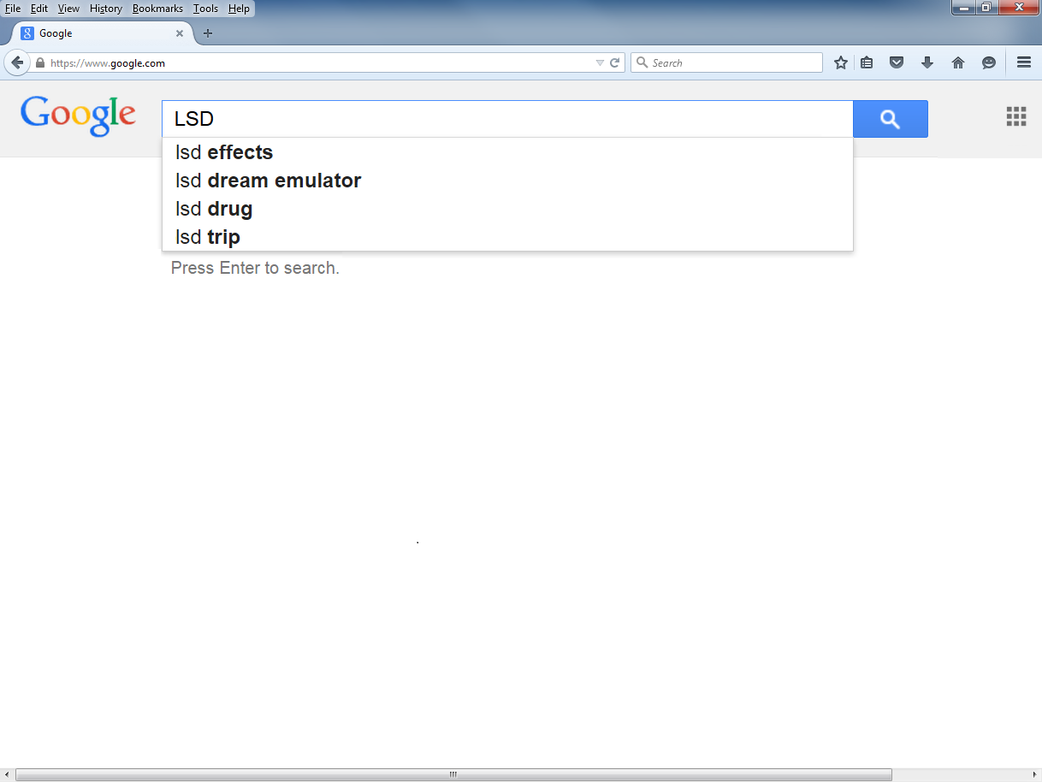
Consider a search—LSD and psychotherapy—from a Religion and Science course called Altered States of Consciousness.
If a searcher knew very little about LSD, the early autocomplete results would offer hints about its significance.
Notes:
The searcher who does know something about LSD will nod knowingly.

Slide 9
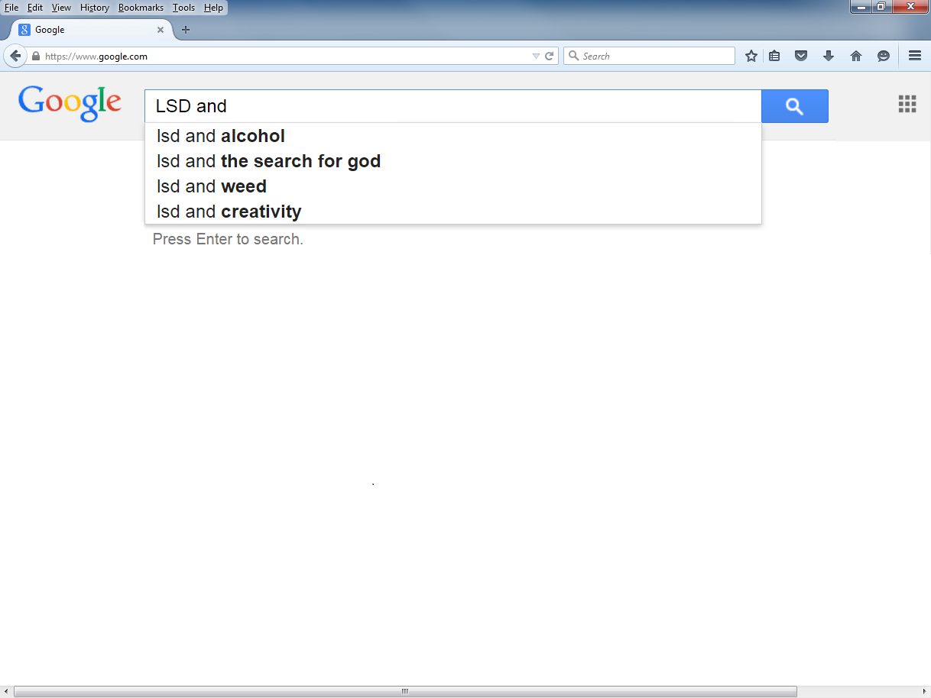
An early match of autocomplete results to the searcher’s topic would hint at its popularity or relevance.
There is none for LSD and psychotherapy which could raise suspicions.
Notes:
The absence of a match until the majority of the search has been typed hints at the popularity of the topic and perhaps the likelihood of relevant search results. The experienced searcher may be guessing how many search results to expect.

Slide 10
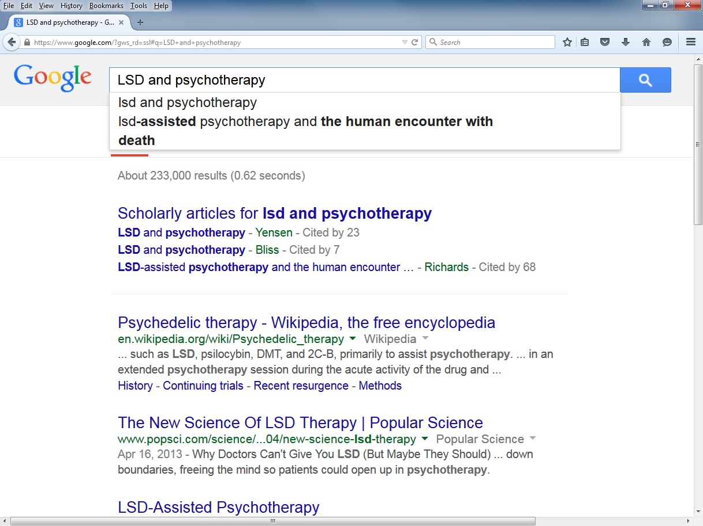
Notes:
Autosearch delivers results before hitting Enter. What can the experienced searcher determine about the topic from the information available the search results?

Slide 11
Relatively large number of results
Title suggests concept isn’t farfetched
Possible alternate search terms
Hint about complexity of affects
Hint about availability of scholarly information and distribution across time
Hint about legal or ethical issues
Notes:
KWICs provide considerable information about the topic itself and may presage what future searches might have in store. “Recent resurgence” means there may be a period during which there isn’t much research to find.

Slide 12
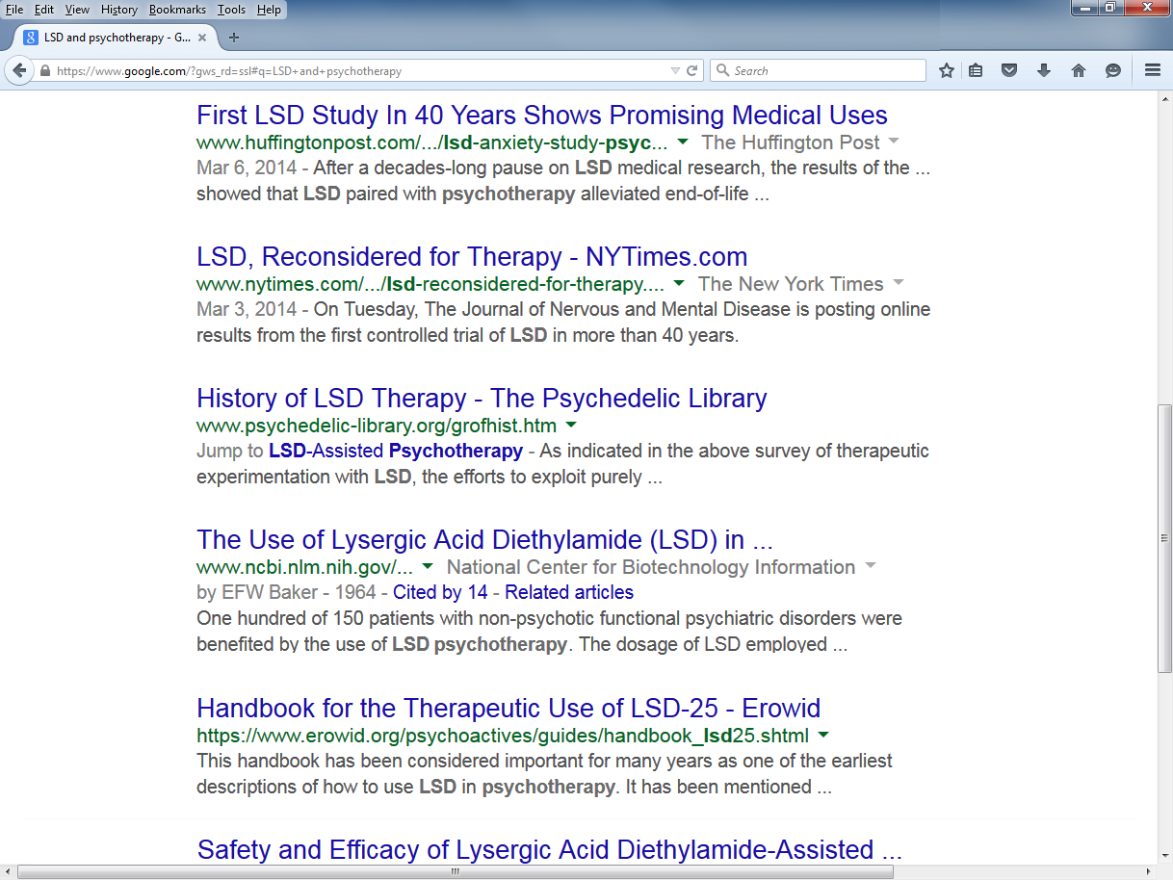
Hints about recency of new research
Evidence of changing attitudes
Possible alternate search terms
Possible book resource

Slide 13
The Cognitive Authority Spectrum
The cognitive authority spectrum begins with a look at the types of information from scholarly to popular.
Literature on the subject has tended only to look at print sources at the expense of electronic sources.
Notes:
Swanson builds on other models by combining print and online resources.

Slide 14
Types of Information
Type: SCHOLARLY
New England Journal of Medicine
The Journal of Aesthetic Education
The American Journal of Political Science
Research findings on a Web site
Guns, Germs, and Steel: The Fates of Human Societies by Jared Diamond (1997)
Swanson, Troy. “Teaching Students About Information: Information Literacy and Cognitive Authority.” Research Strategies 20 (2006): 322-333. Web. 30 Mar. 2009.
Notes:
Swanson builds on other models by combining print and online resources.

Slide 15
Types of Information
Type: PROFESSIONAL or TRADE
American Libraries
Fire Command
Nursing Times
Swanson, Troy. “Teaching Students About Information: Information Literacy and Cognitive Authority.” Research Strategies 20 (2006): 322-333. Web. 30 Mar. 2009.
Notes:
Progression in a less scholarly direction.

Slide 16
Types of Information
Type: GOVERNMENT
Congressional Record
Supreme Court Reporter
Studies conducted by government agencies
Swanson, Troy. “Teaching Students About Information: Information Literacy and Cognitive Authority.” Research Strategies 20 (2006): 322-333. Web. 30 Mar. 2009.
Notes:
Continuing in the less scholarly direction

Slide 17
Types of Information
Type: NEWS
New York Times
www.newsweek.com
TIME
Washington Post
Swanson, Troy. “Teaching Students About Information: Information Literacy and Cognitive Authority.” Research Strategies 20 (2006): 322-333. Web. 30 Mar. 2009.
Notes:
Information sources are increasingly becoming the type less experienced searchers regularly use.

Slide 18
Types of Information
Type: ENTERTAINMENT or POPULAR
Rolling Stone
Glamour
Entertainment Weekly
The Sporting News
Swanson, Troy. “Teaching Students About Information: Information Literacy and Cognitive Authority.” Research Strategies 20 (2006): 322-333. Web. 30 Mar. 2009.

Slide 19
Types of Information
Type: SPECIAL INTEREST or OPINION
We're Right, They're Wrong by James Carville (1996)
National Rifle Association website; http://www.nra.org
Swanson, Troy. “Teaching Students About Information: Information Literacy and Cognitive Authority.” Research Strategies 20 (2006): 322-333. Web. 30 Mar. 2009.

Slide 20
Types of Information
Type: UNSUBSTANTIATED or UNCREDITED
Personal websites
Handwritten note found on the library table
Swanson, Troy. “Teaching Students About Information: Information Literacy and Cognitive Authority.” Research Strategies 20 (2006): 322-333. Web. 30 Mar. 2009.
Notes:
Less experienced searchers don’t equate personal websites to handwritten notes, but there’s effectively no difference.

Slide 21
Scholarly
Professional or Trade
Government
News
Entertainment or Popular
Special Interest or Opinion
Unsubstantiated or Uncredited
Notes:
The entire list of cognitive authority source types. Start visualizing a cognitive authority spectrum by simplifying the list.

Slide 22
Scholarly
Professional
Government
News
Popular
Opinion
Unsubstantiated
Scholarly
Professional
Government
News
Popular
Opinion
Unsubstantiated
Notes:
The new simplified list tipped over.

Slide 23
Unsubstantiated
Opinion
Popular
News
Government
Professional
Scholarly
Professional
Government
News
Popular
Opinion
Unsubstantiated
Notes:
Rotate the list around Scholarly.

Slide 24
Unsubstantiated
Opinion
Popular
News
Government
Professional
Scholarly
Professional
Government
News
Popular
Opinion
Unsubstantiated
Notes:
The x-axis for a chart representing breadth and depth of knowledge

Slide 25
Unsubstantiated
Opinion
Popular
News
Government
Professional
Scholarly
Professional
Government
News
Popular
Opinion
Unsubstantiated
Notes:
The depth and breadth of knowledge of a typical search.

Slide 26
Unsubstantiated
Opinion
Popular
News
Government
Professional
Scholarly
Professional
Government
News
Popular
Opinion
Unsubstantiated
Notes:
The goal of information literacy instruction is to increase the depth and narrow the breadth from shallow and wide to deeper and narrower.

Slide 27
Unsubstantiated
Opinion
Popular
News
Government
Professional
Scholarly
Professional
Government
News
Popular
Opinion
Unsubstantiated
Notes:
The greatest depth and narrowest of breadth of knowledge exists in scholarly literature research.

Slide 28
Google as BFF
Google can collect information from across the cognitive authority spectrum in one search.
Deep and narrow
Shallow and wide
Inexperienced searchers find popular sources, by design, easier to read and understand.
Using them necessarily builds background knowledge.

Slide 29
Google as BFF
Well-designed academic assignments require searchers to use scholarly sources which deepen and narrow the information range in the cognitive authority spectrum.
A critical look at Google result features provides a lay of the land about a topic which sets the groundwork for more sophisticated searching, possibly even using article databases.
Notes:
The sad reality is that few assignments are designed in such a way that requires searchers to go beyond Google. This can depend upon the topic, however.

Slide 30
Deep and narrow knowledge
General and terse can mean literature reviews
Shallow and wide knowledge
Less deep and less narrow knowledge
Notes:
Literature review are scholarly sources of information that are a good next step for learning about a topic after consulting information sources that have a shallower and wider cognitive authority.

Slide 31
General, terse title suggests reviews
Possible alternate search terms
Hint about complexity of affects
Hint about availability of scholarly information and distribution across time
Hint about legality or ethicality
Notes:
KWICs provide considerable information about the topic itself and may presage what future searches might have in store.

Slide 32
Don’t Lose the Forest for a Single Tree
Notes:
When beginning the search process, get a lay of the land and the reject the tendency to click on individual articles. Inexperienced searchers get waylaid easily. A Google search provides a tremendous amount of information about a topic without having to click on individual search results. None of the previous analyses required consultation of the actual search result. Searchers who cannot resist the urge to click on a promising link can right-click and open in a new tab. Once they’ve started analyzing the Google search results, they may end up not consulting the individual links anyway.

Slide 33
Don’t Lose the Forest for a Single Tree
None of the previous analyses required consultation of the actual search result.
Experienced searchers can reject the tendency to click on individual search results.
Inexperienced searchers get waylaid easily and fruitlessly.
Searchers who cannot resist the urge to open a promising link can right-click and open in a new tab.

Slide 34
Frequency Distributions
Children learn in school early how to do them with M&M candy.
Experienced searchers do them automatically, if informally, to determine relevance.
Inclusion may not be because an item is identical but rather because it is similar.
Notes:
Inclusion by similarity is relevant in the next search.

Slide 35
2 hints about recency of research, certainly the same effort in both cases.
2 hints about availability of scholarly information across time

Slide 36
A search on shamanic journeying from the same course.
Some alternate word forms appear with autocomplete and information, again, that reflects the topic’s significance.

Slide 37
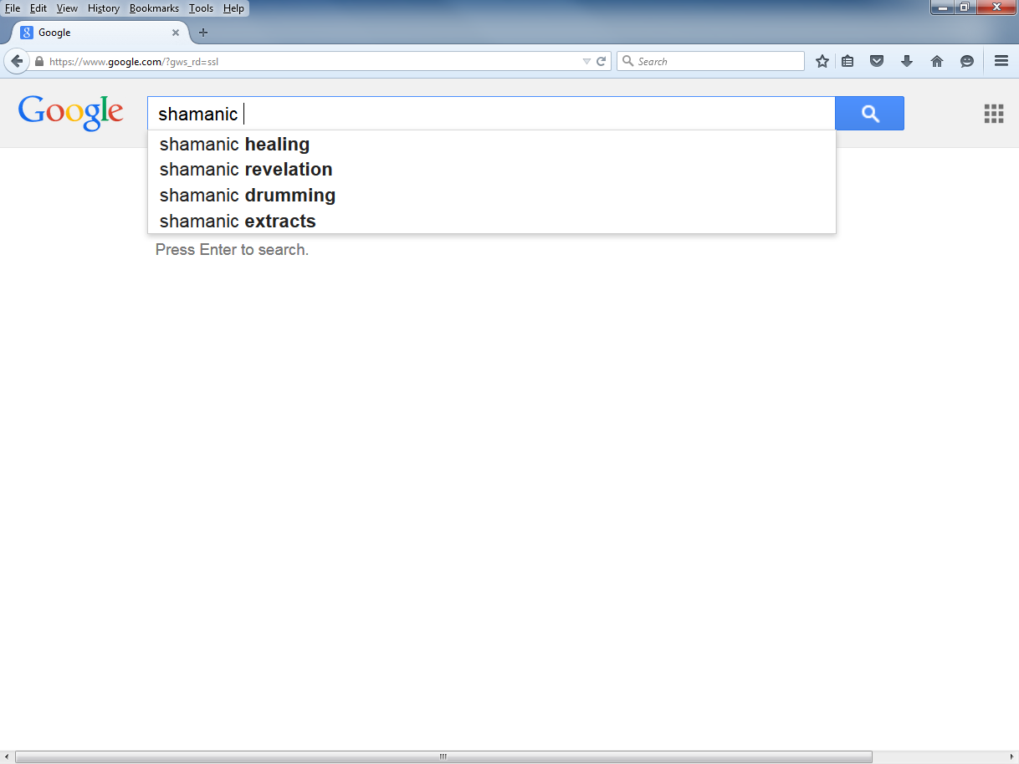
Related concepts appear with more typing that may be valuable to consider searching.
Autosearch disappears which may reflect popularity of search.

Slide 38
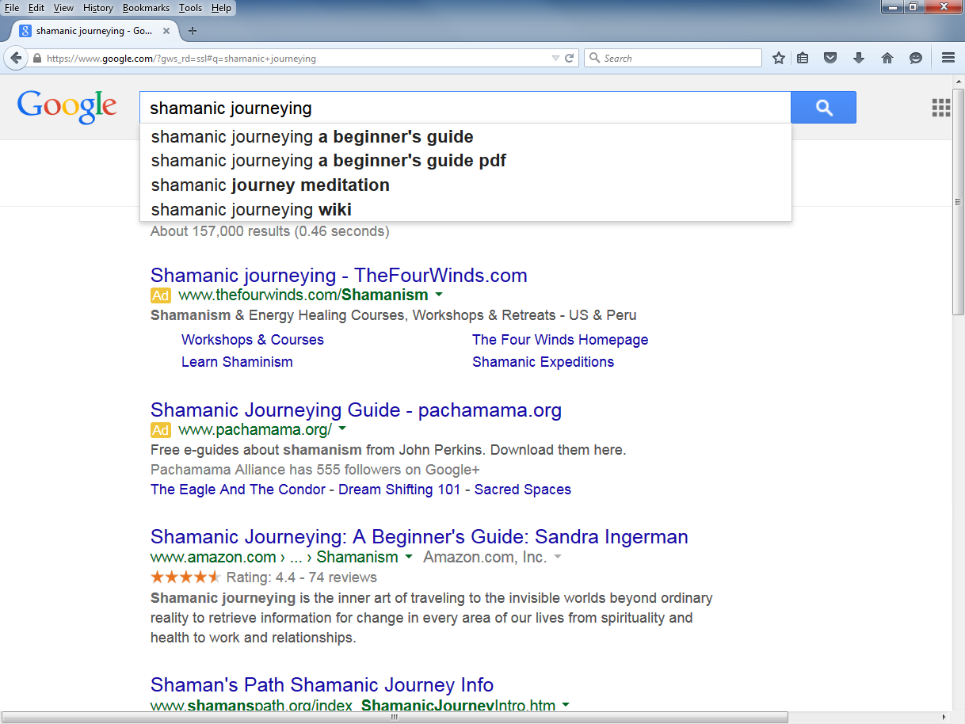
Commercial advertisements
Possible book resource
Metaphysical rhetoric
Notes:
No scholarly articles. Librarians avoid making value judgments about searches: The results are qualitatively different. Conventionally scholarly research may be harder to find.

Slide 39
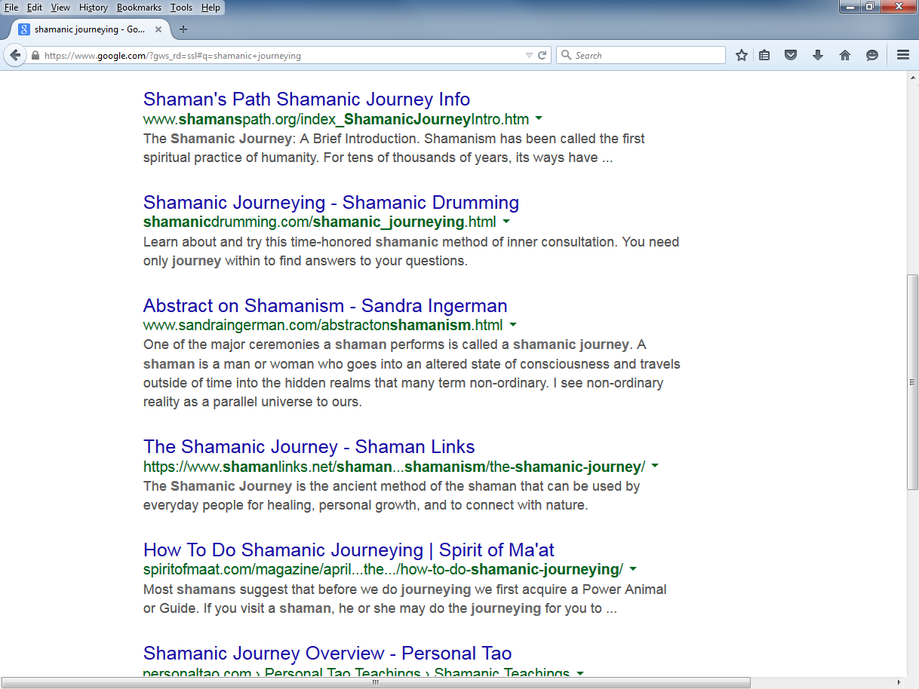
Background information
2nd mention of concept after autocomplete
Equanimous rhetoric
Notes:
Different searches can produce dramatically different results whose significance the searcher must evaluate in relative terms.

Slide 40
Google as BFF
Google as BFF is primarily about getting a lay of the land—the topical landscape—by analyzing Google search results.
Concepts:
Results Features and Search Attributes
Don’t Lose the Forest for the Tree
The Cognitive Authority Spectrum
Search Results and Frequency Distributions
Notes:
Recapitulation

Slide 41
Looking past Google as BFF
Step 1: Get a lay of the land (Google as BFF).
Step 2: Develop a search strategy.
Step 3: Learn the subject.
Step 4: Deepen and narrow.
Topically
In the cognitive authority spectrum
Step 5: Repeat.
Step 6: Formulate a thesis.
Notes:
Google as BFF is a first step.

Slide 42
Looking past Google as BFF
Google as BFF can provide a lay of the land that makes the use of article databases productive.
For the librarian, or an experienced searcher, article database selection and usage becomes simplified.
Keyword development, sense of the cognitive authority available, feel for all the attributes of a topic can come using a tool that is big, fast, and familiar.
Notes:
Google as BFF is a first step.

Slide 43
Looking past Google as BFF
Get a Lay of the Land: Google as BFF
Get a Lay of the Land: Google as BFF
Get a Lay of the Land: Google as BFF
Get a Lay of the Land: Google as BFF
Adapted: Raszewski, Monica, Appy Laspagis, Mary-Louise Edwards, Katie Wood. “Research Cycle.” The Library. Slideshare, 2014. Web. 17 Jul. 2015.
Notes:
This slide has just been bombed.

Slide 44
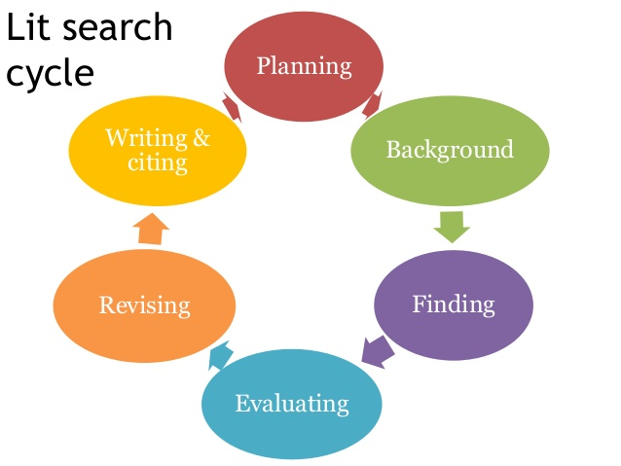
Looking past Google as BFF
Get a Lay of the Land: Google as BFF
Get a Lay of the Land: Google as BFF
Get a Lay of the Land: Google as BFF
Adapted: Yates, Elizabeth. “Research Cycle.” Finding Information Resources for NUSC 4P50 Applied Nursing Research. Slideshare, 2014. Web. 17 Jul. 2015.
Notes:
So has this one.

Slide 45
Google as BFF
Additional sample searching
Questions
Notes:
Recapitulation

